Slide 1


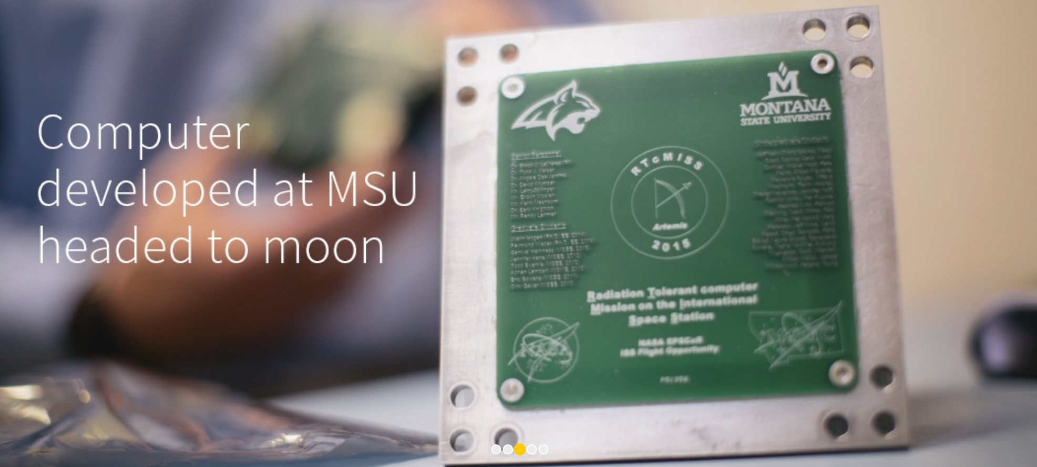
Building Computers for the Moon and Beyond…
Dr. Brock J. LaMeres
Professor, Electrical & Computer Engineering
Director, MT Engineering Education Research Center
Boeing Professor of Engineering Education

Slide 2


Today’s Talk
What is possible
in Montana?

Slide 3
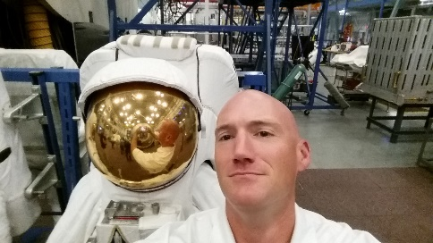




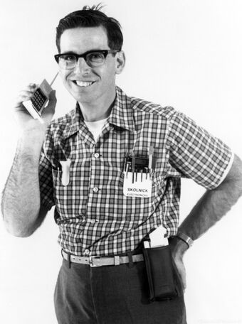

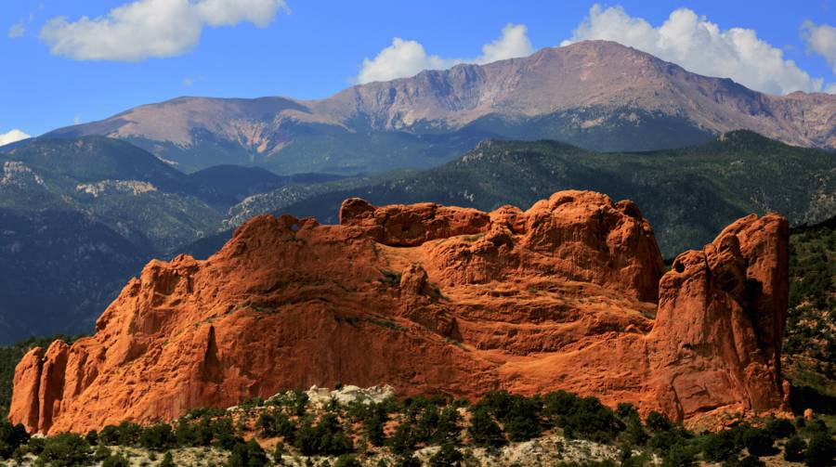


A little bit about me…
Class of 98
25 years later…

Slide 4
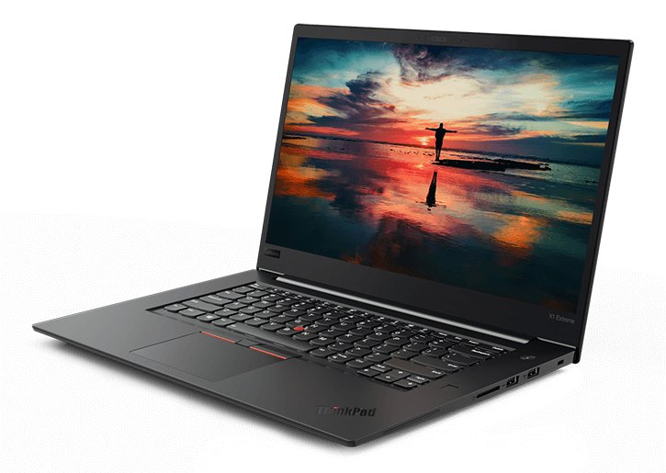
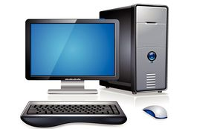
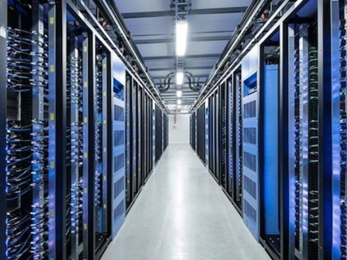
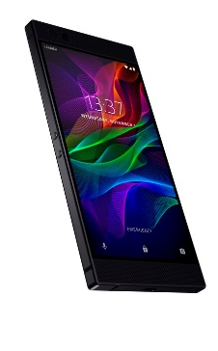
Brock’s Computer Research
Can you image life without a computer?
  What images do you conjure when someone says “computer”?

Slide 5
Brock’s Computer Research
Can you image life without a computer?
  What images do you conjure when someone says “computer”?
  There were ~400M personal computers sold in 2018.
  There were ~1.5B smart phones sold in 2018 (1.3B Android, 0.2B iOS)

Slide 6
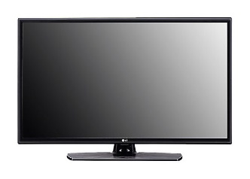
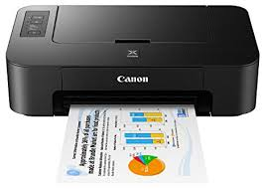
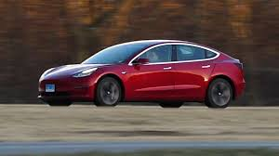
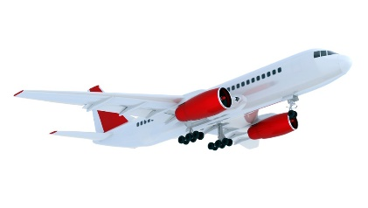
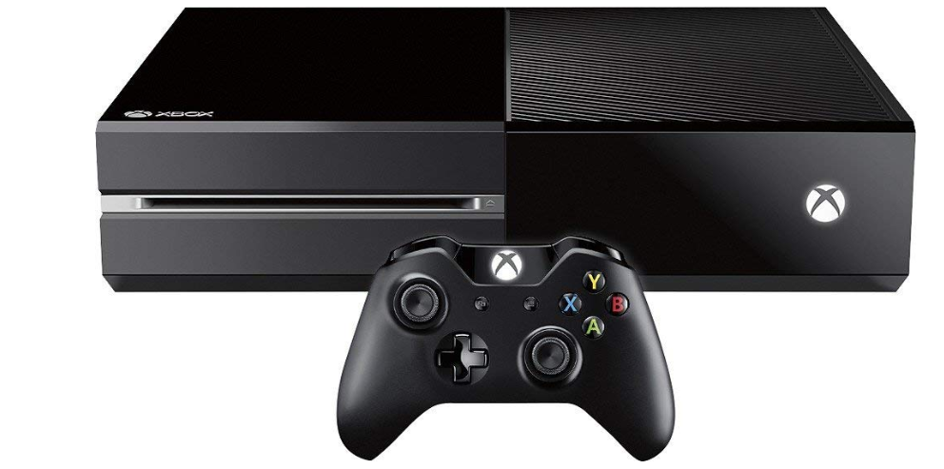

Brock’s Computer Research
Can you image life without a computer?
  What images do you conjure when someone says “computer”?
  There were ~400M personal computers sold in 2018.
  There were ~1.5B smart phones sold in 2018 (1.3B Android, 0.2B iOS)
But what about these things?

Slide 7
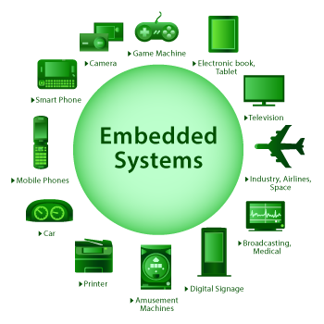
Brock’s Computer Research
Can you image life without a computer?
  What images do you conjure when someone says “computer”?
  There were ~400M personal computers sold in 2018.
  There were ~1.5B smart phones sold in 2018 (1.3B Android, 0.2B iOS)
But what about these things?
  There were 32B embedded computers sold in 2021.

Slide 8
Brock’s Computer Research
Our Existing Computers Work Well. What’s the Problem?

Slide 9
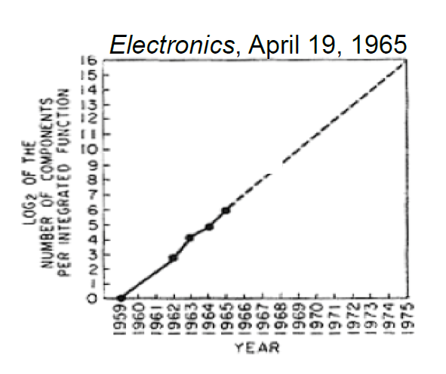
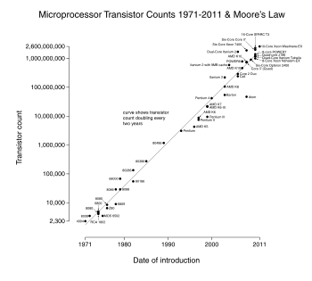
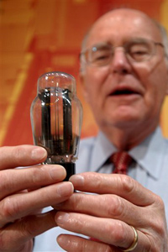
Brock’s Computer Research
Our Existing Computers Work Well. What’s the Problem?
  Our existing computers have benefited from 40+ years of Moore’s Law.
  In the 1960’s, Gordon Moore predicted that the number of transistors on a chip would double every ~24 months.
1959 - 1965
1971* - 2011
Gordon Moore, co-founder of Intel, holding a vacuum tube.
Note: First microprocessor introduced in 1971,
the Intel 4004 with 2300 transistors.

Slide 10
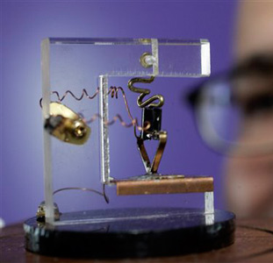
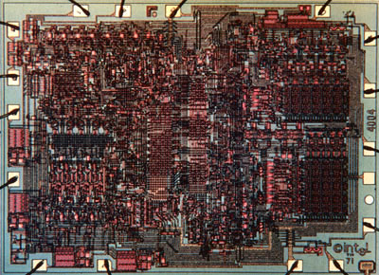
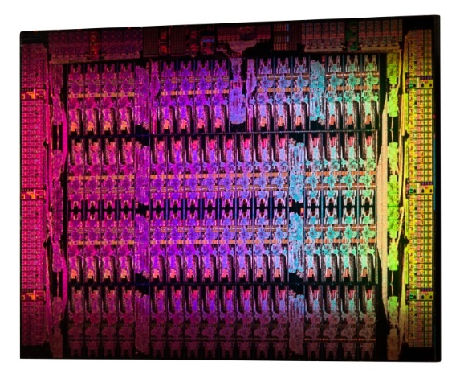
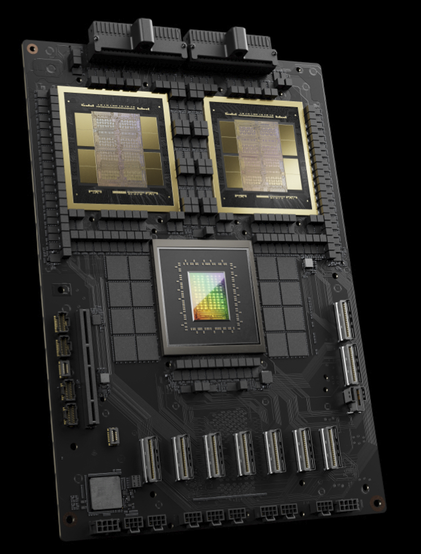
Brock’s Computer Research
Why is Moore’s Law so Cool?
  It gives us smaller, faster, and less power.
1947 (1 transistor)
1971 (2300 transistors)
2012 (5B transistors)
2024 (208B transistors)
Replica of the First Transistor
(Source: AP Photo Paul Sakuma)
Intel 4004, 10um
(Source: newsroom.intel.com)
Intel Xeon Phi, 22nm
(Source: newsroom.intel.com)
NVIDIA Blackwell GPU
(Source: invidia.com)

Slide 11
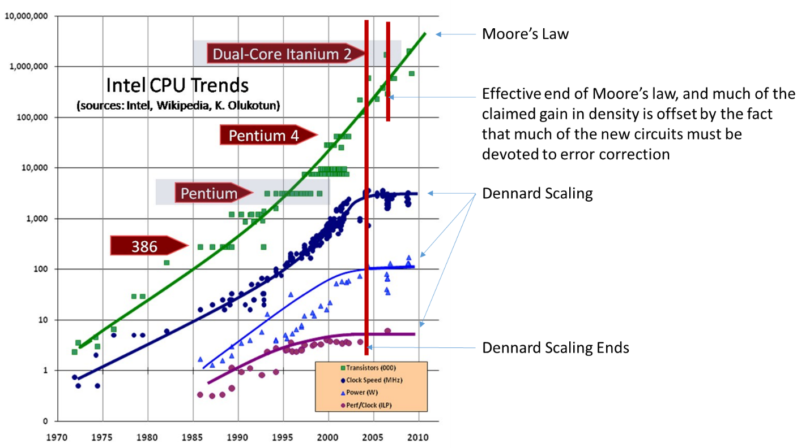
Brock’s Computer Research
When will Moore’s Law End?
  Most exponentials do come to an end.
Clock Speed
Power
Performance per Clock Cycle

Slide 12

Brock’s Computer Research
When will Moore’s Law End?
  Most exponentials do come to an end.
So it’s over?
Clock Speed
Power
Performance per Clock Cycle

Slide 13
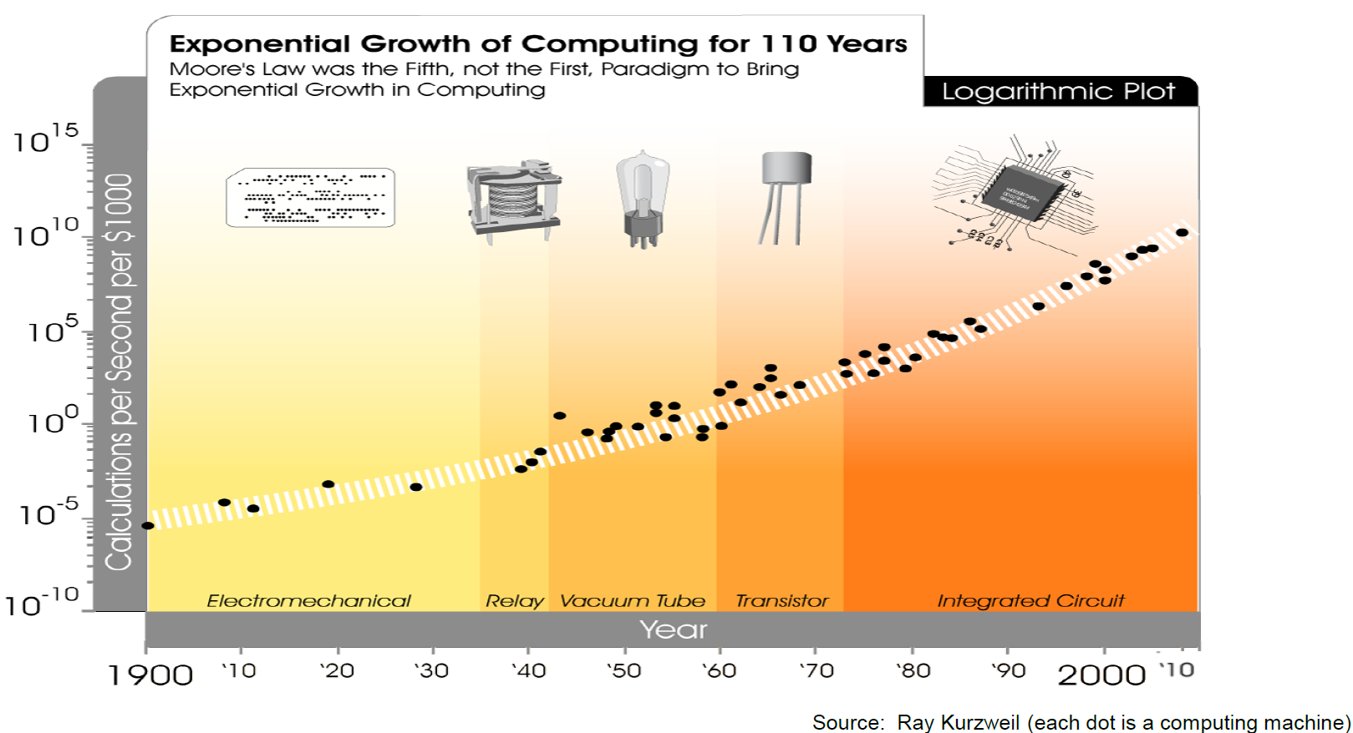

Brock’s Computer Research
Moore’s Law Wasn’t the First Exponential, and Won’t be the Last…
You Are Here

Slide 14
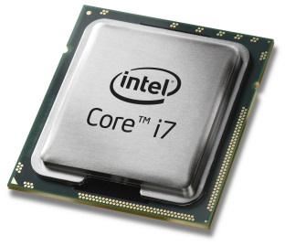
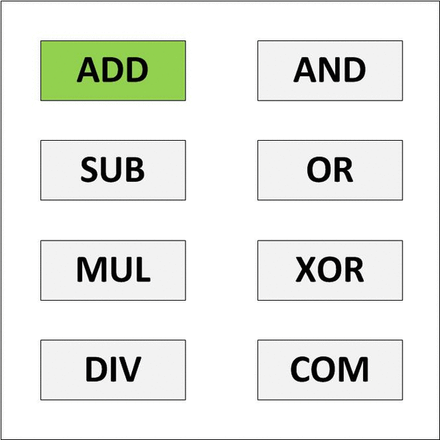
Brock’s Computer Research
Today’s Computers are Based on a General-Purpose Processor
  The GP CPU is designed to do many things.
  This is the “Jack of All Trades, Master of None” approach.
General Purpose CPU Model

Slide 15
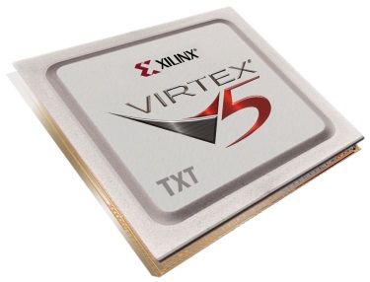

Brock’s Computer Research
Today’s Computers are Based on a General-Purpose Processor
  The GP CPU is designed to do many things.
  This is the “Jack of All Trades, Master of None” approach.
General Purpose CPU Model
Reconfigurable Computing Model
This can be faster because the hardware is smaller and consumes less power.

Slide 16
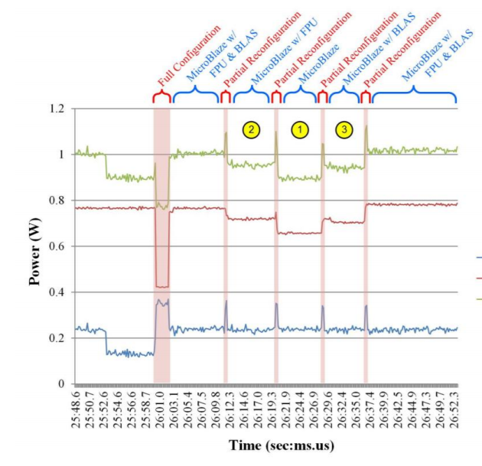
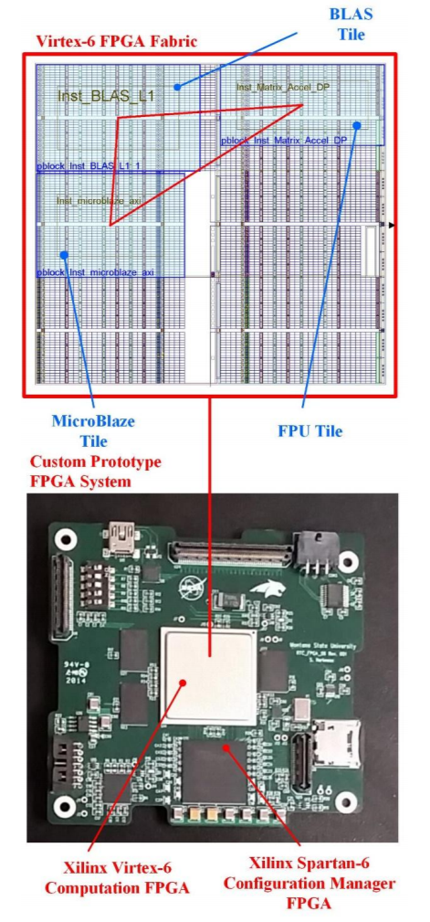
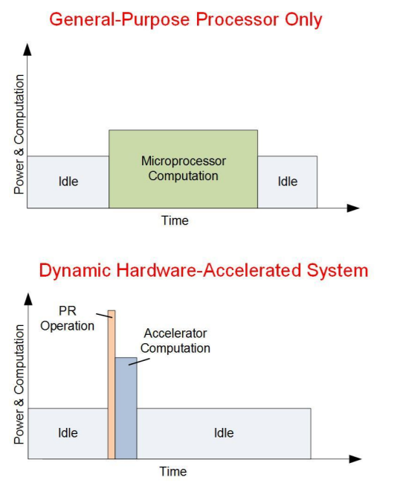
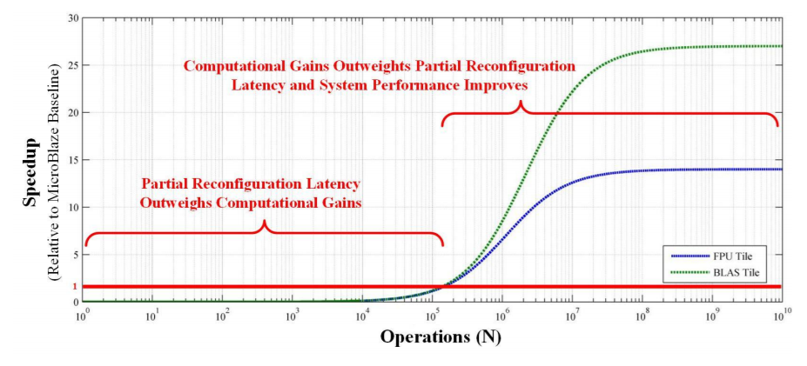
Brock’s Computer Research
So off to work…
  We started investigating computational speedup by swapping in HW in real-time.

Slide 17

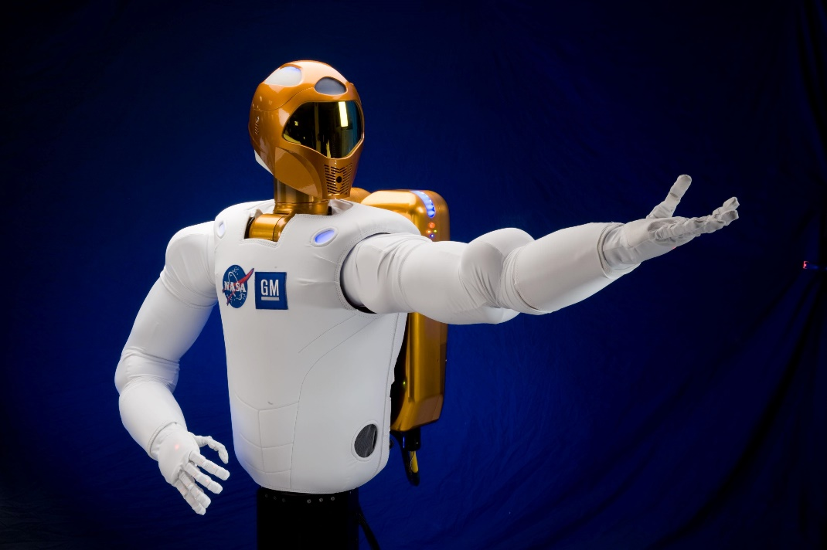
Brock’s Computer Research
But then…
Hey, that’s pretty cool. That might help our space computers.

Slide 18
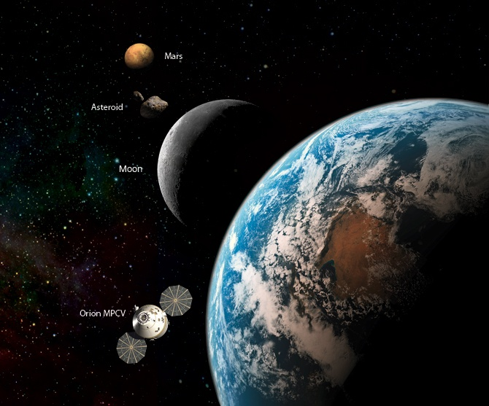
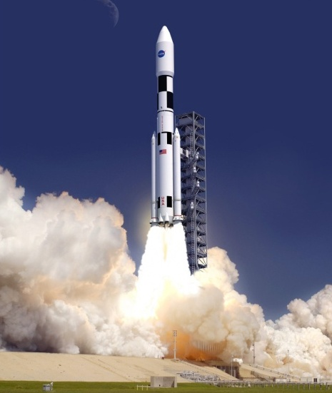
NASA’s Computing Needs
The Promise of RC
  We discovered that space computers could be greatly enhanced by RC.
  They need to be light. RC reuses hardware, that saves mass.

Slide 19

NASA’s Computing Needs
The Promise of RC
  We discovered that space computers could be greatly enhanced by RC.
  They need to be light. RC reuses hardware, that saves mass.

Slide 20
NASA’s Computing Needs
The Promise of RC
  We discovered that space computers could be greatly enhanced by RC.
  They need to be light. RC reuses hardware, that saves mass.
  They need to be low power. RC eliminates unnecessary circuitry.

Slide 21
NASA’s Computing Needs
The Promise of RC
  We discovered that space computers could be greatly enhanced by RC.
  They need to be light. RC reuses hardware, that saves mass.
  They need to be low power. RC eliminates unnecessary circuitry.

Slide 22
NASA’s Computing Needs
The Promise of RC
  We discovered that space computers could be greatly enhanced by RC.
  They need to be light. RC reuses hardware, that saves mass.
  They need to be low power. RC eliminates unnecessary circuitry.
  They need to have high computation. RC can do that.

Slide 23
NASA’s Computing Needs
The Promise of RC
  We discovered that space computers could be greatly enhanced by RC.
  They need to be light. RC reuses hardware, that saves mass.
  They need to be low power. RC eliminates unnecessary circuitry.
  They need to have high computation. RC can do that.

Slide 24
NASA’s Computing Needs
The Promise of RC
  We discovered that space computers could be greatly enhanced by RC.
  They need to be light. RC reuses hardware, that saves mass.
  They need to be low power. RC eliminates unnecessary circuitry.
  They need to have high computation. RC can do that.
  They need to operate in the presence of harsh radiation.

Slide 25
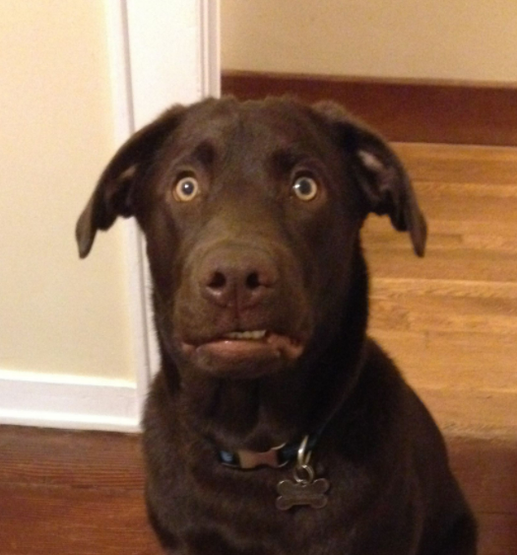
NASA’s Computing Needs
The Promise of RC
  We discovered that space computers could be greatly enhanced by RC.
  They need to be light. RC reuses hardware, that saves mass.
  They need to be low power. RC eliminates unnecessary circuitry.
  They need to have high computation. RC can do that.
  They need to operate in the presence of harsh radiation.
Can you repeat the question???

Slide 26
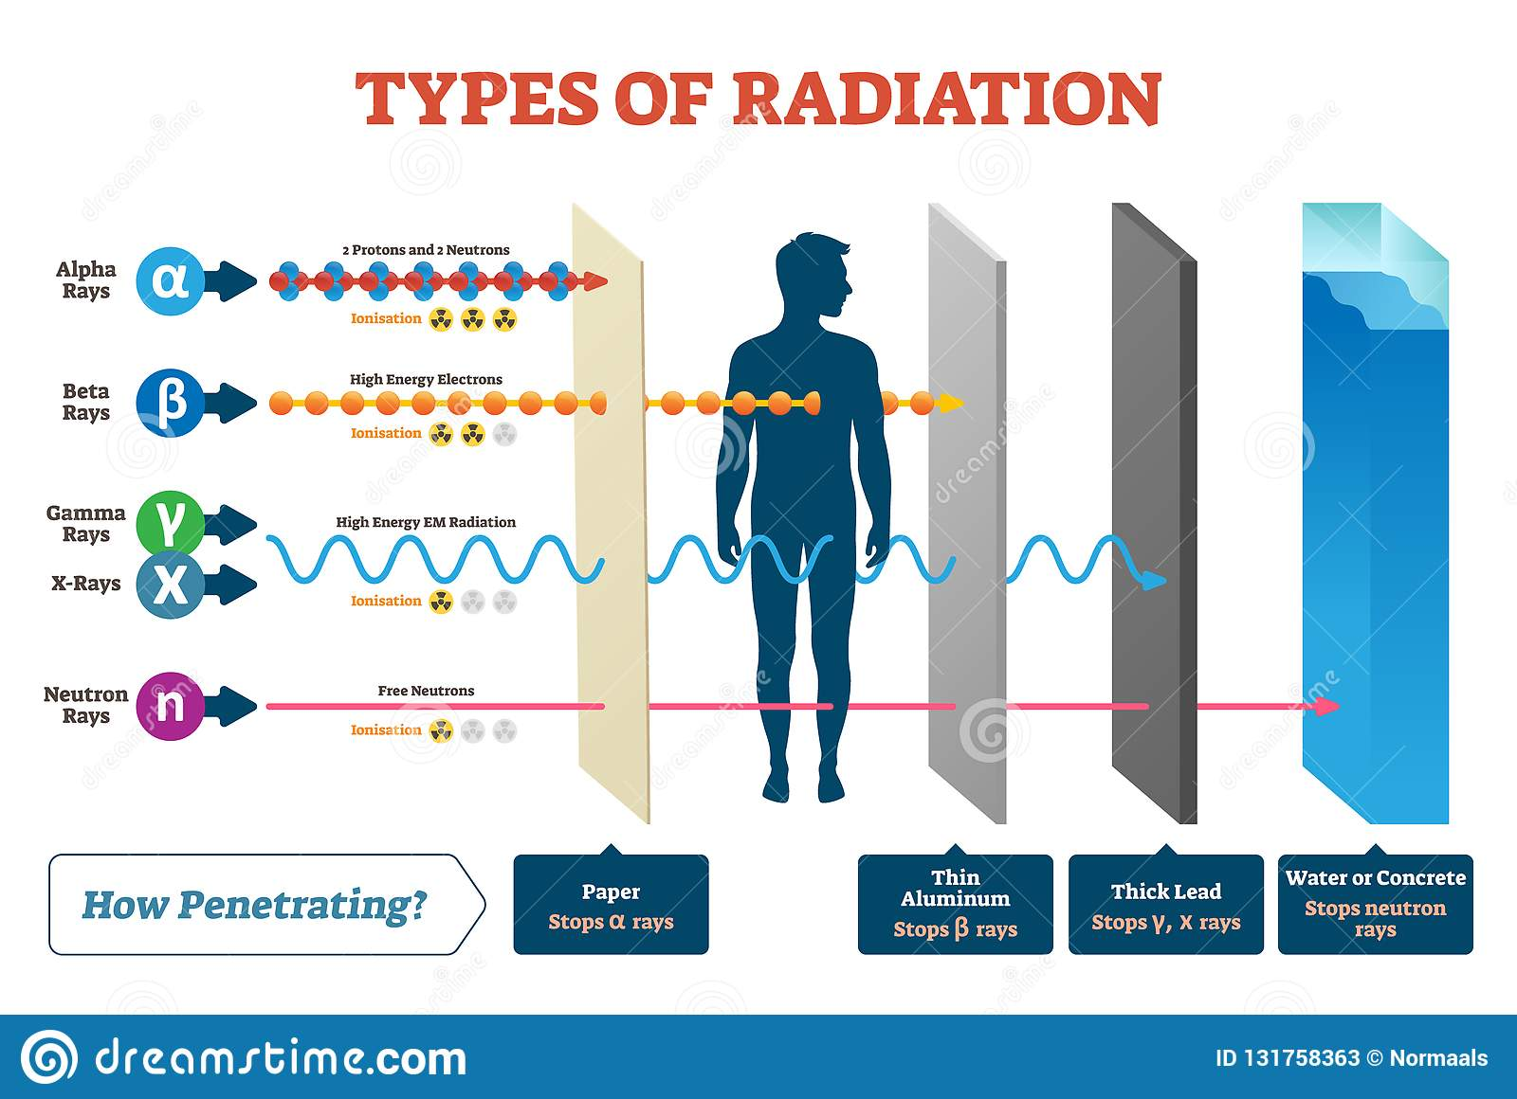
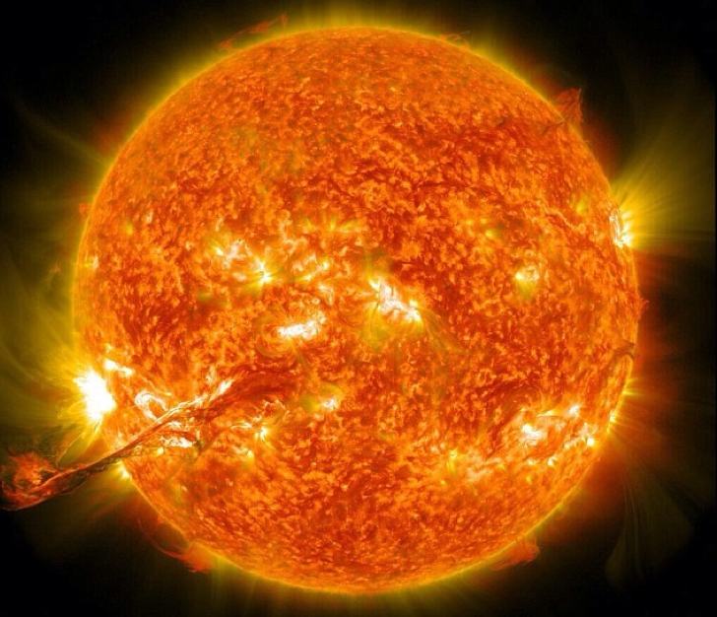
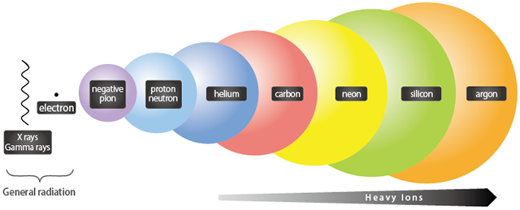
NASA’s Computing Needs
The Space Radiation Environment

Slide 27
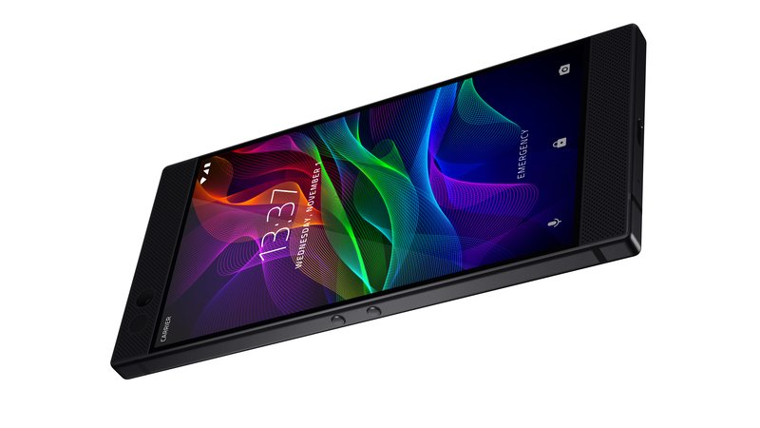
NASA’s Computing Needs
If this radiation is a problem, how do our computers work now?

Slide 28
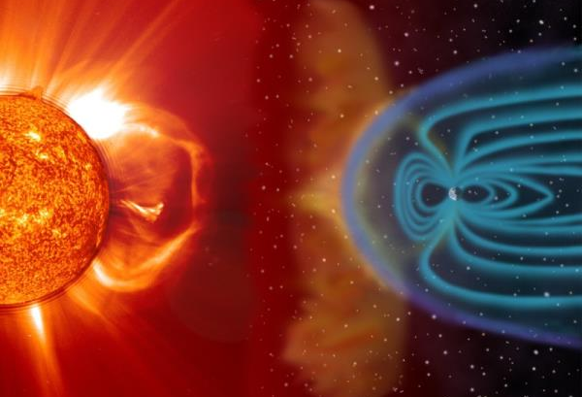

NASA’s Computing Needs
The Earth’s Magnetic Field Deflects Much of the Radiation
You Are Here

Slide 29
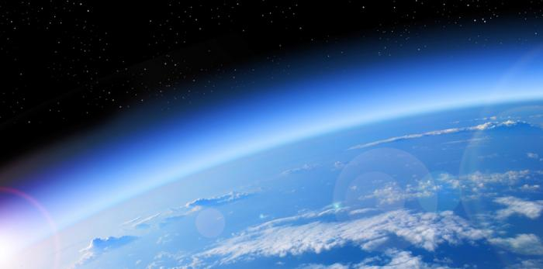
NASA’s Computing Needs
The Atmosphere Attenuates the Rest
You Are Here

Slide 30
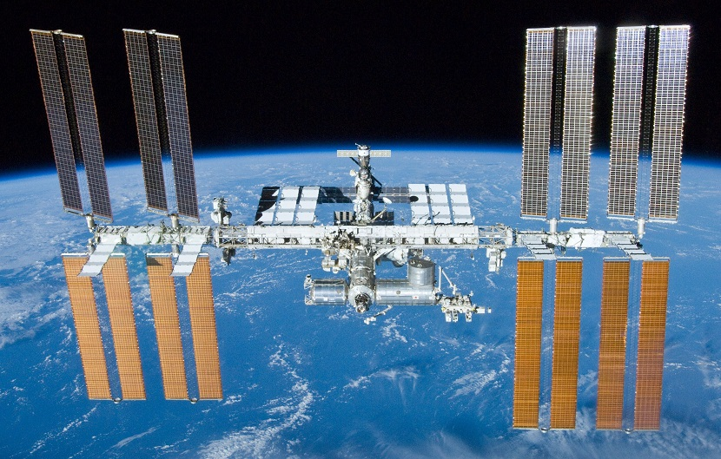
NASA’s Computing Needs
But There are Computers in Space Now?

Slide 31
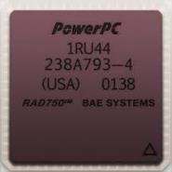
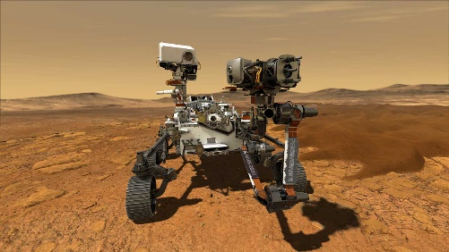

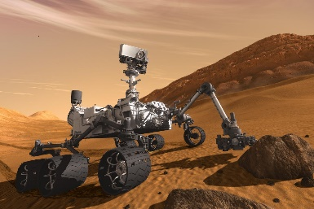

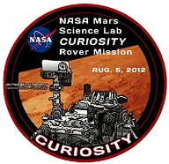
NASA’s Computing Needs
NASA and the Military have Devised “Hardening Techniques”
  But they are expensive ($200,000).
  And they are slow (25 years behind Earth computers)
1. The most advanced space mission ever attempted uses a BAE RAD750 radiation-hardened computer.
($200,000 USD, 200 MHz)
2. This was also used on Mars Curiosity 11 years earlier.
3. And started being used in 2002.
2002
2021

Slide 32
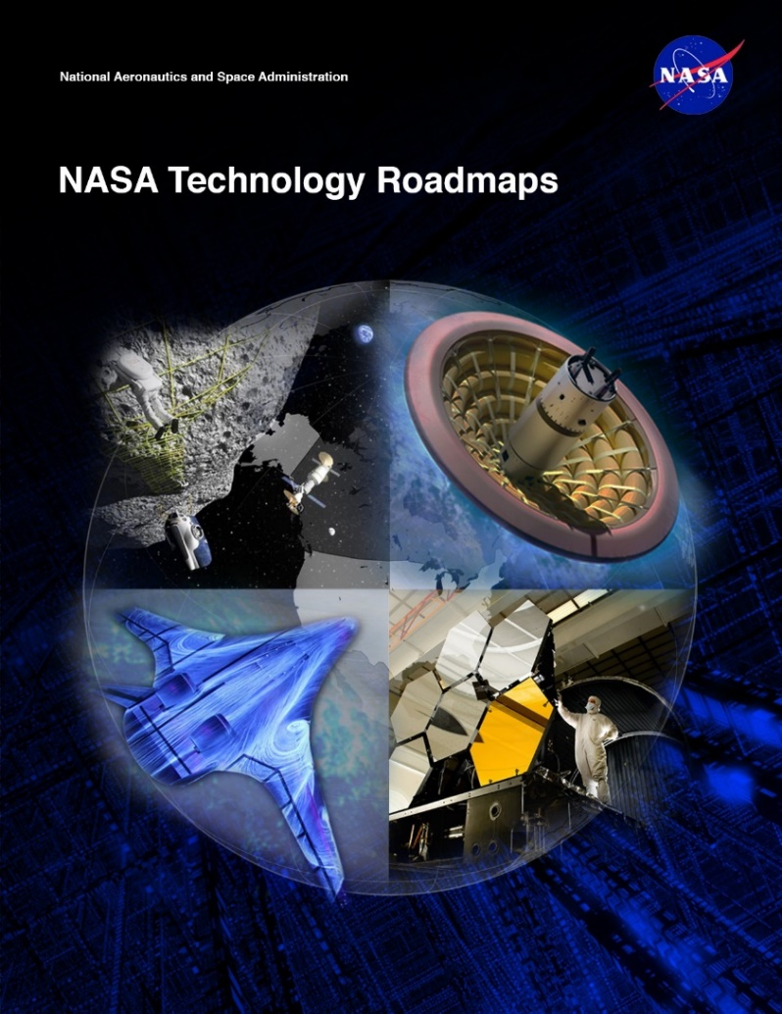
NASA’s Computing Needs
Space Computing Needs
  NASA Technology Area 11 – Flight Computing
    Increased Computation
    Radiation hardened technologies
    Low power requirements
    Cost Feasible
This is the new variable for NASA
So that it the problem statement:
Fast, Low-Power, Cheap, Reliable
Good luck…

Slide 33
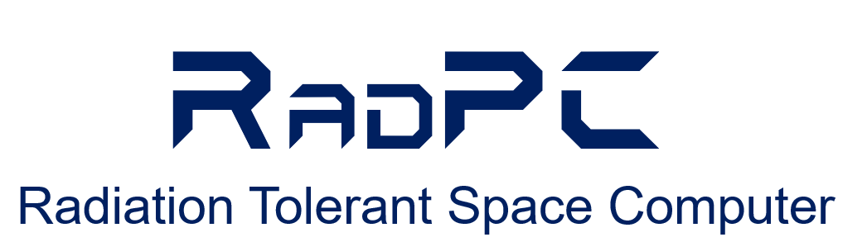
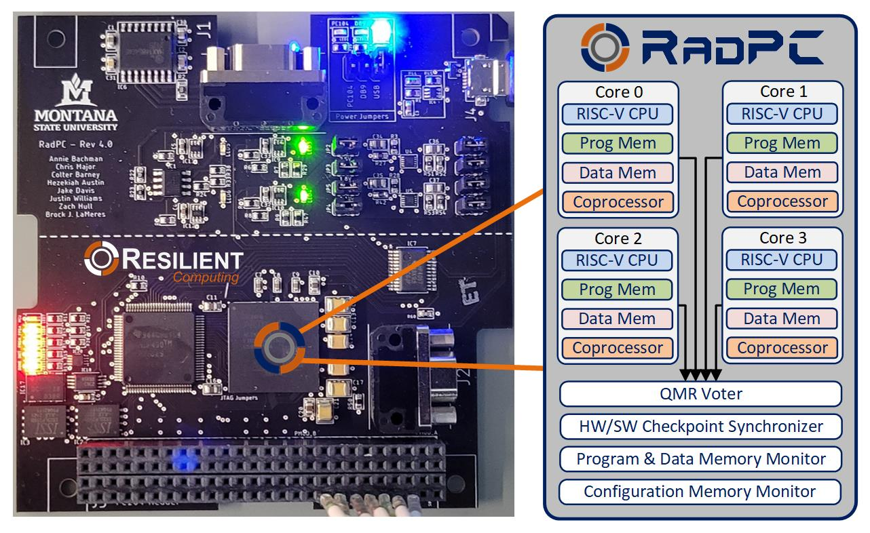
MSU’s Approach

Slide 34
MSU’s Approach
  Instead of preventing crashes, expect them to happen and elegantly recover from them.
1. Off-the-Shelf Part
Lower $
Higher Performance
2. Multiple Computers on Single Chip
Vote on the outputs
The majority is right
3. “Fix” Errors in the Background
Reprogram the damaged region.
Kind of like “Reconfigurable Computing”.

Slide 35
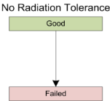
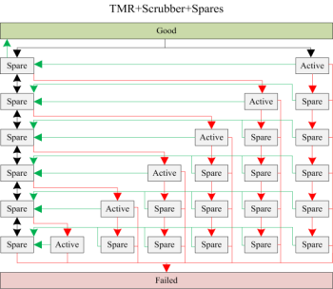




MSU’s Approach - RadPC
Simulate it and See if it is Better.
  So, we did.
ISS
HEO
HRBE
GEO
And it looked promising.

Slide 36


MSU’s Approach - RadPC
Technical Readiness Level (TRL)
  If you want to fly on a NASA mission, you need to prove it works.

Slide 37




MSU’s Approach - RadPC
Step 1 – Build a Prototype to See if it is Possible
  The Montana Space Grant Consortium funds an investigation into conducting radiation tolerant computing research at MSU. The goal is to understand the problem, propose a solution, and build relationships with scientists at NASA.
Clint Gauer (MSEE from MSU 2009) demo’s computer to MSFC Chief of Technology Andrew Keys
Timeline of Activity at MSU
Proof of Concept
(2008-2010)
2008
2009
2010
2011
2012
2013
2014-16
2016
2017-20

Slide 38






MSU’s Approach - RadPC
Step 2 –Test in a Cyclotron
  NASA funds the development of a more functional prototype and testing
  under bombardment by radiation at the Texas A&M Radiation Effects Facility.
MSU Computer
Ray Weber (Ph.D., EE from MSU, 2014) prepares experiment.
Timeline of Activity at MSU
Proof of Concept
Prototype Development & Cyclotron Testing
(2008-2010)
(2010-2012)
2008
2009
2010
2011
2012
2013
2014-16
2016
2017-20

Slide 39






MSU’s Approach - RadPC
Step 3 – Demonstrate as Flight Hardware on High Altitude Balloons
  NASA funds the development of the computer into flight hardware for demonstration on high altitude balloon systems, both in Montana and at NASA.
MSU
Computer
Timeline of Activity at MSU
Justin Hogan (Ph.D., EE from MSU, 2014) prepares payload.
Proof of Concept
Prototype Development & Cyclotron Testing
High Altitude Balloon Demos
(2008-2010)
(2010-2012)
(2011-2013)
2008
2009
2010
2011
2012
2013
2014-16
2016
2017-20

Slide 40






MSU’s Approach - RadPC
Step 4 – Demonstrate as Flight Hardware on a Research Rockets
  NASA fund the demonstration of the computer system on sounding rocket.
  Flew on two rockets (2014 and 2016)
MSU
Computer
Timeline of Activity at MSU
Proof of Concept
Prototype Development & Cyclotron Testing
High Altitude Balloon Demos
Sounding
Rocket Demo
(2008-2010)
(2010-2012)
(2011-2013)
(2012-2016)
2008
2009
2010
2011
2012
2013
2014-16
2016
2017-20

Slide 41
MSU’s Approach - RadPC
Step 5 – Demonstrate on the International Space Station
  NASA funds the demonstration of RadPC on ISS

Slide 42
MSU’s Approach - RadPC
Step 5 – Demonstrate on the International Space Station
  NASA funds the demonstration of RadPC on ISS

Slide 43




MSU’s Approach - RadPC
A little help please
  Larry Springer, Project Manager
  Space Science & Engineering Lab
  Montana State University (14 years)
  Expertise: Spacecraft Development
  Dr. David Klumpar, Science-I
  Director, Space Science & Engineering Lab
  Montana State University (21 years)
  Expertise: Spacecraft Development &
  Space Radiation
Program Manager
Spacecraft instrument development.
Solar & atmospheric instrumentation.
(35 Years)
Staff Physicist
Spacecraft instrument development.
Space radiation research.
(16 Years)

Slide 44














MSU’s Approach - RadPC
SSEL Track Record
MEROPE
PrintSat
Explorer 1’
FIREBIRD 1 & 2
HRBE
FIREBIRD 3 & 4
IT-SPINS
2006
2016
2021

Slide 45

MSU’s Approach - RadPC
Step 5 – Demonstrate on the International Space Station
  NASA funds the demonstration of RadPC on ISS

Slide 46

MSU’s Approach - RadPC
Step 5 – Demonstrate on the International Space Station
  NASA funds the demonstration of RadPC on ISS

Slide 47




MSU’s Approach - RadPC
Step 6 – Demonstrate as a Stand-Alone Satellite
  NASA funds the development of satellites to carry RadPC.
Timeline of Activity at MSU
Proof of Concept
Prototype Development & Cyclotron Testing
High Altitude Balloon Demos
Sounding
Rocket Demo
ISS
Demo
Satellite
Demo
(2008-2010)
(2010-2012)
(2011-2013)
(2012-2016)
(2014-2016)
(2015-2020)
2008
2009
2010
2011
2012
2013
2014-16
2016
2017-20

Slide 48


MSU’s Approach - RadPC
RadSat-g
Brock & Skylar Tamke (MSEE 2019) at Integration
Houston, TX. 2018.

Slide 49


MSU’s Approach - RadPC
RadSat-g
Orbital ATK OA9 ISS Resupply Mission.
NASA Wallops Flight Facility, 5/22/18.
Brock & Skylar Tamke (MSEE 2000) at Launch.

Slide 50



MSU’s Approach - RadPC
RadSat Mission Concept
Students Build It
Launch it to the International Space Station
Push into orbit
Operate from Ground Station at MSU

Slide 51

MSU’s Approach - RadPC
In case you
didn’t see
that…

Slide 52

MSU’s Approach - RadPC
In case you
didn’t see
that…

Slide 53

MSU’s Approach - RadPC
In case you
didn’t see
that…

Slide 54

MSU’s Approach - RadPC

Slide 55


MSU’s Approach - RadPC
RadSat-u
Chris Major (MSEE 2000) at Integration
Houston, TX. 2018.

Slide 56


MSU’s Approach - RadPC
RadSat-u
Chris Major (MSEE 2000), Brock, & Colter Barney (BSCpE 2021) at Launch.
Northrop Grumman NG-12 ISS Resupply Mission.
NASA Wallops Flight Facility, 11/2/19.

Slide 57

MSU’s Approach - RadPC
RadSat-u

Slide 58




MSU’s Approach - RadPC
RadSat Mission Concept
Students Build It
Launch it to the International Space Station
Put into Orbit using NanoRacks CubeSat Deployer
Operate from Ground Station at MSU

Slide 59

MSU’s Approach - RadPC
In case you
didn’t see
that…

Slide 60

MSU’s Approach - RadPC
In case you
didn’t see
that…

Slide 61

MSU’s Approach - RadPC
In case you
didn’t see
that…

Slide 62

MSU’s Approach - RadPC
Now What?

Slide 63


MSU’s Approach - RadPC
Now What?

Slide 64
MSU’s Approach - RadPC
Nice!

Slide 65

Bobcats on the Moon
Lunar Exploration in the Next 10 Years

Slide 66
Bobcats on the Moon
Lunar Exploration in the Next 10 Years
RadPC is going to be part of this.

Slide 67



Bobcats on the Moon
What does MSU’s Moon Mission Look Like?

Slide 68


Bobcats on the Moon
What does MSU’s Moon Mission Look Like?

Slide 69



Bobcats on the Moon
What does MSU’s Moon Mission Look Like?
The RadPC-Lunar payload isn’t huge. A little larger than a Rubik’s cube.

Slide 70
Bobcats on the Moon
What does MSU’s Moon Mission Look Like?

Slide 71

Bobcats on the Moon
What does MSU’s Moon Mission Look Like?

Slide 72

Bobcats on the Moon
What does MSU’s Moon Mission Look Like?

Slide 73


Bobcats on the Moon
Landing Site:
Mare Crisium
“the sea of crisis”

Slide 74

Bobcats on the Moon
Are you coming back? Nope…
Mare Crisium
“the sea of crisis”
Visible from Earth with the Naked Eye
Bobcats on the Moon for the next 1000 years!

Slide 75


Bobcats on the Moon
We Decided to Send Messages to the Moon Too

Slide 76




Bobcats on the Moon
We Decided to Send Messages to the Moon Too
  1000 inspirational messages (well, mostly…)
  700+ pictures
  Tributes from MSU departments, colleges, & President Cruzado.
  Videos from the Governor, our two US Senators, and our US Representative.
  Every Edition of the MSU Student News Paper the Exponent (since 1895!)

Slide 77





Bobcats on the Moon
This Research has had Local Economic Impact Too

Slide 78

Bobcats on the Moon
How are you doing all this?

Slide 79










MSU’s Approach - RadPC
Everything was Designed & Built By MSU Students (~150)
Todd Buerkle, Justin Hogan, Ray Weber at Johnson Space Center for demo, 2012.
Todd Buerkle & Jennifer Hane demo computer at Marshall Space Flight Center, 2012.
Justin Hogan at the NASA Columbia Scientific Balloon Facility, 2012.
Clint Gauer at Marshall Space Flight Center for demo, 2009.
Clint Gauer demo’s computer at Marshall Space Flight Center, 2009.
Kaysha Young prepares payload for balloon flight, 2012.
2011 balloon team featured in MSU news story, 2011.
Todd Buerkle, Jennifer Hane at the Marshall Space Flight Center, 2011.
2013 balloon team recovers payload in front of moose, 2013.
Justin Hogan & Ray Weber featured in MSU News Story, 2012.

Slide 80




Your Students Can Too!
Due 11/1/24
(2 weeks)

Slide 81

The Future of Engineering Education
What People are Talking About
  Pathways into STEM. We need MORE people than ever, but maybe not everyone needs 4-semesters of calculus?
    Can the MSU Moon computer story help?
    Rockets and Robots get the same folks.
    Helping and working with people gets new folks.

Slide 82

The Future of Engineering Education
What People are Talking About
  Shrinking high school enrollment leading to shrinking enrollment in higher education.
    Consolidation of universities (private colleges are shutting doors rapidly)
    Liberal arts will be the first to go.
    But, predicting the future is hard! Remember 2007?

Slide 83

The Future of Engineering Education
What People are Talking About
  The diminished perception of the value of higher education.
    60% of Americans have a negative view of higher education.
    This was at 50% LAST year!

Slide 84




The Future of Engineering Education
What People are Talking About
  How will Artificial Intelligence change education?
    AI can allow us to skip the grind (e.g., weed out courses).
    But can you be an engineer without the grind?
    Are you capable of evaluating AI solutions without the grind?

Slide 85





Questions
MSU Computer
MSU Computer
MSU Computer
MSU Computer
MSU Computer
Coming Jan 2025

Slide 86
Backup Slides
Cool pictures of rockets…

Slide 87

Bobcats on the Moon
Let’s step back and see and look at the Space Exploration Roadmap

Slide 88


Bobcats on the Moon
Let’s Talk Moon Rockets – NASA’s Artemis

Slide 89

Bobcats on the Moon
Let’s Talk Moon Rockets – NASA’s Artemis

Slide 90

Bobcats on the Moon
Let’s Talk Moon Rockets – NASA’s Artemis

Slide 91


Bobcats on the Moon
Let’s Talk Moon Rockets – NASA’s Artemis
The Orion capsule is a little cramped. But it is only for a 3-day trip.
This is only for Lunar and low Earth Orbit.
Gateway will be a BIG DEAL, but it isn’t used in Artemis III

Slide 92


Bobcats on the Moon
Let’s Talk Moon Rockets - Starship

Slide 93




Bobcats on the Moon
Let’s Talk Moon Rockets - Starship
A Different Approach
Roomy
Reusable
Refuel it over and over.

Slide 94

Bobcats on the Moon
Let’s Talk Moon Rockets - Starship
That’s because it is being designed for Mars!

