Slide 1

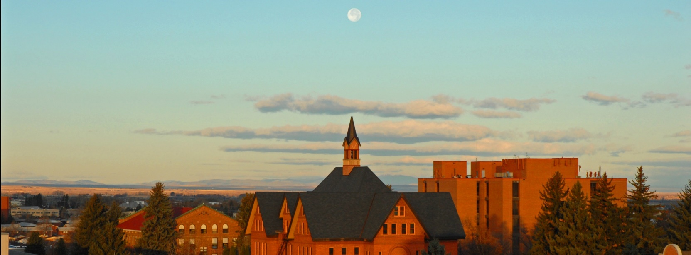

From Montana to the Moon
The Story of MSU’s Space Computer
Dr. Brock J. LaMeres
Professor, Electrical & Computer Engineering

Slide 2


Tonight’s Talk
What is possible
in Montana?

Slide 3
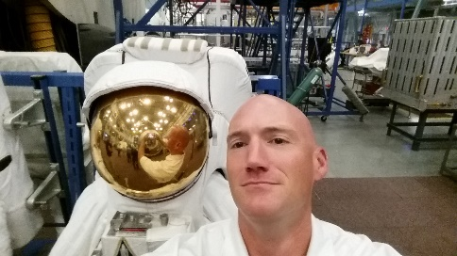
A little bit about me…

Slide 4


A little bit about me…

Slide 5

A little bit about me…

Slide 6


A little bit about me…
Class of 98

Slide 7

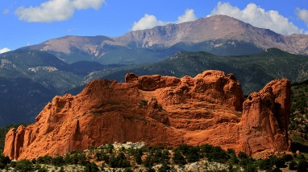

A little bit about me…
Class of 98

Slide 8

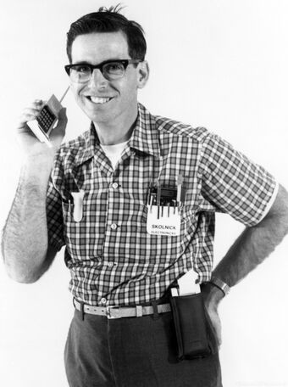
A little bit about me…
20 years later…
Class of 98

Slide 9
Becoming a Professor

Slide 10
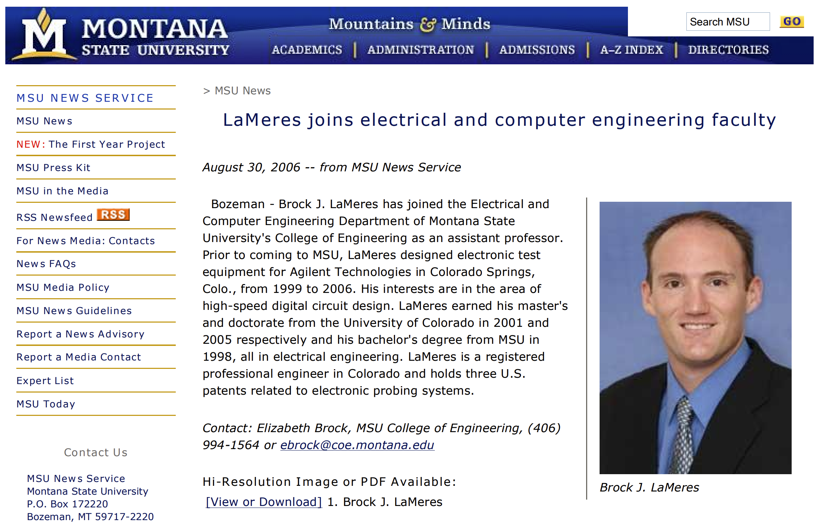
Becoming a Professor

Slide 11

Becoming a Professor

Slide 12
Becoming a Professor
?

Slide 13
Becoming a Professor
?
Well, I really like computers…

Slide 14
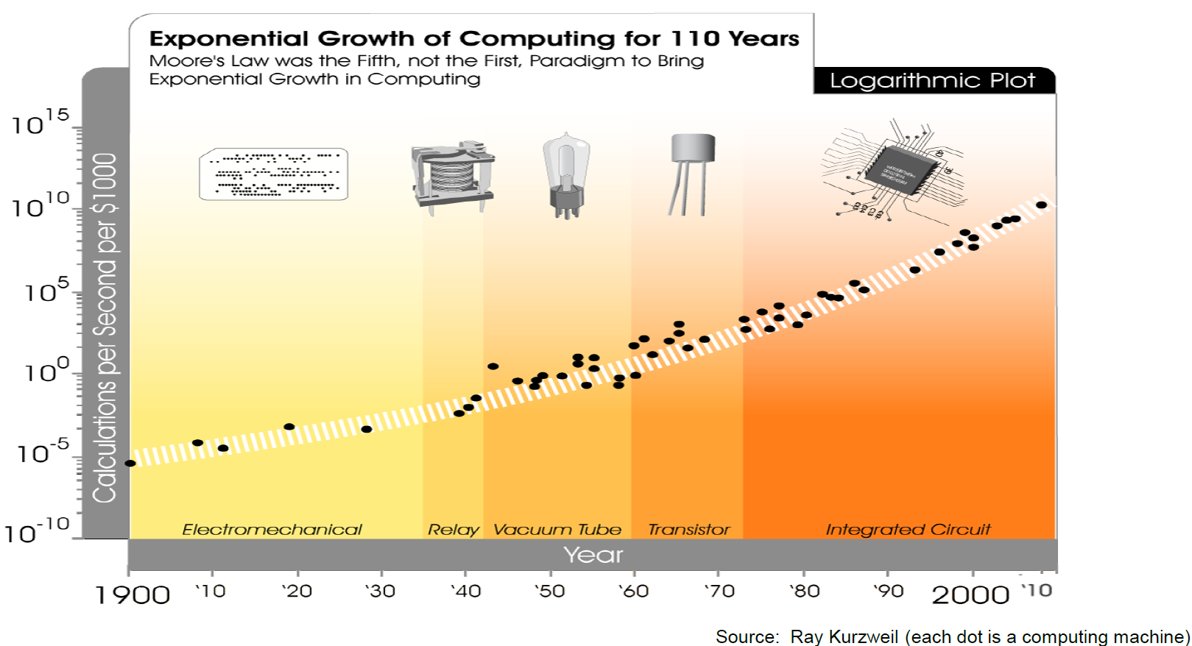

Brock’s Computer Research
You Are Here

Slide 15
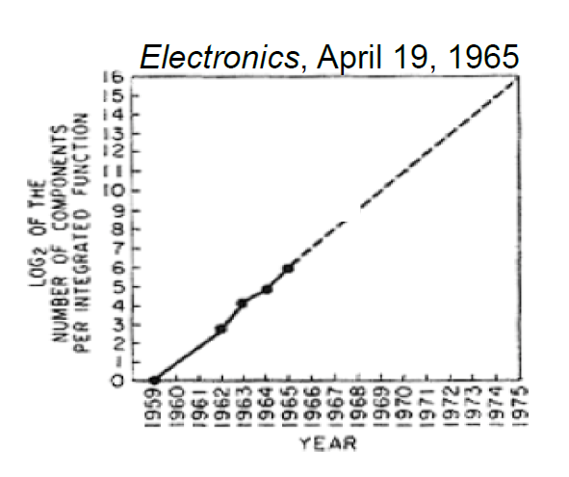
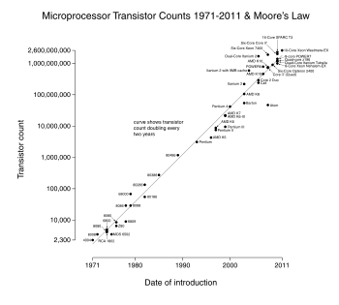
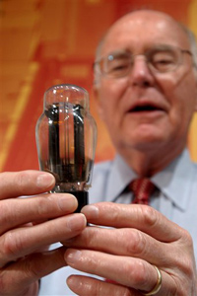
Brock’s Computer Research
Our Existing Computers Work Well. What’s the Problem?
  Our existing computers have benefited from 40+ years of Moore’s Law.
  In the 1960’s, Gordon Moore predicted that the number of transistors on a chip would double every ~24 months.
1959 - 1965
1971* - 2011
Gordon Moore, co-founder of Intel, holding a vacuum tube.
Note: First microprocessor introduced in 1971,
the Intel 4004 with 2300 transistors.

Slide 16
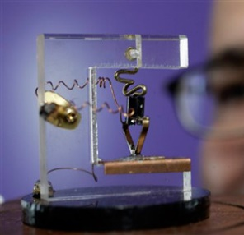
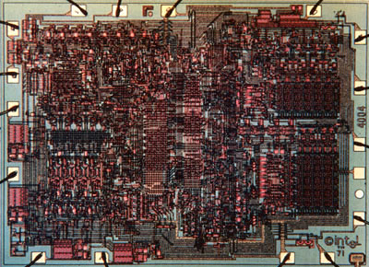
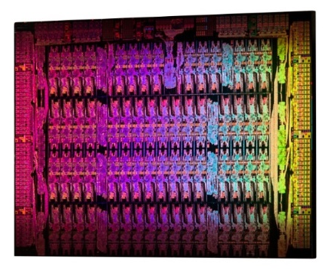
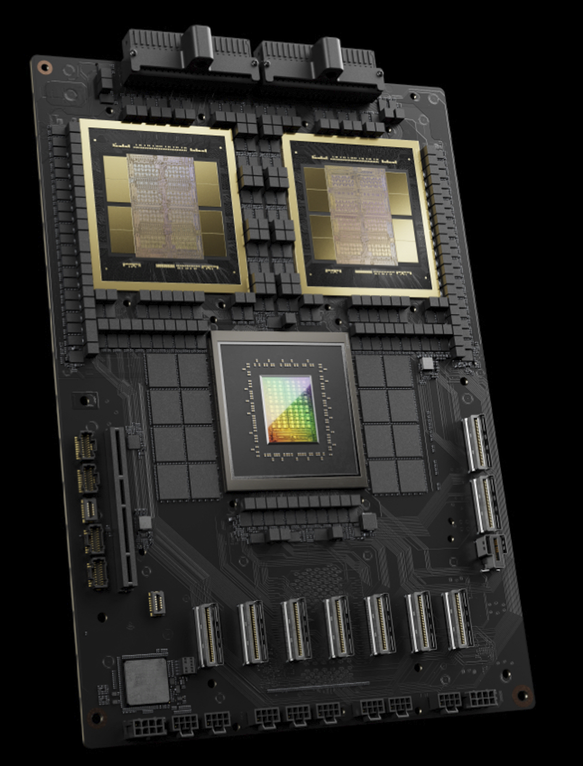
Brock’s Computer Research
Why is Moore’s Law so Cool?
  It gives us smaller, faster, and less power.
1947 (1 transistor)
1971 (2300 transistors)
2012 (5B transistors)
2024 (208B transistors)
Replica of the First Transistor
(Source: AP Photo Paul Sakuma)
Intel 4004, 10um
(Source: newsroom.intel.com)
Intel Xeon Phi, 22nm
(Source: newsroom.intel.com)
NVIDIA Blackwell GPU
(Source: invidia.com)

Slide 17
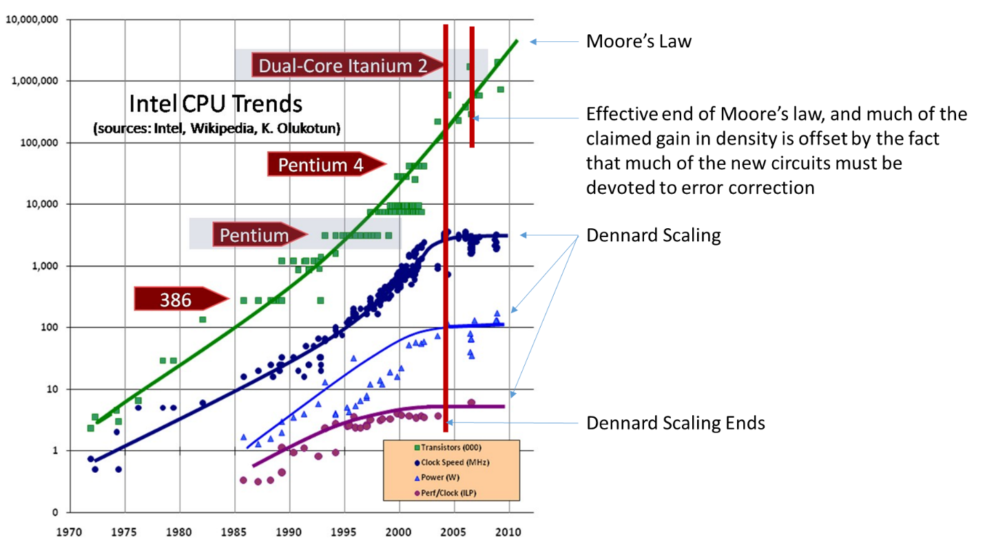
Brock’s Computer Research
Why is Moore’s Law so Cool?
  It gives us smaller, faster, and less power.
Clock Speed
Power
Performance per Clock Cycle

Slide 18

Brock’s Computer Research
When will Moore’s Law End?
Clock Speed
Power
Performance per Clock Cycle

Slide 19
Brock’s Computer Research
When will Moore’s Law End?
Clock Speed
Power
Performance per Clock Cycle
Don’t worry, it’s going to be OK.

Slide 20
Brock’s Computer Research
You Are Here

Slide 21
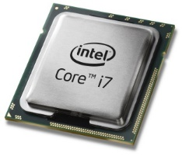
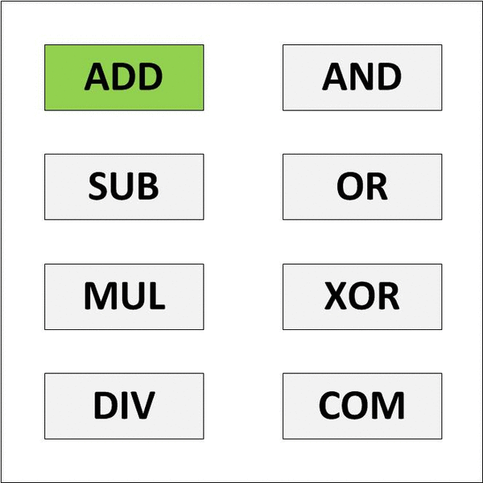
Brock’s Computer Research
Reconfigurable Computing
  Current computers are “Jack of All Trades, Master of None”.
General Purpose CPU Model

Slide 22
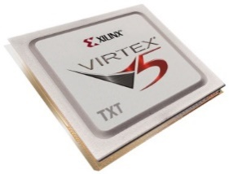
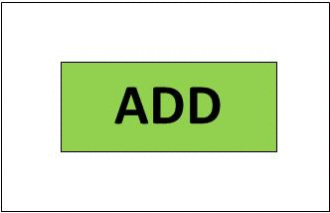
Brock’s Computer Research
Reconfigurable Computing
  Current computers are “Jack of All Trades, Master of None”.
General Purpose CPU Model
Reconfigurable Computing Model
This can be faster because the hardware is smaller and consumes less power.

Slide 23
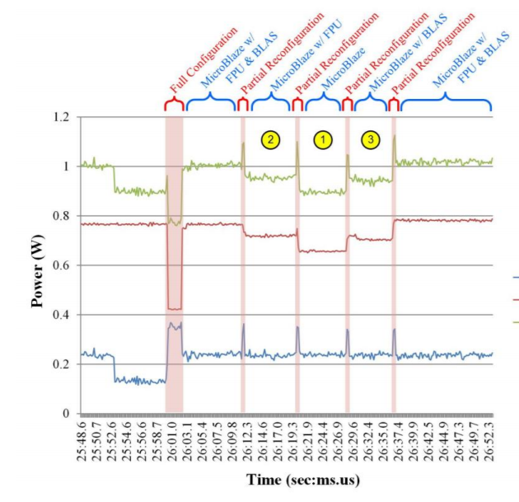
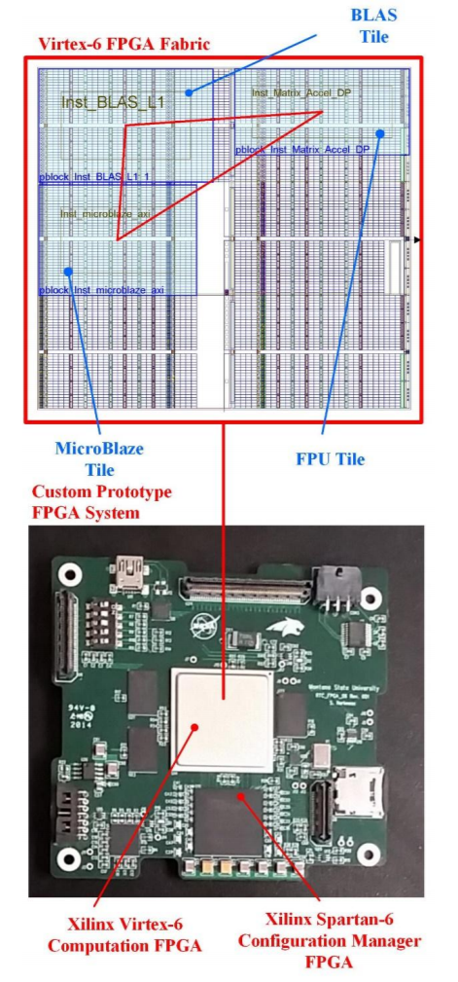
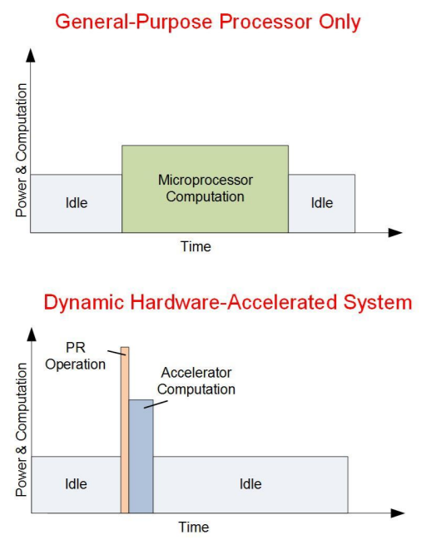
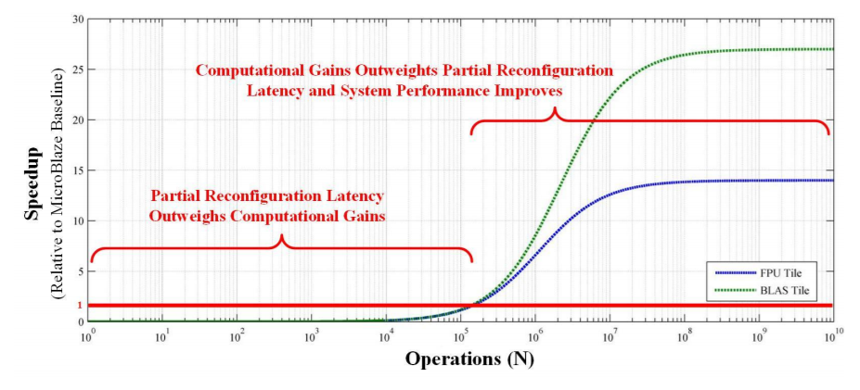
Brock’s Computer Research
So off to work…
  We started investigating computational speedup by swapping in hardware in real-time.

Slide 24

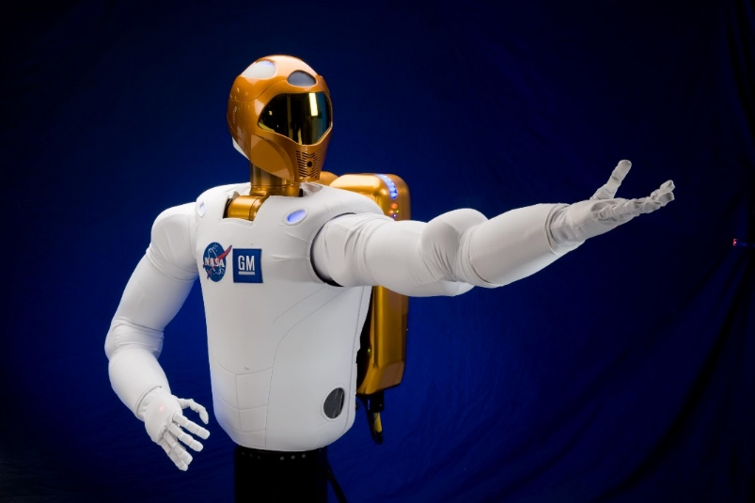
Brock’s Computer Research
But then…
Hey, that’s pretty cool. That might help our space computers.

Slide 25
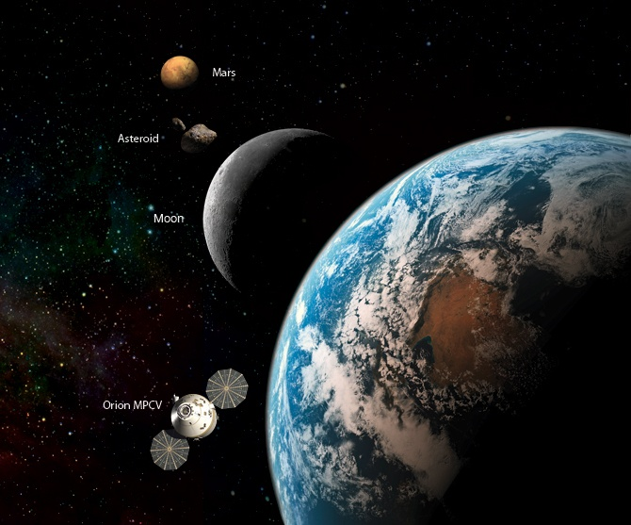
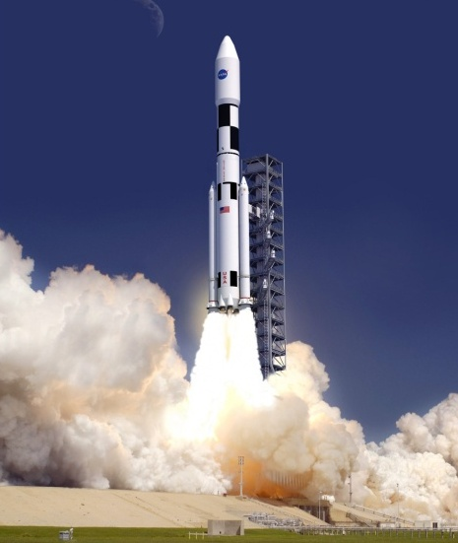
NASA’s Computing Needs
The Promise of Reconfigurable Computing
  What do space Computers need?
  They need to be light. RC reuses hardware, that saves mass.

Slide 26

NASA’s Computing Needs
The Promise of Reconfigurable Computing
  What do space Computers need?
  They need to be light. RC reuses hardware, that saves mass.

Slide 27
NASA’s Computing Needs
The Promise of Reconfigurable Computing
  What do space Computers need?
  They need to be light. RC reuses hardware, that saves mass.
  They need to be low power. RC eliminates unnecessary circuitry.

Slide 28
NASA’s Computing Needs
The Promise of Reconfigurable Computing
  What do space Computers need?
  They need to be light. RC reuses hardware, that saves mass.
  They need to be low power. RC eliminates unnecessary circuitry.

Slide 29
NASA’s Computing Needs
The Promise of Reconfigurable Computing
  What do space Computers need?
  They need to be light. RC reuses hardware, that saves mass.
  They need to be low power. RC eliminates unnecessary circuitry.
  They need to be fast. RC can do that.

Slide 30
NASA’s Computing Needs
The Promise of Reconfigurable Computing
  What do space Computers need?
  They need to be light. RC reuses hardware, that saves mass.
  They need to be low power. RC eliminates unnecessary circuitry.
  They need to be fast. RC can do that.

Slide 31
NASA’s Computing Needs
The Promise of Reconfigurable Computing
  What do space Computers need?
  They need to be light. RC reuses hardware, that saves mass.
  They need to be low power. RC eliminates unnecessary circuitry.
  They need to be fast. RC can do that.
  They need to operate in the presence of harsh radiation.

Slide 32

NASA’s Computing Needs
The Promise of Reconfigurable Computing
  What do space Computers need?
  They need to be light. RC reuses hardware, that saves mass.
  They need to be low power. RC eliminates unnecessary circuitry.
  They need to be fast. RC can do that.
  They need to operate in the presence of harsh radiation.
Huh???

Slide 33
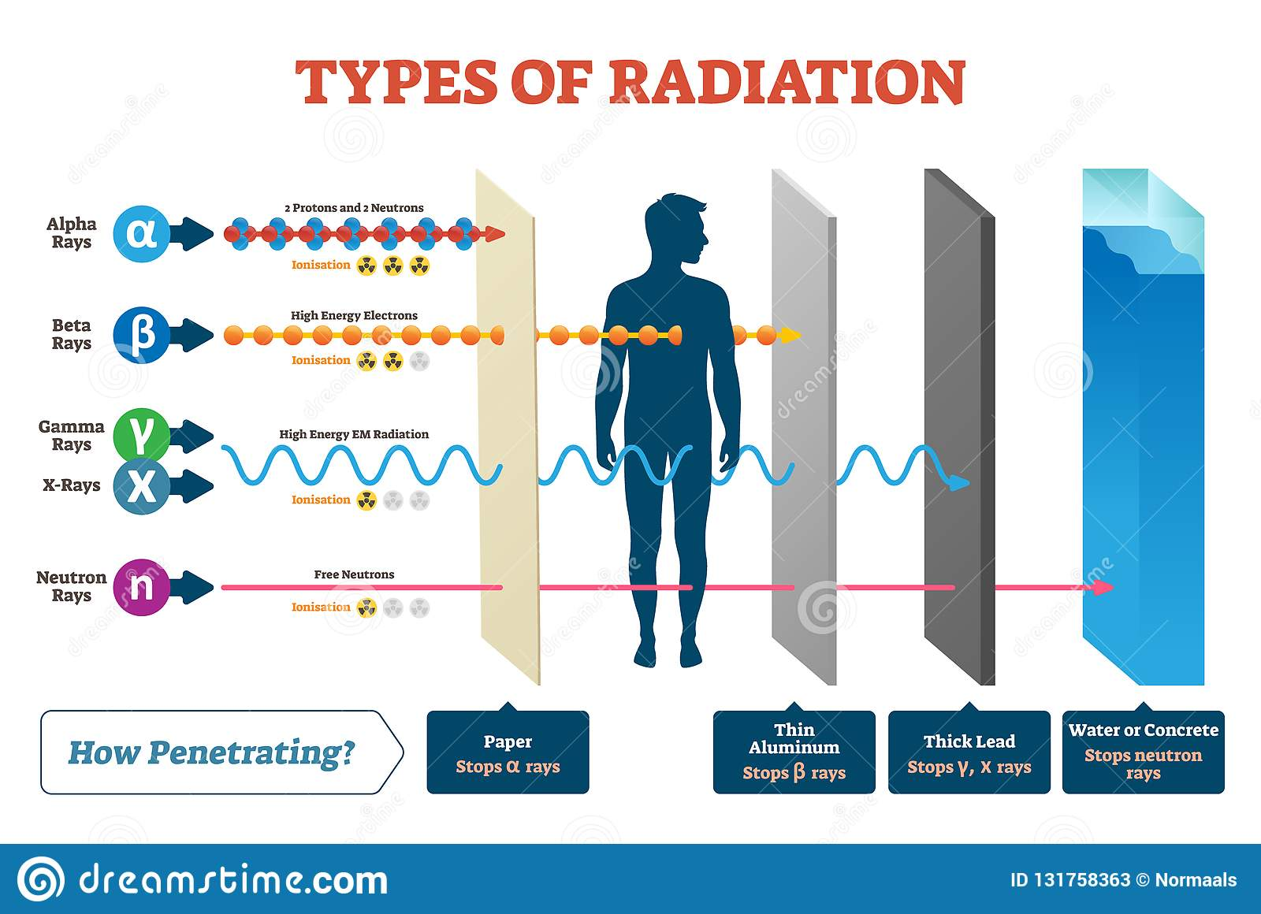
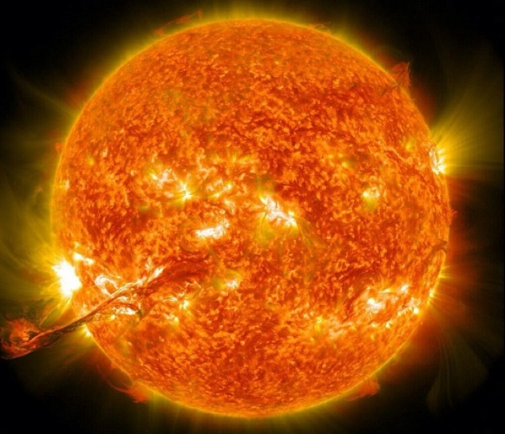
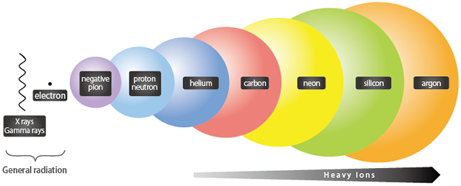
NASA’s Computing Needs
The Space Radiation Environment

Slide 34
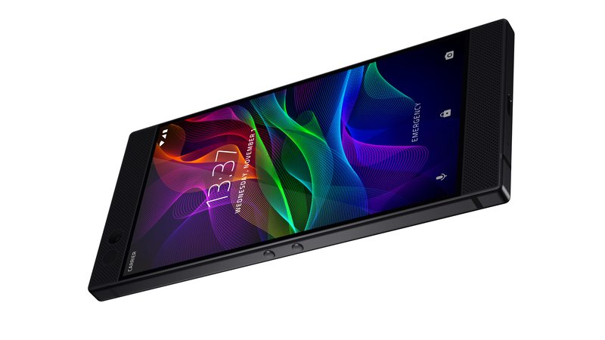
NASA’s Computing Needs
If this radiation is a problem, how do our computers work now?

Slide 35
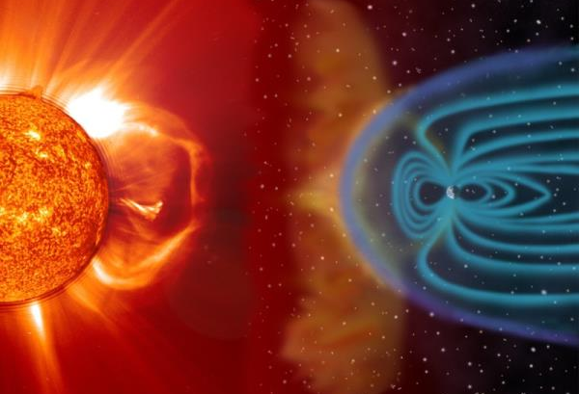
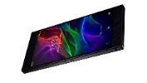
NASA’s Computing Needs
The Earth’s Magnetic Field Deflects Much of the Radiation
You Are Here

Slide 36

NASA’s Computing Needs
The Atmosphere Attenuates the Rest
You Are Here

Slide 37
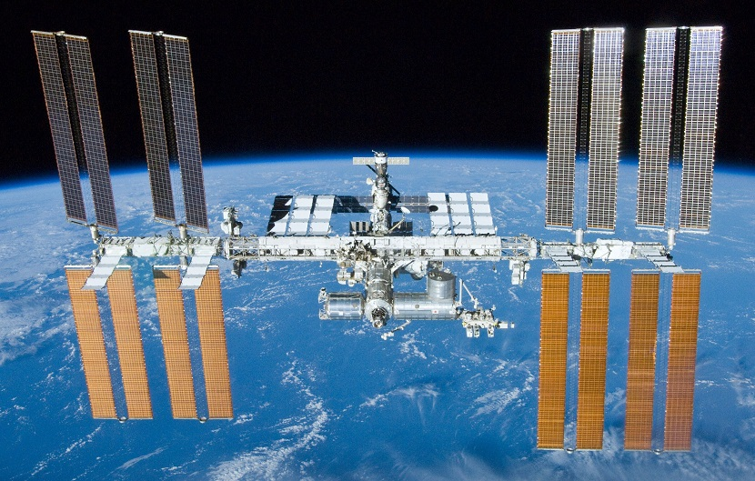
NASA’s Computing Needs
But There are Computers in Space Now?

Slide 38
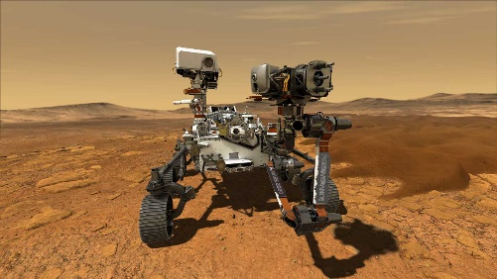

NASA’s Computing Needs
NASA and the Military have Devised “Hardening Techniques”
  But they are expensive and slow.
The State-of-the-Art hardened computer was used on the most advanced space mission ever attempted.
2021

Slide 39
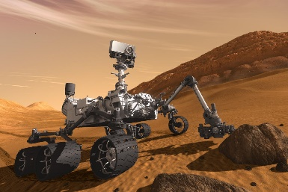
NASA’s Computing Needs
NASA and the Military have Devised “Hardening Techniques”
  But they are expensive and slow.
The State-of-the-Art hardened computer was used on the most advanced space mission ever attempted.
2021
And also used 10 years before that…
2012

Slide 40

NASA’s Computing Needs
NASA and the Military have Devised “Hardening Techniques”
  But they are expensive and slow.
The State-of-the-Art hardened computer was used on the most advanced space mission ever attempted.
2021
And another 10 years before that…
And also used 10 years before that…
2002
2012

Slide 41
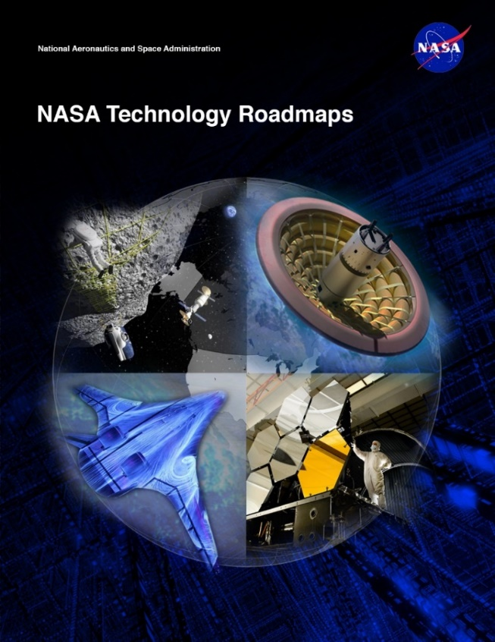
NASA’s Computing Needs
Space Computing Needs
  NASA Technology Area 11 – Flight Computing
    Increased Computation
    Radiation hardened technologies
    Low power requirements
    Cost Feasible
This is the new variable for NASA
So that it the problem statement:
Fast, Low-Power, Cheap, Reliable
Good luck…

Slide 42
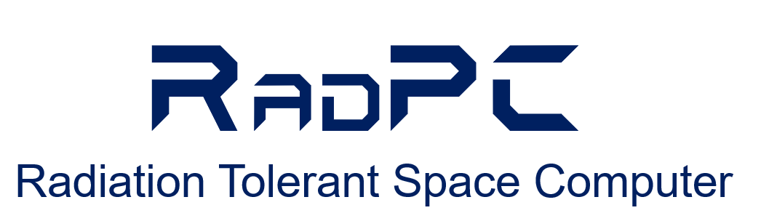
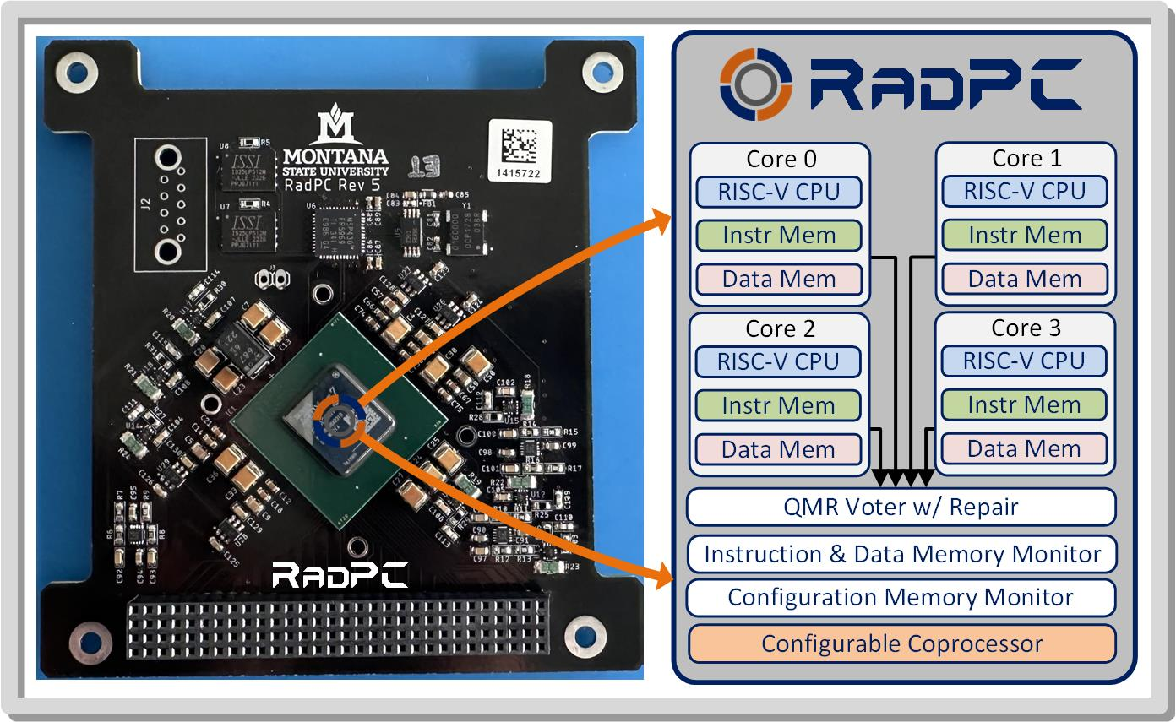
MSU’s Approach - RadPC

Slide 43
MSU’s Approach - RadPC
1. Off-the-Shelf Parts
2. Redundancy & Voting
3. Memory Scrubbing
4. Repair using hardware Reconfiguration!!!

Slide 44
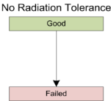
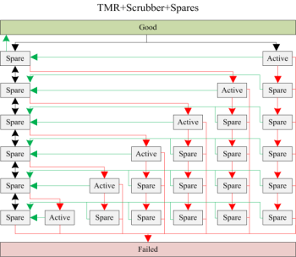
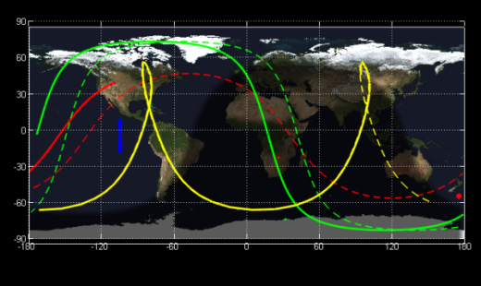
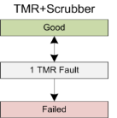
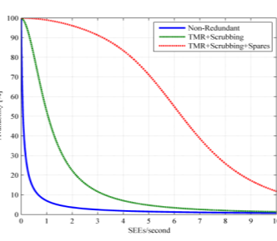
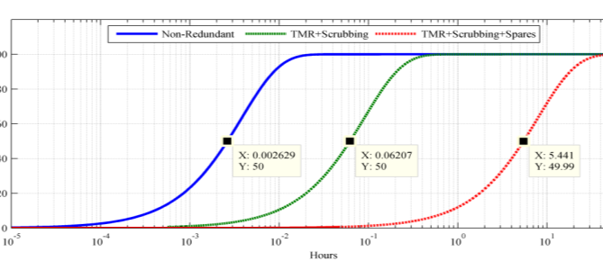
MSU’s Approach - RadPC
Simulate it and see if it is better.
  So, we did.
ISS
HEO
HRBE
GEO
And it looked promising.

Slide 45
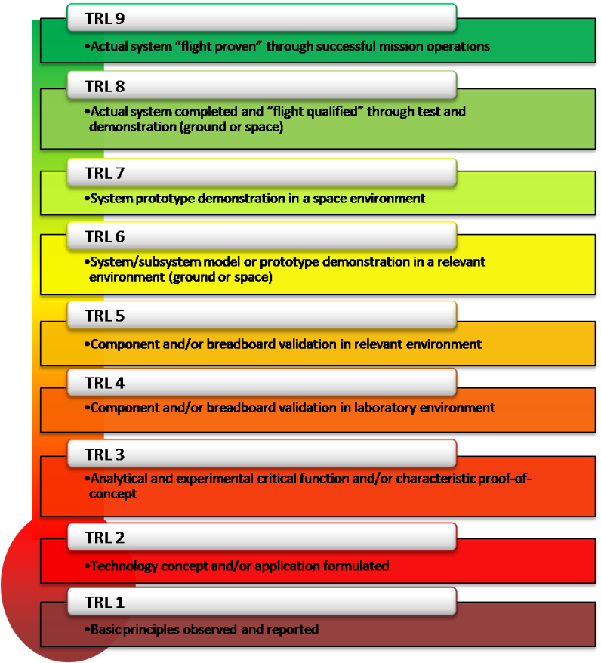
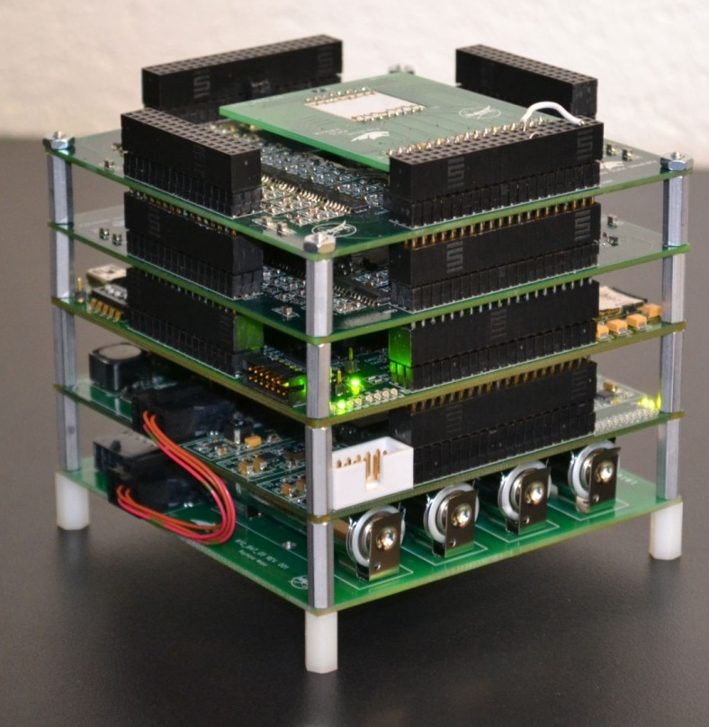
MSU’s Approach - RadPC
Technical Readiness Level (TRL)
  If you want to fly on a NASA mission, you need to prove it works.

Slide 46
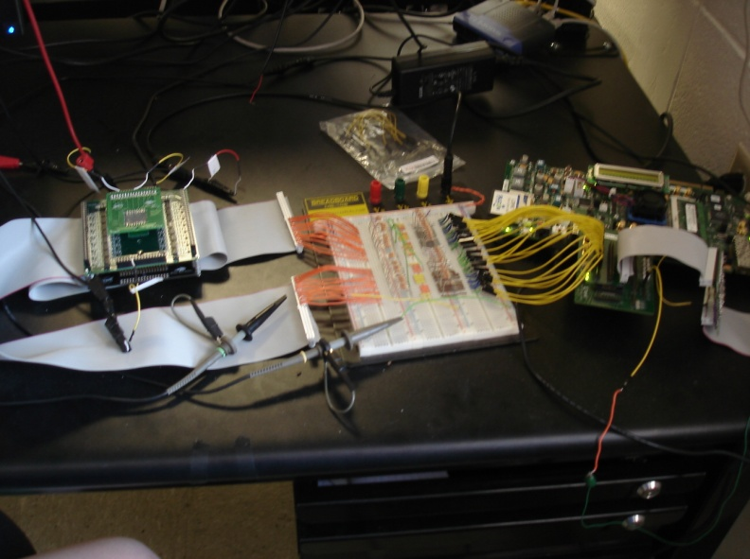
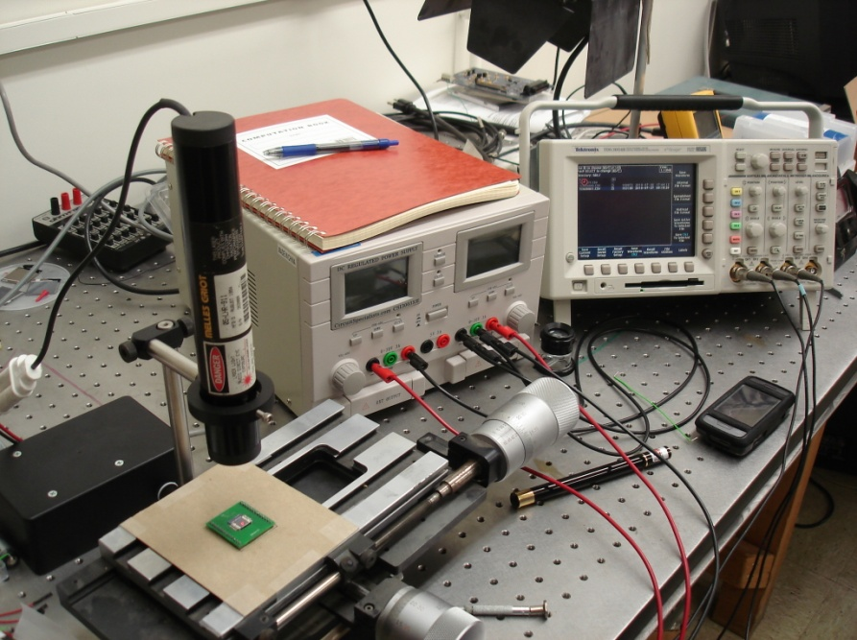
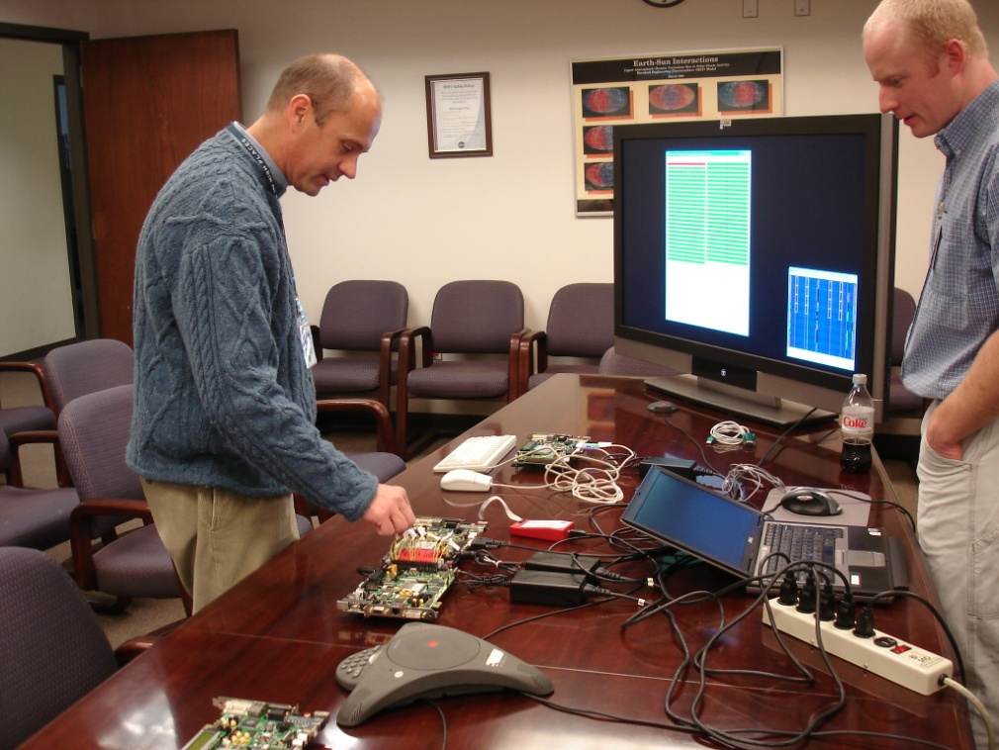

MSU’s Approach - RadPC
Step 1 – Build a Prototype to See if it is Possible
  The Montana Space Grant Consortium funds an investigation into conducting radiation tolerant computing research at MSU. The goal is to understand the problem, propose a solution, and build relationships with scientists at NASA.
Clint Gauer (MSEE from MSU 2009) demo’s computer to MSFC Chief of Technology Andrew Keys
Timeline of Activity at MSU
Proof of Concept
(2008-2010)
2008
2009
2010
2011
2012
2013
2014-16
2016
2017-20

Slide 47
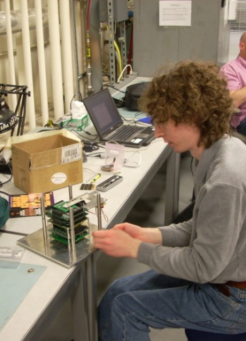
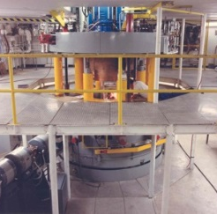




MSU’s Approach - RadPC
Step 2 –Test in a Cyclotron
  NASA funds the development of a more functional prototype and testing
  under bombardment by radiation at the Texas A&M Radiation Effects Facility.
MSU Computer
Ray Weber (Ph.D., EE from MSU, 2014) prepares experiment.
Timeline of Activity at MSU
Proof of Concept
Prototype Development & Cyclotron Testing
(2008-2010)
(2010-2012)
2008
2009
2010
2011
2012
2013
2014-16
2016
2017-20

Slide 48







MSU’s Approach - RadPC
Step 3 – Demonstrate as Flight Hardware on High Altitude Balloons
  NASA funds the development of the computer into flight hardware for demonstration on high altitude balloon systems, both in Montana and at NASA.
MSU
Computer
Timeline of Activity at MSU
Justin Hogan (Ph.D., EE from MSU, 2014) prepares payload.
Proof of Concept
Prototype Development & Cyclotron Testing
High Altitude Balloon Demos
(2008-2010)
(2010-2012)
(2011-2013)
2008
2009
2010
2011
2012
2013
2014-16
2016
2017-20

Slide 49






MSU’s Approach - RadPC
Step 4 – Demonstrate as Flight Hardware on a Research Rockets
  NASA fund the demonstration of the computer system on sounding rocket.
  Flew on two rockets (2014 and 2016)
MSU
Computer
Timeline of Activity at MSU
Proof of Concept
Prototype Development & Cyclotron Testing
High Altitude Balloon Demos
Sounding
Rocket Demo
(2008-2010)
(2010-2012)
(2011-2013)
(2012-2016)
2008
2009
2010
2011
2012
2013
2014-16
2016
2017-20

Slide 50
MSU’s Approach - RadPC
Step 5 – Demonstrate on the International Space Station
  NASA funds the demonstration of RadPC on ISS

Slide 51
MSU’s Approach - RadPC
Step 5 – Demonstrate on the International Space Station
  NASA funds the demonstration of RadPC on ISS
Huh???

Slide 52

MSU’s Approach - RadPC
A little help please…

Slide 53






MSU’s Approach - RadPC
A little help please…
Loren Acton
Former Astronaut
MSU Department of Physics
David Klumpar
Former Lockheed Martin
MSU Department of Physics
Larry Springer
Former Lockheed Martin
MSU Department of Physics

Slide 54














MSU’s Approach - RadPC
SSEL Track Record
MEROPE
PrintSat
Explorer 1’
FIREBIRD 1 & 2
HRBE
FIREBIRD 3 & 4
IT-SPINS
2006
2016
2021

Slide 55

MSU’s Approach - RadPC
Step 5 – Demonstrate on the International Space Station
  NASA funds the demonstration of RadPC on ISS

Slide 56

MSU’s Approach - RadPC
Step 5 – Demonstrate on the International Space Station
  NASA funds the demonstration of RadPC on ISS

Slide 57




MSU’s Approach - RadPC
Step 6 – Demonstrate as a Stand-Alone Satellite
  NASA funds the development of satellites to carry RadPC.
Timeline of Activity at MSU
Proof of Concept
Prototype Development & Cyclotron Testing
High Altitude Balloon Demos
Sounding
Rocket Demo
ISS
Demo
Satellite
Demo
(2008-2010)
(2010-2012)
(2011-2013)
(2012-2016)
(2014-2016)
(2015-2020)
2008
2009
2010
2011
2012
2013
2014-16
2016
2017-20

Slide 58


MSU’s Approach - RadPC
RadSat-g
Brock & Skylar Tamke (MSEE 2019) at Integration
Houston, TX. 2018.

Slide 59


MSU’s Approach - RadPC
RadSat-g
Orbital ATK OA9 ISS Resupply Mission.
NASA Wallops Flight Facility, 5/22/18.
Brock & Skylar Tamke (MSEE 2000) at Launch.

Slide 60




MSU’s Approach - RadPC
RadSat Mission Concept
Students Build It
Launch it to the International Space Station
Push into orbit
Operate from Ground Station at MSU

Slide 61

MSU’s Approach - RadPC
In case you
didn’t see
that…

Slide 62

MSU’s Approach - RadPC
In case you
didn’t see
that…

Slide 63

MSU’s Approach - RadPC
In case you
didn’t see
that…

Slide 64

MSU’s Approach - RadPC

Slide 65


MSU’s Approach - RadPC
RadSat-u
Chris Major (MSEE 2000) at Integration
Houston, TX. 2018.

Slide 66


MSU’s Approach - RadPC
RadSat-u
Chris Major (MSEE 2000), Brock, & Colter Barney (BSCpE 2021) at Launch.
Northrop Grumman NG-12 ISS Resupply Mission.
NASA Wallops Flight Facility, 11/2/19.

Slide 67

MSU’s Approach - RadPC
RadSat-u

Slide 68




MSU’s Approach - RadPC
RadSat Mission Concept
Students Build It
Launch it to the International Space Station
Put into Orbit using NanoRacks CubeSat Deployer
Operate from Ground Station at MSU

Slide 69

MSU’s Approach - RadPC
In case you
didn’t see
that…

Slide 70

MSU’s Approach - RadPC
In case you
didn’t see
that…

Slide 71

MSU’s Approach - RadPC
In case you
didn’t see
that…

Slide 72


MSU’s Approach - RadPC

Slide 73

MSU’s Approach - RadPC
Now What?

Slide 74


MSU’s Approach - RadPC
Now What?

Slide 75
MSU’s Approach - RadPC
Nice!

Slide 76

Bobcats on the Moon
Lunar Exploration in the Next 10 Years

Slide 77
Bobcats on the Moon
Lunar Exploration in the Next 10 Years
RadPC is here.

Slide 78



Bobcats on the Moon
What does MSU’s Moon Mission Look Like?
RadPC

Slide 79

Bobcats on the Moon
What does MSU’s Moon Mission Look Like?

Slide 80

Bobcats on the Moon
What does MSU’s Moon Mission Look Like?

Slide 81

Bobcats on the Moon
What does MSU’s Moon Mission Look Like?

Slide 82

Bobcats on the Moon
What does MSU’s Moon Mission Look Like?

Slide 83

Bobcats on the Moon
What does MSU’s Moon Mission Look Like?

Slide 84

Bobcats on the Moon
What does MSU’s Moon Mission Look Like?

Slide 85


Bobcats on the Moon
Landing Site:
Mare Crisium
“the sea of crisis”

Slide 86


Bobcats on the Moon
Are you coming back? Nope…
Mare Crisium
“the sea of crisis”
Visible from Earth with the Naked Eye
Bobcats on the Moon for the next 1000 years!

Slide 87


Bobcats on the Moon
We Decided to Send Messages to the Moon

Slide 88





Bobcats on the Moon
We Decided to Send Messages to the Moon
  1000 inspirational messages (well, mostly…) & 700+ pictures.
  Tributes from MSU departments, colleges, & President Cruzado.
  Videos from the Governor, our two US Senators,
  and our US Representative.
  Every Edition of the MSU Student News Paper the
  Exponent (since 1895!)
MSU President Waded Cruzado

Slide 89
Bobcats on the Moon
Current Status

Slide 90





Bobcats on the Moon
Current Status – enroute!!!

Slide 91



Bobcats on the Moon
Current Status
RadPC Powered on first 6 hours after launch.

Slide 92

Bobcats on the Moon
Current Status
  27 Days of Operation, >1 Million Miles Traveled

Slide 93

Bobcats on the Moon
How we get there.
RadPC Powered on first 6 hours after launch.

Slide 94

Bobcats on the Moon
How we get there.
We will be in lunar orbit this Friday (2/14)

Slide 95





Bobcats on the Moon
What kind of data do we get?
Most Radiation Observed is in Earth’s Own Belts
Zoomed View

Slide 96

Bobcats on the Moon
What kind of data do we get?
Most Radiation Observed is in Earth’s Own Belts
And RadPC has operated 100% without a failure!
Zoomed View

Slide 97
Bobcats on the Moon
Current Status

Slide 98

Bobcats on the Moon
Current Status
March 2, 2025
The Biggest Party in MSU’s History

Slide 99
Bobcats on the Moon
Current Status
March 2, 2025
The Biggest Party in MSU’s History
or
you’ll never hear about this project again…

Slide 100
Bobcats on the Moon
Now What?

Slide 101






What’s Next
Commercialization
Now What?

Slide 102



What’s Next
Cybersecurity
Now What?

Slide 103

What’s Next
Cybersecurity
Now What?

Slide 104

What’s Next
Cybersecurity
Now What?

Slide 105
What’s Next
Cybersecurity
Nice

Slide 106

Bobcats on the Moon
How are you doing all this?

Slide 107










Bobcats on the Moon
Everything was Designed & Built By MSU Students (~150)
Todd Buerkle, Justin Hogan, Ray Weber at Johnson Space Center for demo, 2012.
Todd Buerkle & Jennifer Hane demo computer at Marshall Space Flight Center, 2012.
Justin Hogan at the NASA Columbia Scientific Balloon Facility, 2012.
Clint Gauer at Marshall Space Flight Center for demo, 2009.
Clint Gauer demo’s computer at Marshall Space Flight Center, 2009.
Kaysha Young prepares payload for balloon flight, 2012.
2011 balloon team featured in MSU news story, 2011.
Todd Buerkle, Jennifer Hane at the Marshall Space Flight Center, 2011.
2013 balloon team recovers payload in front of moose, 2013.
Justin Hogan & Ray Weber featured in MSU News Story, 2012.

Slide 108
Tonight’s Talk
What is possible
in Montana?

Slide 109


Tonight’s Talk
What is possible
in Montana?

Slide 110





Thank You & Any Questions?
MSU Computer
MSU Computer
MSU Computer
MSU Computer
MSU Computer
Go Cats!
Go RadPC!

Slide 111
Backup Slides
Cool pictures of rockets…

Slide 112

Bobcats on the Moon
Let’s step back and see and look at the Space Exploration Roadmap

Slide 113


Bobcats on the Moon
Let’s Talk Moon Rockets – NASA’s Artemis

Slide 114

Bobcats on the Moon
Let’s Talk Moon Rockets – NASA’s Artemis

Slide 115

Bobcats on the Moon
Let’s Talk Moon Rockets – NASA’s Artemis

Slide 116


Bobcats on the Moon
Let’s Talk Moon Rockets – NASA’s Artemis
The Orion capsule is a little cramped. But it is only for a 3-day trip.
This is only for Lunar and low Earth Orbit.
Gateway will be a BIG DEAL, but it isn’t used in Artemis III

Slide 117


Bobcats on the Moon
Let’s Talk Moon Rockets - Starship

Slide 118




Bobcats on the Moon
Let’s Talk Moon Rockets - Starship
A Different Approach
Roomy
Reusable
Refuel it over and over
IN SPACE!!!.

Slide 119

Bobcats on the Moon
Let’s Talk Moon Rockets - Starship
That’s because it is being designed for Mars!

