Slide 1

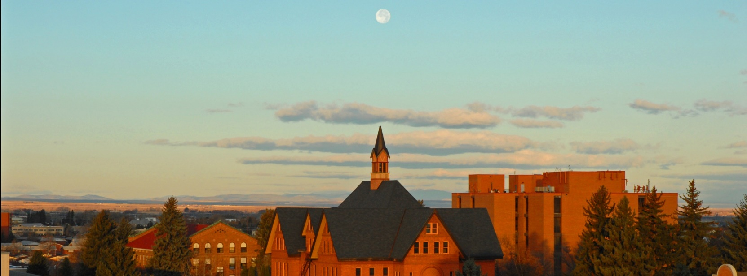

Radiation Effects on Computers
The Story of MSU’s Moon Computer
Dr. Brock J. LaMeres
Professor, Electrical & Computer Engineering

Slide 2
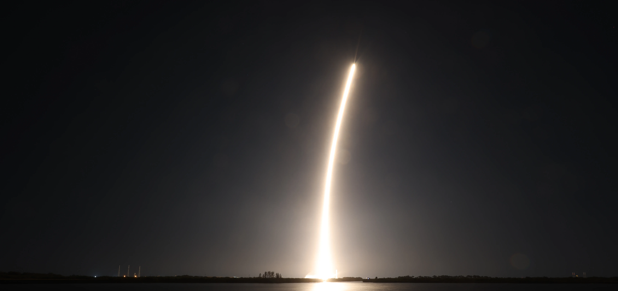
Today’s Talk
My Computer Research
How it Led to Working for NASA
Flight Testing Leading to the Moon
The Moon Mission on BGM1

Slide 3
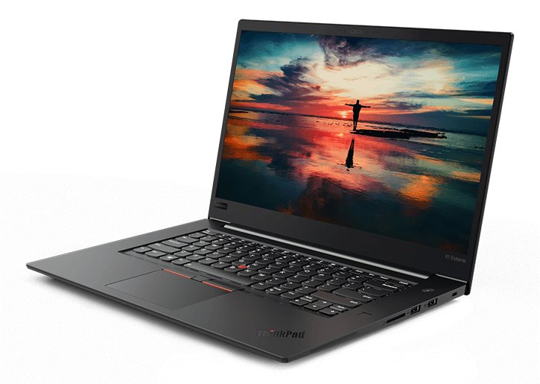
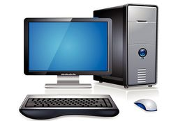
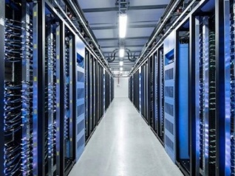
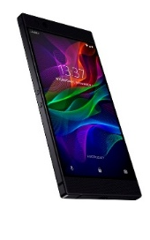
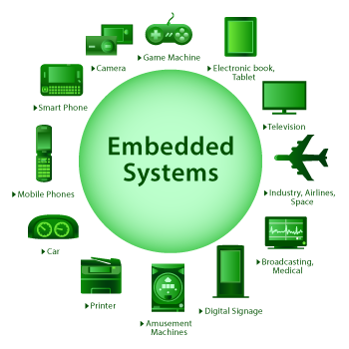
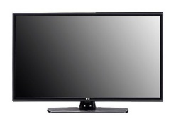
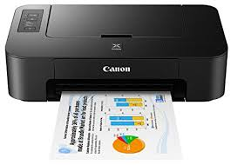
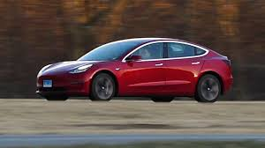
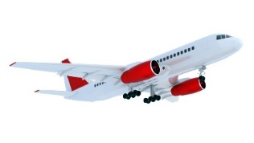
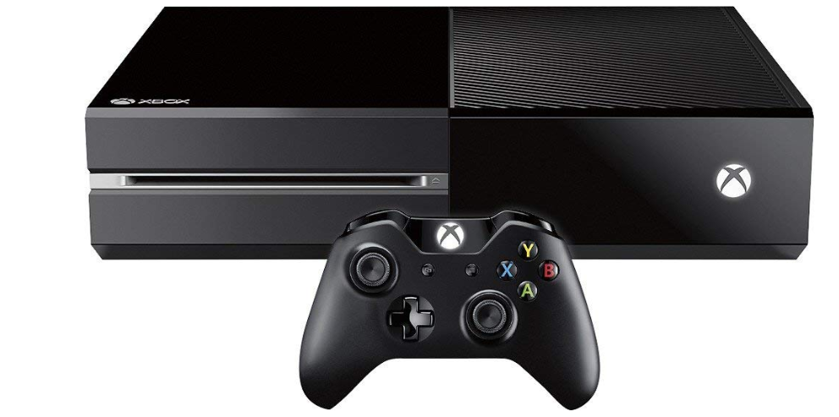
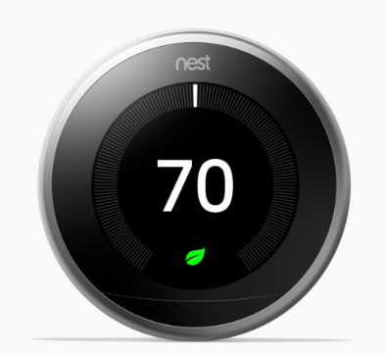
My Computer Research
Can you imagine life without a computer?
  What images do you conjure when someone says “computer”?
  There were ~250M personal computers sold in 2024.
  There were ~1.2B smart phones sold in 2018 (850M Android, 350M iPhone)
But what about these things?
  There were 25B embedded computers sold in 2024.

Slide 4
My Computer Research
Our Existing Computers Work Well. What’s the Problem?

Slide 5
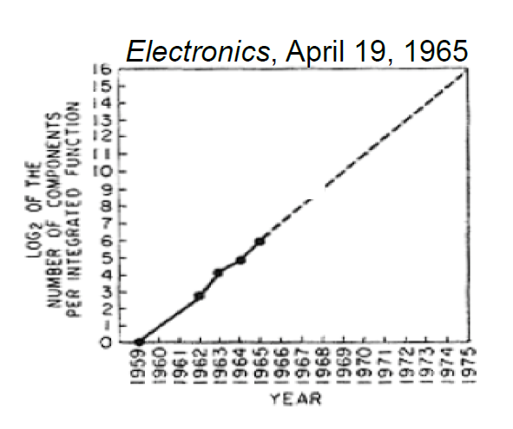
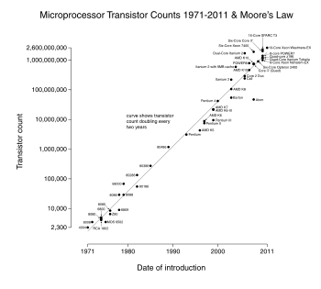
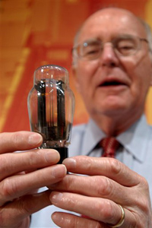
My Computer Research
Our Existing Computers Work Well. What’s the Problem?
  Our existing computers have benefited from 50+ years of Moore’s Law.
  In the 1960’s, Gordon Moore predicted that the number of transistors on a chip would double every ~24 months.
1959 - 1965
1971* - 2011
Gordon Moore, co-founder of Intel, holding a vacuum tube.
Note: First microprocessor introduced in 1971,
the Intel 4004 with 2300 transistors.

Slide 6
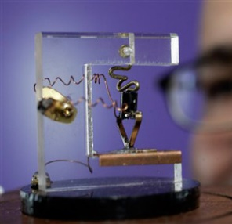
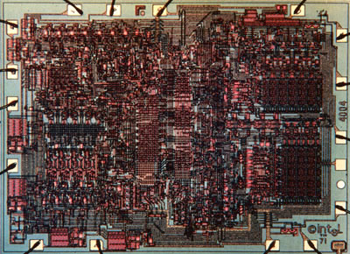
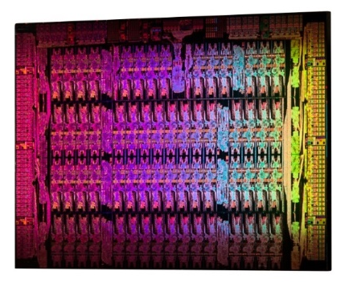
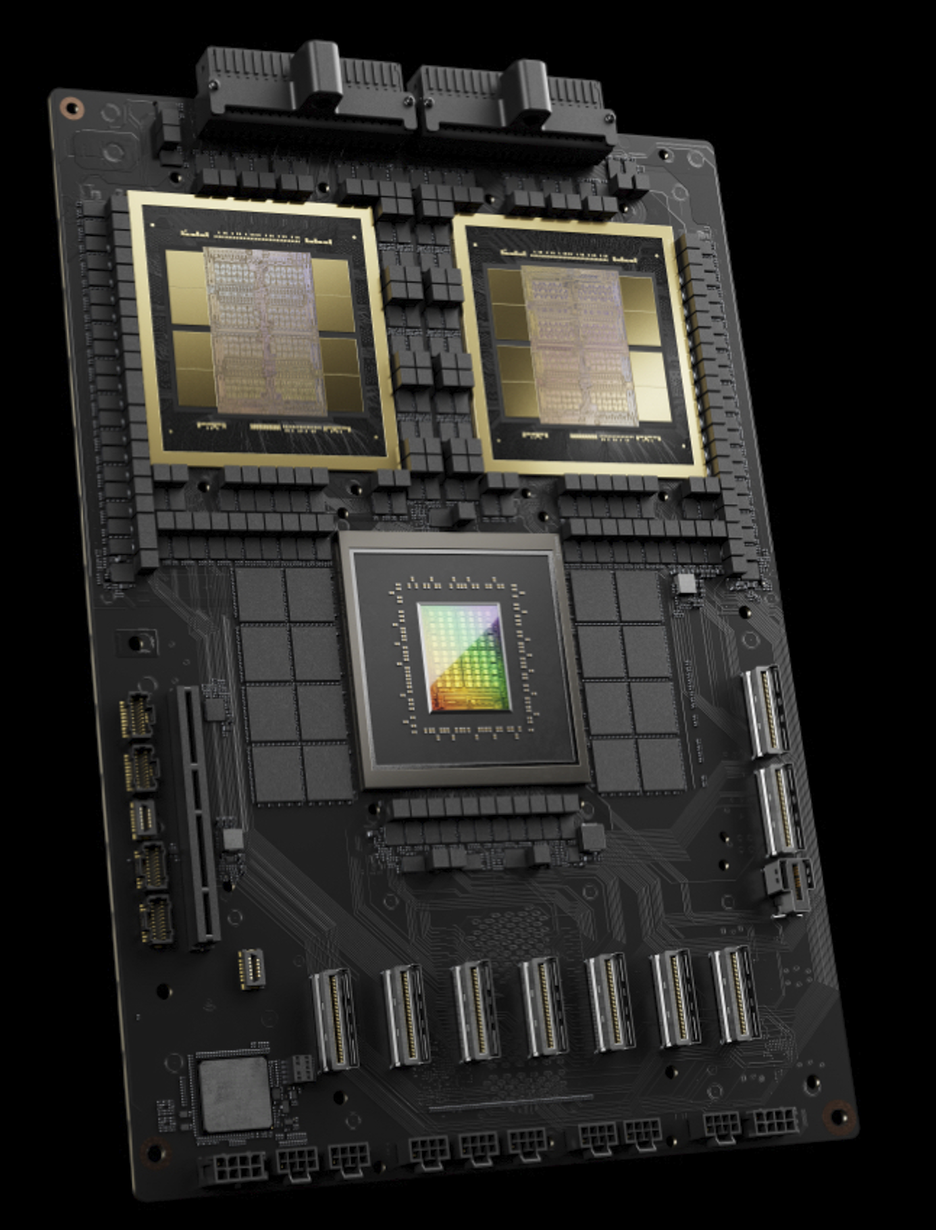
My Computer Research
Why is Moore’s Law so Cool?
  It gives us smaller, faster, and less power.
1947 (1 transistor)
1971 (2300 transistors)
2012 (5B transistors)
2024 (208B transistors)
Replica of the First Transistor
(Source: AP Photo Paul Sakuma)
Intel 4004, 10um
(Source: newsroom.intel.com)
Intel Xeon Phi, 22nm
(Source: newsroom.intel.com)
NVIDIA Blackwell GPU
(Source: invidia.com)

Slide 7
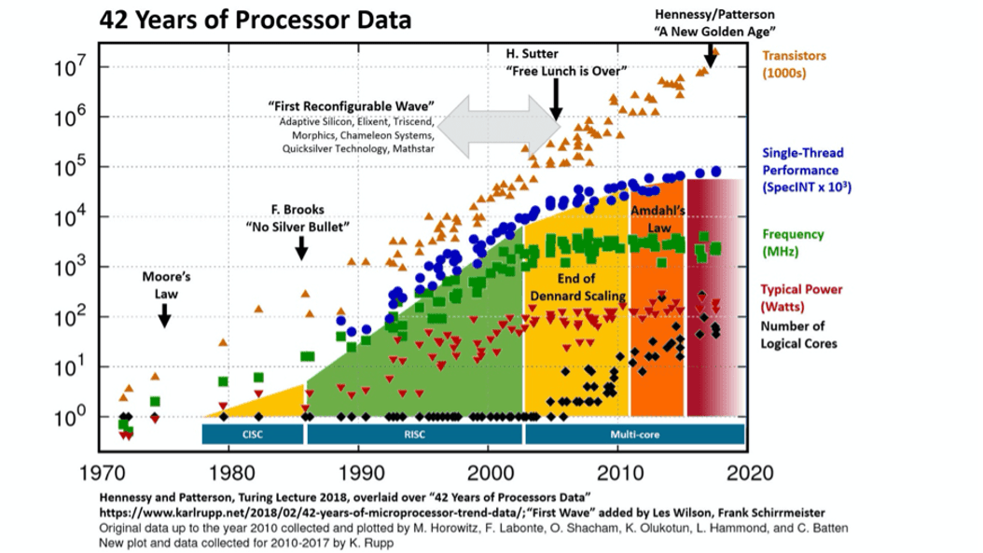
My Computer Research
When Will Moore’s Law End?
  All exponentials do?
Performance
Clock Frequency
Power

Slide 8
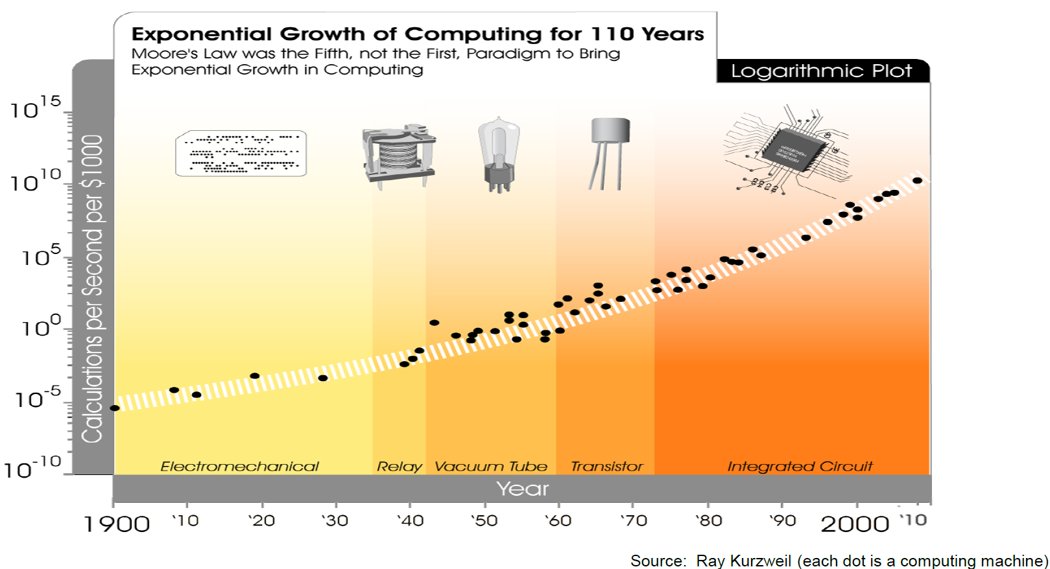

My Computer Research
Moore’s Law Wasn’t the First Exponential, and Won’t be the Last…
You Are Here

Slide 9
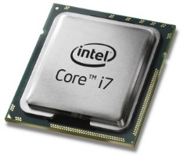
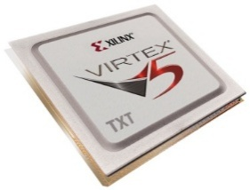
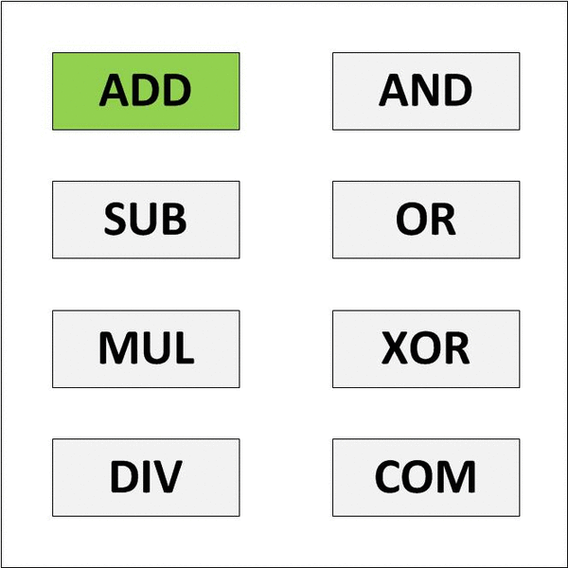

My Computer Research
Today’s Computers are Based on a General-Purpose Processor
  The GP CPU is designed to do many things.
  This is the “Jack of All Trades, Master of None” approach.
General Purpose CPU Model
Reconfigurable Computing Model
This can be faster because the hardware is smaller and consumes less power.

Slide 10
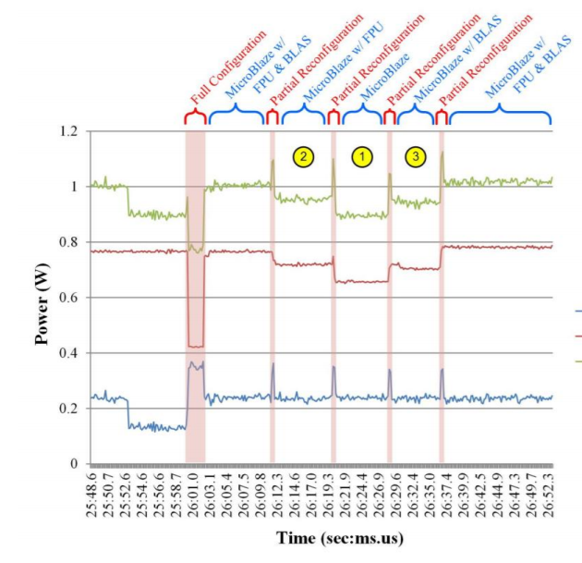
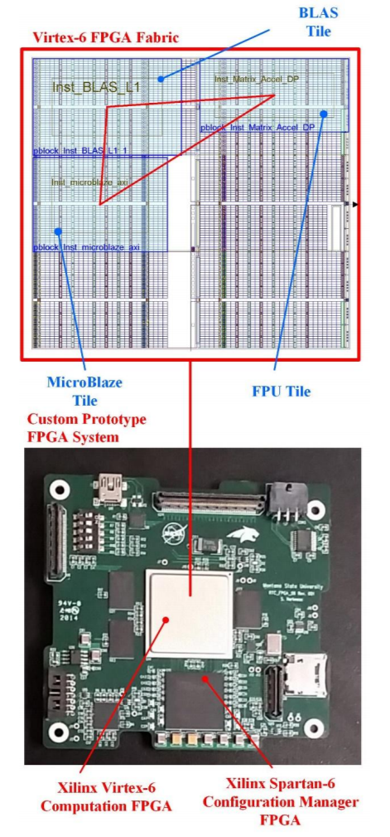
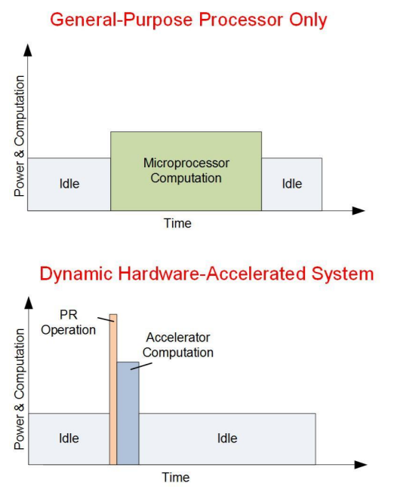
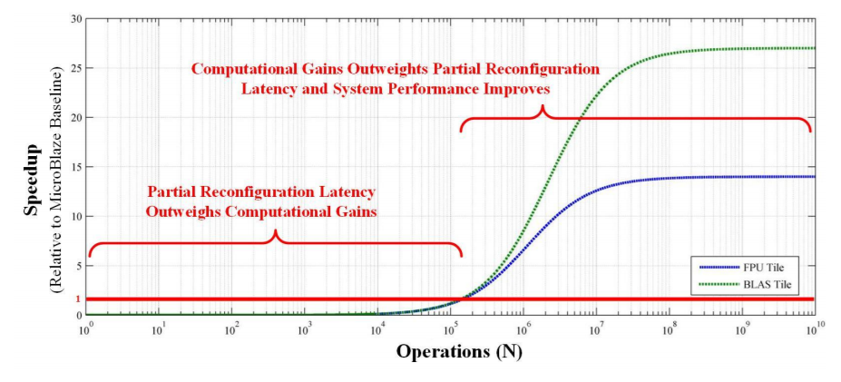
My Computer Research
So off to work…
  We started investigating computational speedup by swapping in HW in real-time.

Slide 11

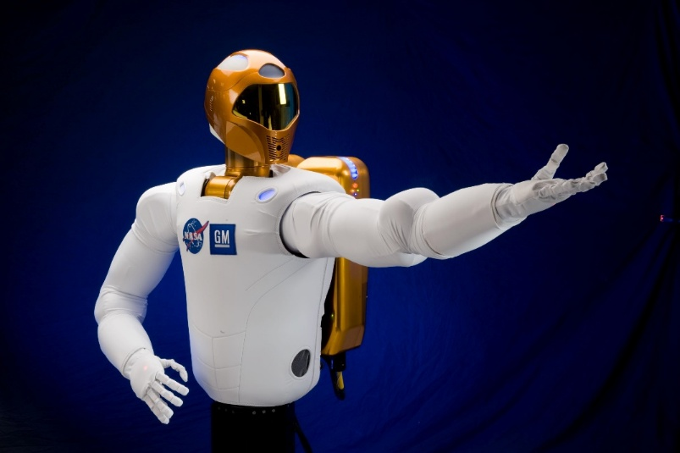
My Computer Research
But then…
Hey, that’s pretty cool. That might help our space computers.

Slide 12
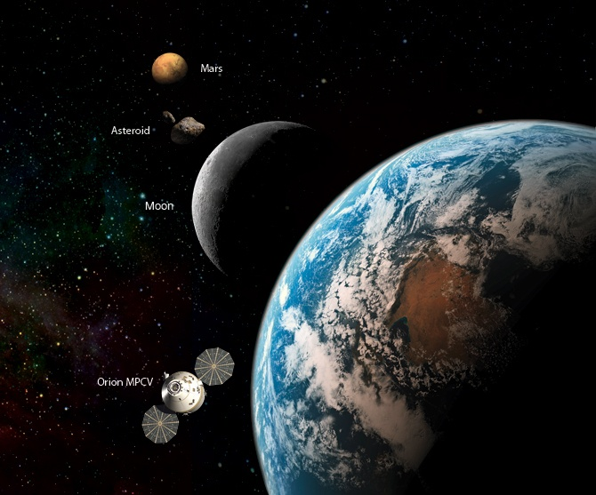
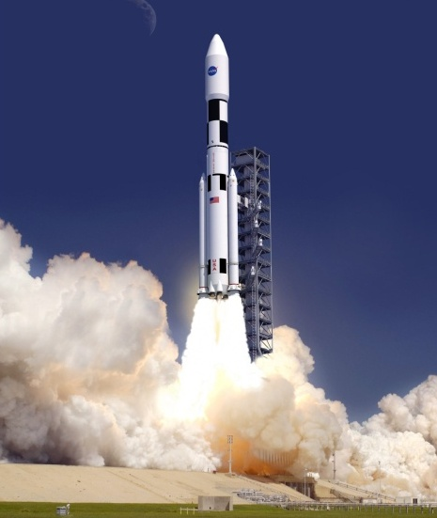

NASA’s Computing Needs
The Promise of Reconfigurable Computing
  What do space Computers need?
  They need to be light. RC reuses hardware, that saves mass.

Slide 13
NASA’s Computing Needs
The Promise of Reconfigurable Computing
  What do space Computers need?
  They need to be light. RC reuses hardware, that saves mass.
  They need to be low power. RC eliminates unnecessary circuitry.

Slide 14
NASA’s Computing Needs
The Promise of Reconfigurable Computing
  What do space Computers need?
  They need to be light. RC reuses hardware, that saves mass.
  They need to be low power. RC eliminates unnecessary circuitry.
  They need to be fast. RC can do that.

Slide 15
NASA’s Computing Needs
The Promise of Reconfigurable Computing
  What do space Computers need?
  They need to be light. RC reuses hardware, that saves mass.
  They need to be low power. RC eliminates unnecessary circuitry.
  They need to be fast. RC can do that.
  They need to operate in the presence of harsh radiation.

Slide 16
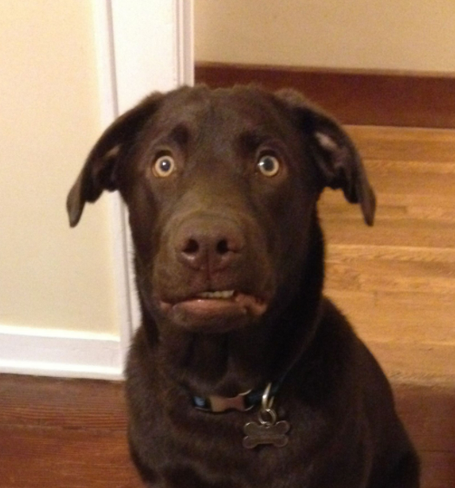
NASA’s Computing Needs
The Promise of Reconfigurable Computing
  What do space Computers need?
  They need to be light. RC reuses hardware, that saves mass.
  They need to be low power. RC eliminates unnecessary circuitry.
  They need to be fast. RC can do that.
  They need to operate in the presence of harsh radiation.
Can you repeat the question???

Slide 17
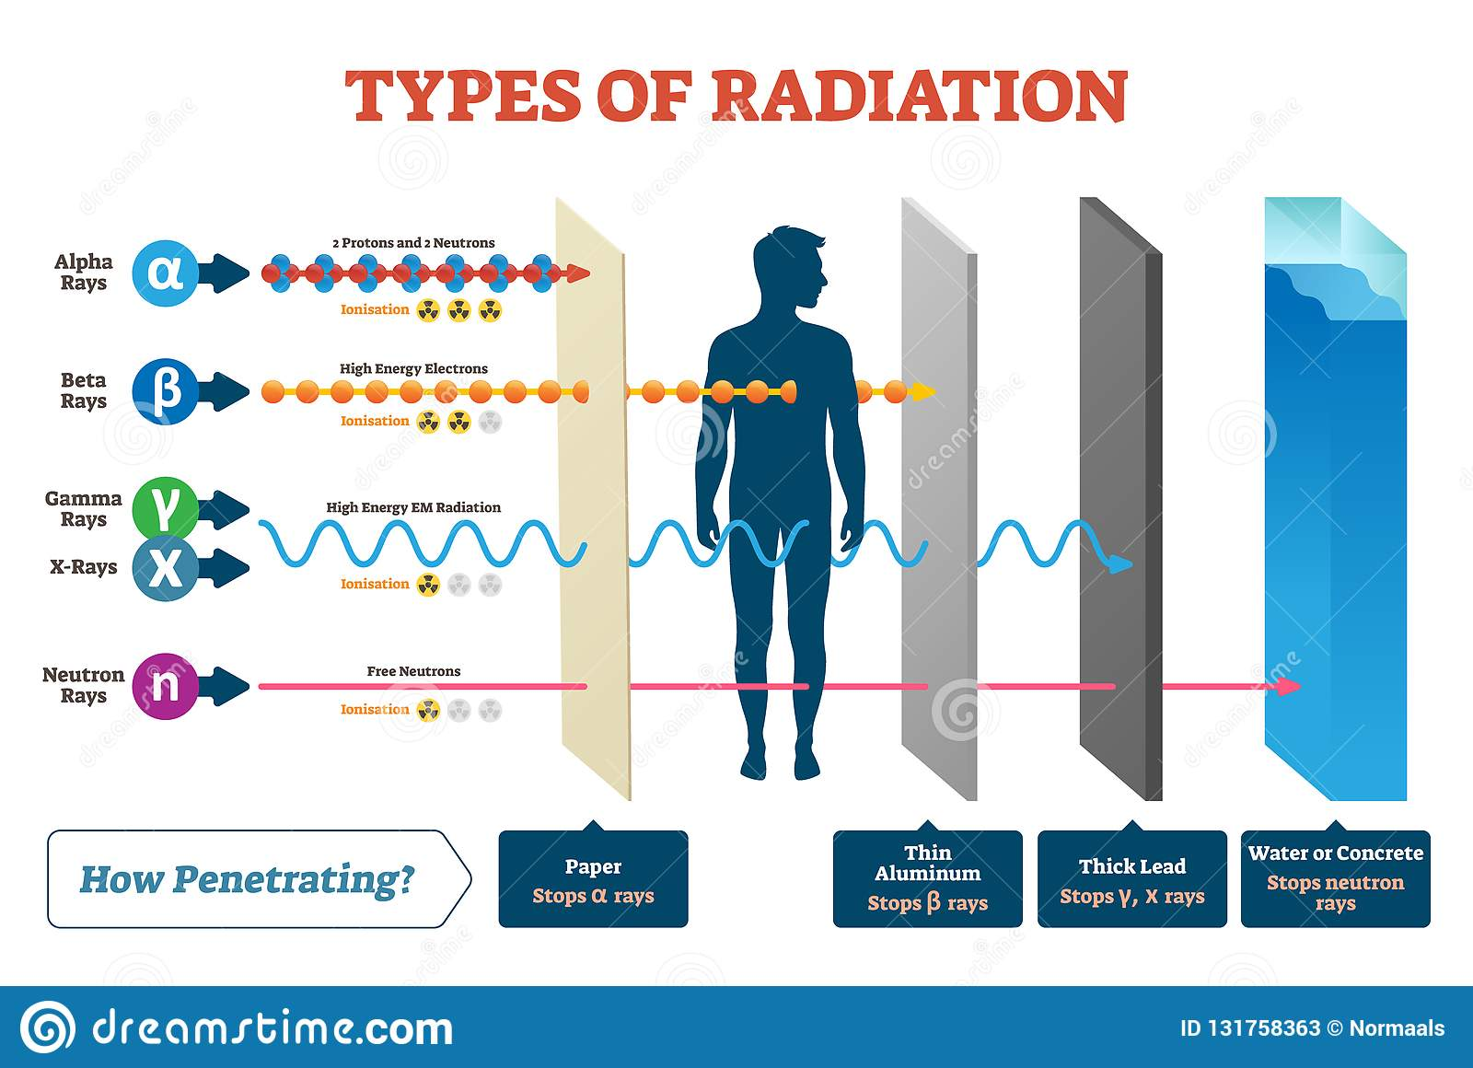
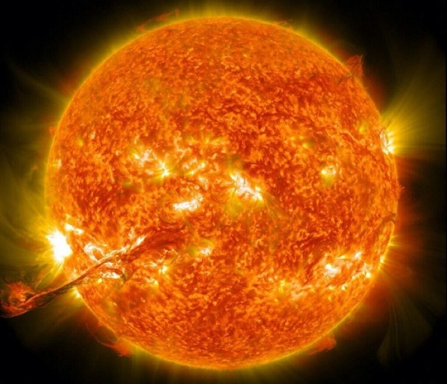
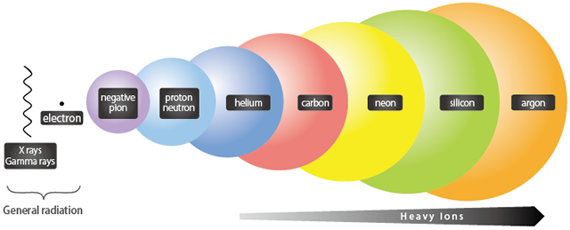
NASA’s Computing Needs
The Space Radiation Environment

Slide 18
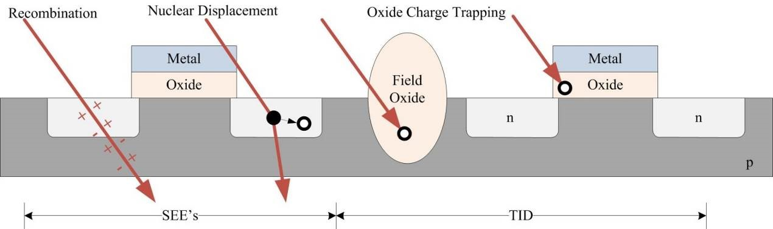
NASA’s Computing Needs
What Does Radiation do to our Computers?
Single Event Effects
Bit flips (1 → 0, 0 → 1).
Erroneous performance.
Full system crashes.
Total Ionizing Dose (TID)
Doping of insulators.
Causes leakage current
Causes transistors to be stuck on/off.

Slide 19
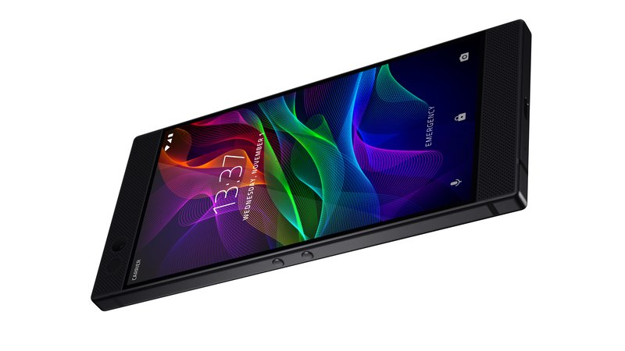
NASA’s Computing Needs
If this radiation is a problem, how do our computers work now?

Slide 20
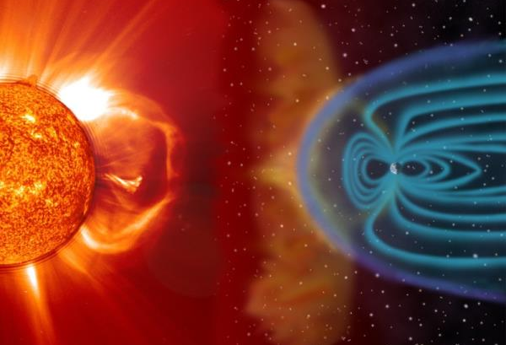

NASA’s Computing Needs
The Earth’s Magnetic Field Deflects Much of the Radiation
You Are Here

Slide 21
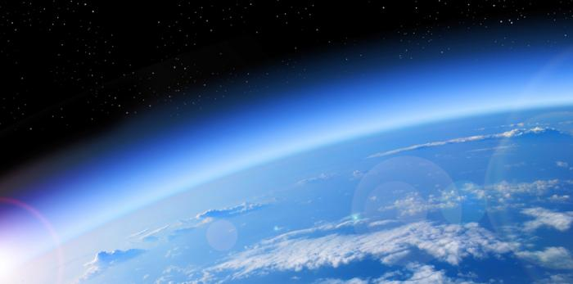
NASA’s Computing Needs
The Atmosphere Attenuates the Rest
You Are Here

Slide 22
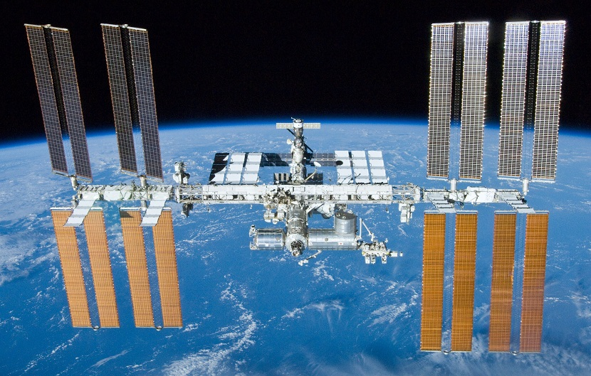
NASA’s Computing Needs
But There are Computers in Space Now?

Slide 23
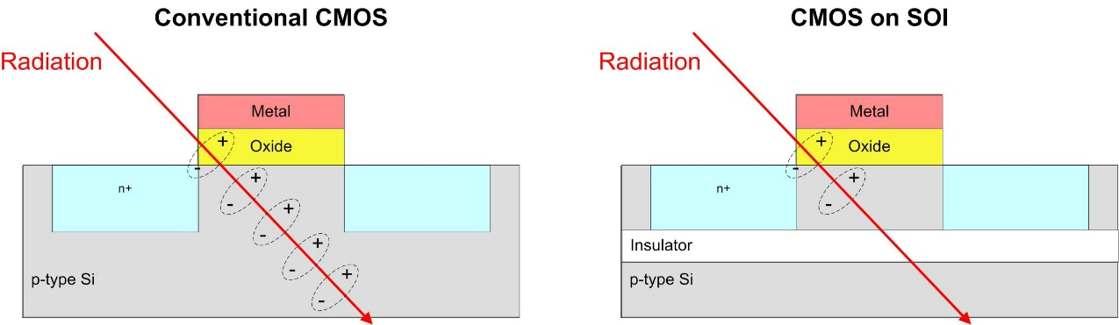
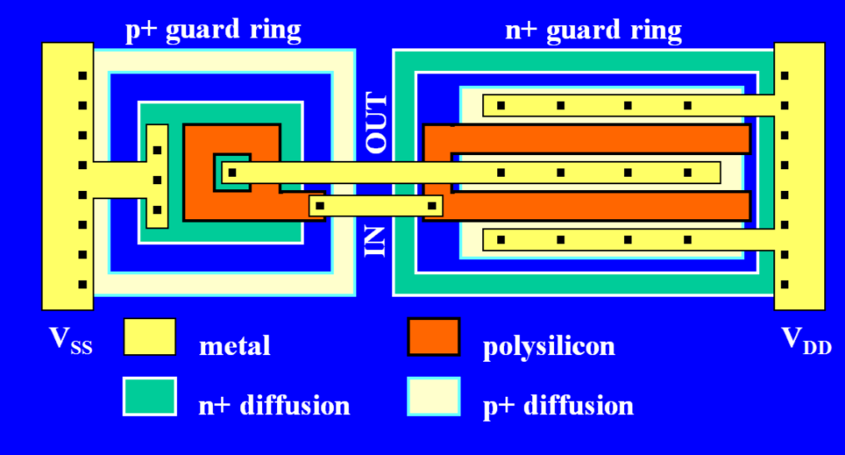
NASA’s Computing Needs
NASA and the Military have Devised “Hardening Techniques”
  The goal: reduce the amount of electrical charge generated when struck by radiation.
Change the Materials
Change the Layout

Slide 24
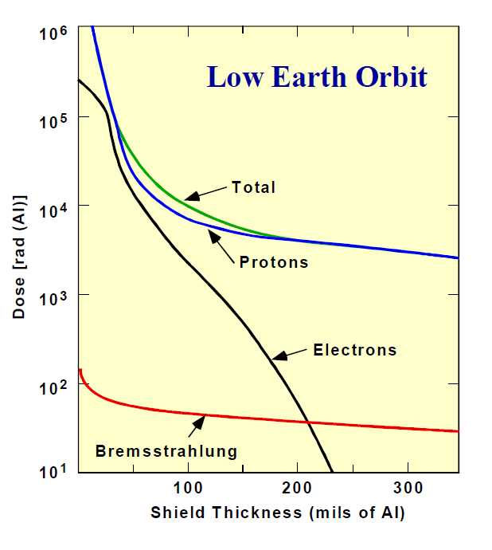

NASA’s Computing Needs
NASA and the Military have Devised “Hardening Techniques”
  The goal: reduce the amount of electrical charge generated when struck by radiation.
  What about just shielding them?
Shield Thickness vs. Dose Rate (LEO)
It is expensive to get mass into space.
It would take a meter of aluminum to stop all radiation energies!
It can sometimes make things worse due to scattering.

Slide 25
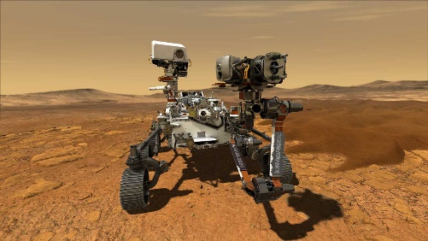

NASA’s Computing Needs
NASA and the Military have Devised “Hardening Techniques”
  But they are expensive and slow.
The State-of-the-Art hardened computer was used on the most advanced space mission ever attempted.
2021

Slide 26
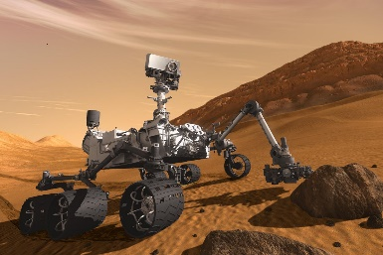
NASA’s Computing Needs
NASA and the Military have Devised “Hardening Techniques”
  But they are expensive and slow.
The State-of-the-Art hardened computer was used on the most advanced space mission ever attempted.
2021
And also used 10 years before that…
2012

Slide 27

NASA’s Computing Needs
NASA and the Military have Devised “Hardening Techniques”
  But they are expensive and slow.
The State-of-the-Art hardened computer was used on the most advanced space mission ever attempted.
2021
And another 10 years before that…
And also used 10 years before that…
2002
2012

Slide 28
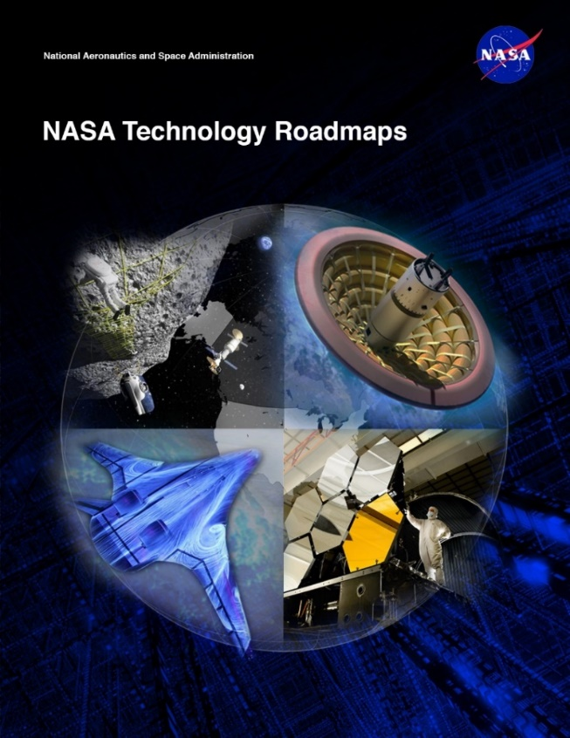
NASA’s Computing Needs
Space Computing Needs
  NASA Technology Area 11 – Flight Computing
    Increased Computation
    Radiation hardened technologies
    Low power requirements
    Cost Feasible
This is the new variable for NASA
So that it the problem statement:
Fast, Low-Power, Cheap, Reliable
Good luck…

Slide 29
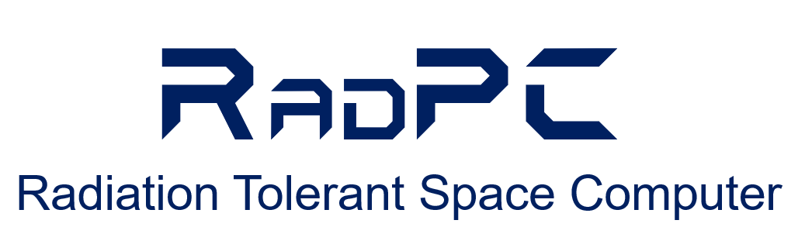
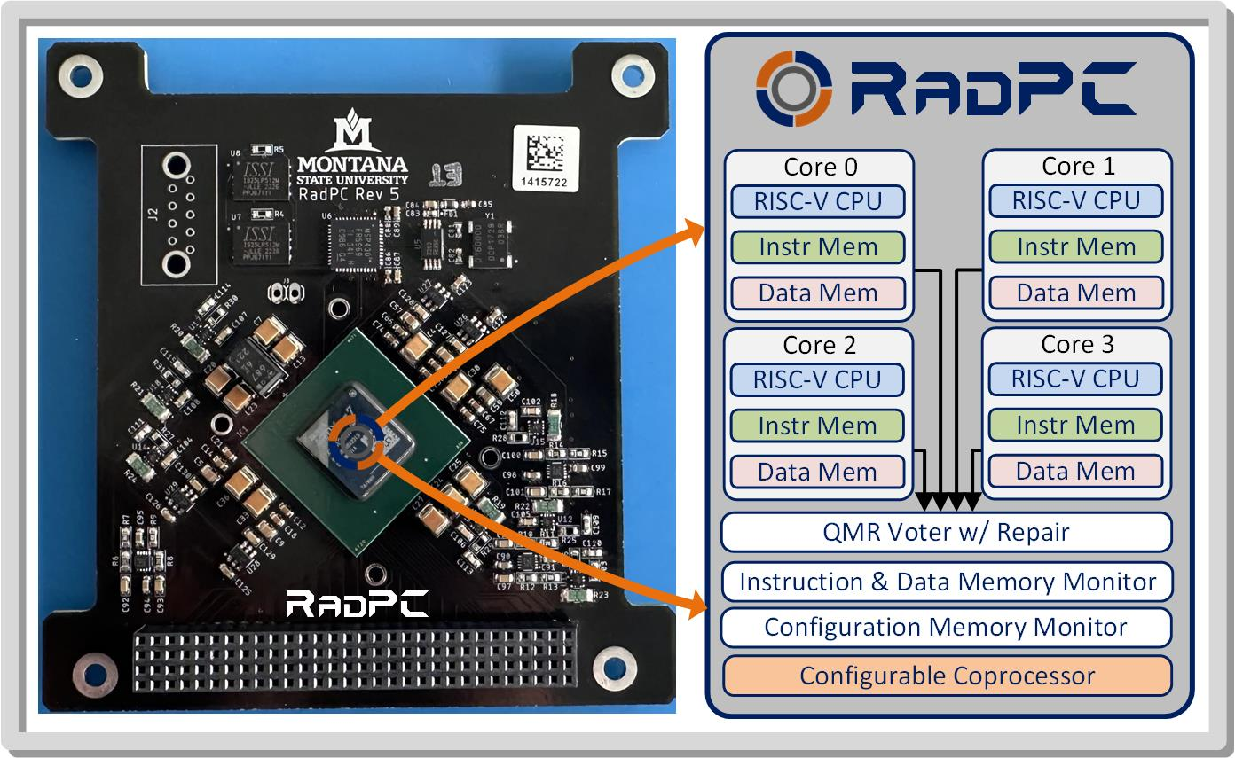
MSU’s Approach - RadPC

Slide 30
MSU’s Approach - RadPC
1. Off-the-Shelf Programmable Part
Gives us lower cost
Gives us higher performance
2. Redundancy
Vote on the outputs.
The majority is the right answer.
3. “Scrub” Memory Errors
Compare values and auto-fix
4. “Fix” Errors in the Background
Reprogram the damaged region.
Kind of like “Reconfigurable Computing”.

Slide 31

MSU’s Approach - RadPC
1. Off-the-Shelf Programmable Part
Gives us lower cost
Gives us higher performance
2. Redundancy
Vote on the outputs.
The majority is the right answer.
3. “Scrub” Memory Errors
Compare values and auto-fix
4. “Fix” Errors in the Background
Reprogram the damaged region.
Kind of like “Reconfigurable Computing”.
It sounds like you are only dealing with SEEs?

Slide 32
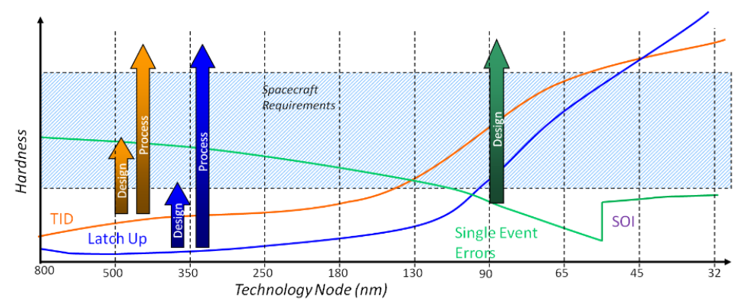
MSU’s Approach - RadPC
As transistors get smaller, the probability of charge getting trapped in the insulators goes down.
Courtesy of the Boeing Company

Slide 33






MSU’s Approach - RadPC
Simulate it and see if it is better.
  So, we did.
ISS
HEO
HRBE
GEO
And it looked promising.

Slide 34


MSU’s Approach - RadPC
Technical Readiness Level (TRL)
  If you want to fly on a NASA mission, you need to prove it works.

Slide 35




MSU’s Approach - RadPC
Step 1 – Build a Prototype to See if it is Possible
  The Montana Space Grant Consortium funds an investigation into conducting radiation tolerant computing research at MSU. The goal is to understand the problem, propose a solution, and build relationships with scientists at NASA.
Clint Gauer (MSEE from MSU 2009) demo’s computer to MSFC Chief of Technology Andrew Keys
Timeline of Activity at MSU
Proof of Concept
(2008-2010)
2008
2009
2010
2011
2012
2013
2014-16
2016
2017-20

Slide 36






MSU’s Approach - RadPC
Step 2 –Test in a Cyclotron
  NASA funds the development of a more functional prototype and testing
  under bombardment by radiation at the Texas A&M Radiation Effects Facility.
MSU Computer
Ray Weber (Ph.D., EE from MSU, 2014) prepares experiment.
Timeline of Activity at MSU
Proof of Concept
Prototype Development & Cyclotron Testing
(2008-2010)
(2010-2012)
2008
2009
2010
2011
2012
2013
2014-16
2016
2017-20

Slide 37







MSU’s Approach - RadPC
Step 3 – Demonstrate as Flight Hardware on High Altitude Balloons
  NASA funds the development of the computer into flight hardware for demonstration on high altitude balloon systems, both in Montana and at NASA.
MSU
Computer
Timeline of Activity at MSU
Justin Hogan (Ph.D., EE from MSU, 2014) prepares payload.
Proof of Concept
Prototype Development & Cyclotron Testing
High Altitude Balloon Demos
(2008-2010)
(2010-2012)
(2011-2013)
2008
2009
2010
2011
2012
2013
2014-16
2016
2017-20

Slide 38






MSU’s Approach - RadPC
Step 4 – Demonstrate as Flight Hardware on a Research Rockets
  NASA fund the demonstration of the computer system on sounding rocket.
  Flew on two rockets (2014 and 2016)
MSU
Computer
Timeline of Activity at MSU
Proof of Concept
Prototype Development & Cyclotron Testing
High Altitude Balloon Demos
Sounding
Rocket Demo
(2008-2010)
(2010-2012)
(2011-2013)
(2012-2016)
2008
2009
2010
2011
2012
2013
2014-16
2016
2017-20

Slide 39

MSU’s Approach - RadPC
Step 5 – Demonstrate on the International Space Station
  NASA funds the demonstration of RadPC on ISS

Slide 40




MSU’s Approach - RadPC
Step 6 – Demonstrate as a Stand-Alone Satellite
  NASA funds the development of satellites to carry RadPC.
Timeline of Activity at MSU
Proof of Concept
Prototype Development & Cyclotron Testing
High Altitude Balloon Demos
Sounding
Rocket Demo
ISS
Demo
Satellite
Demo
(2008-2010)
(2010-2012)
(2011-2013)
(2012-2016)
(2014-2016)
(2015-2020)
2008
2009
2010
2011
2012
2013
2014-16
2016
2017-20

Slide 41


MSU’s Approach - RadPC
RadSat-g
Brock & Skylar Tamke (MSEE 2019) at Integration
Houston, TX. 2018.

Slide 42


MSU’s Approach - RadPC
RadSat-g
Orbital ATK OA9 ISS Resupply Mission.
NASA Wallops Flight Facility, 5/22/18.
Brock & Skylar Tamke (MSEE 2000) at Launch.

Slide 43




MSU’s Approach - RadPC
RadSat Mission Concept
Students Build It
Launch it to the International Space Station
Push into orbit
Operate from Ground Station at MSU

Slide 44

MSU’s Approach - RadPC
In case you
didn’t see
that…

Slide 45

MSU’s Approach - RadPC
In case you
didn’t see
that…

Slide 46

MSU’s Approach - RadPC
In case you
didn’t see
that…

Slide 47

MSU’s Approach - RadPC

Slide 48


MSU’s Approach - RadPC
RadSat-u
Chris Major (MSEE 2000) at Integration
Houston, TX. 2018.

Slide 49


MSU’s Approach - RadPC
RadSat-u
Chris Major (MSEE 2000), Brock, & Colter Barney (BSCpE 2021) at Launch.
Northrop Grumman NG-12 ISS Resupply Mission.
NASA Wallops Flight Facility, 11/2/19.

Slide 50

MSU’s Approach - RadPC
RadSat-u

Slide 51




MSU’s Approach - RadPC
RadSat Mission Concept
Students Build It
Launch it to the International Space Station
Put into Orbit using NanoRacks CubeSat Deployer
Operate from Ground Station at MSU

Slide 52

MSU’s Approach - RadPC
In case you
didn’t see
that…

Slide 53

MSU’s Approach - RadPC
In case you
didn’t see
that…

Slide 54

MSU’s Approach - RadPC
In case you
didn’t see
that…

Slide 55
MSU’s Approach - RadPC
Now What?

Slide 56


MSU’s Approach - RadPC
Now What?

Slide 57
MSU’s Approach - RadPC
Nice!

Slide 58

Bobcats on the Moon
Lunar Exploration in the Next 10 Years

Slide 59

Bobcats on the Moon
Lunar Exploration in the Next 10 Years
RadPC is here.

Slide 60



Bobcats on the Moon
What does MSU’s Moon Mission Look Like?
RadPC

Slide 61

Bobcats on the Moon
What does MSU’s Moon Mission Look Like?

Slide 62

Bobcats on the Moon
What does MSU’s Moon Mission Look Like?

Slide 63

Bobcats on the Moon
What does MSU’s Moon Mission Look Like?

Slide 64


Bobcats on the Moon
Landing Site:
Mare Crisium
“the sea of crisis”

Slide 65


Bobcats on the Moon
Are you coming back? Nope…
Mare Crisium
“the sea of crisis”
Visible from Earth with the Naked Eye
Bobcats on the Moon for the next 1000 years!

Slide 66


Bobcats on the Moon
We Decided to Send Messages to the Moon

Slide 67





Bobcats on the Moon
We Decided to Send Messages to the Moon
  1000 inspirational messages (well, mostly…) & 700+ pictures.
  Tributes from MSU departments, colleges, & President Cruzado.
  Videos from the Governor, our two US Senators,
  and our US Representative.
  Every Edition of the MSU Student News Paper the
  Exponent (since 1895!)
MSU President Waded Cruzado

Slide 68
Bobcats on the Moon
Current Status

Slide 69

Bobcats on the Moon
Current Status – Mission Accomplished!!!

Slide 70





Bobcats on the Moon
Launch was January 15, 2025 from KSC

Slide 71



Bobcats on the Moon
RadPC Operated enroute
RadPC Powered on first 6 hours after launch.

Slide 72

Bobcats on the Moon
45 days of transit + 14 days on the surface
RadPC Powered on first 6 hours after launch.

Slide 73

Bobcats on the Moon
How we get there.
Three passes through Van Allen Radiation Belts

Slide 74

Bobcats on the Moon
What kind of data do we get?
Most Radiation Observed is in Earth’s Own Belts

Slide 75

Bobcats on the Moon
What kind of data do we get?
Most Radiation Observed is in Earth’s Own Belts

Slide 76

Bobcats on the Moon
What kind of data do we get?
Most Radiation Observed is in Earth’s Own Belts
And RadPC operated 100% without a failure!

Slide 77
Bobcats on the Moon
Now What?

Slide 78






What’s Next
Commercialization
Now What?

Slide 79

Bobcats on the Moon
How was all this done in Montana?

Slide 80










Bobcats on the Moon
Everything was Designed & Built By MSU Students (~150)
Todd Buerkle, Justin Hogan, Ray Weber at Johnson Space Center for demo, 2012.
Todd Buerkle & Jennifer Hane demo computer at Marshall Space Flight Center, 2012.
Justin Hogan at the NASA Columbia Scientific Balloon Facility, 2012.
Clint Gauer at Marshall Space Flight Center for demo, 2009.
Clint Gauer demo’s computer at Marshall Space Flight Center, 2009.
Kaysha Young prepares payload for balloon flight, 2012.
2011 balloon team featured in MSU news story, 2011.
Todd Buerkle, Jennifer Hane at the Marshall Space Flight Center, 2011.
2013 balloon team recovers payload in front of moose, 2013.
Justin Hogan & Ray Weber featured in MSU News Story, 2012.

Slide 81






Thank You & Any Questions?
MSU Computer
MSU Computer
MSU Computer
MSU Computer
MSU Computer
Go Cats!
Go RadPC!

Slide 82
Backup Slides
Cool pictures of rockets…

Slide 83

Bobcats on the Moon
Let’s step back and see and look at the Space Exploration Roadmap

Slide 84


Bobcats on the Moon
Let’s Talk Moon Rockets – NASA’s Artemis

Slide 85

Bobcats on the Moon
Let’s Talk Moon Rockets – NASA’s Artemis

Slide 86

Bobcats on the Moon
Let’s Talk Moon Rockets – NASA’s Artemis

Slide 87


Bobcats on the Moon
Let’s Talk Moon Rockets – NASA’s Artemis
The Orion capsule is a little cramped. But it is only for a 3-day trip.
This is only for Lunar and low Earth Orbit.
Gateway will be a BIG DEAL, but it isn’t used in Artemis III

Slide 88


Bobcats on the Moon
Let’s Talk Moon Rockets - Starship

Slide 89




Bobcats on the Moon
Let’s Talk Moon Rockets - Starship
A Different Approach
Roomy
Reusable
Refuel it over and over
IN SPACE!!!.

Slide 90

Bobcats on the Moon
Let’s Talk Moon Rockets - Starship
That’s because it is being designed for Mars!

