Slide 1
Types of beef cattle operations

Slide 2
Important Terms to Remember
Backgrounder
Background – stocker
commercial
Cow-calf operation
Creep feeding
Culling
Custom Feedlot
Feedlot
Seedstock Breeders
Stocker

Slide 3
What are the types of beef production systems?
There are many ways to organize and classify beef-production systems that are used in the US
Most commonly used systems are the following: cow-calf, background-stocker, and feedlots.

Slide 4
Cow-Calf operation
Consists of keeping mature cattle to produce calves to sell to other producers
Cows are bred in this setup to have a calf every year, usually in late winter or early spring.
Most beef calves are born on a cow-calf operation located primarily in the Plains, the Corn Belt, and the Southeast
At this stage of beef cattle, the cows and calves graze in herds on large pastures.
Creep Feeding is used to allow the calf to gain more weight while nursing
Calves are weaned at 6 to 10 months of age and then are moved to the next phase.
This type of operation is mainly family owned and operated.

Slide 5
Classifications of cow-calf operations
Two different general classifications of cow-calf operations exist
The Commercial Cow-Calf Producer- raises most of the potential harvest steers and heifers
The Seedstock Breeders – these producers keep herds for purebred breeding stock and provide replacement bulls and semen for cow-calf operations
Their stock provides genetic improvements to the herds

Slide 6
Commercial cow-calf producers utilize crossbred and a few purebred cows
These producers rely on seedstock breeders for replacement heifers and bulls
The focus of seedstock breeders is to provide genetic improvements for other cattle breeders
The initial start-up cost for a seedstock breeder are high because genetically superior animals are more expensive than average animals
Another large investment is the time to develop high-quality animals
These operations need a knowledgeable manager to run them proficiently

Slide 7
Cow-calf profitability
Several factors can affect a cow-calf operation profitability
Costs include: feed, vet bills, medicine, bedding, marketing, embryo transfer and AI
Ownership expenses include: annual cost of maintaining the capital investment in cow-calf facilities/equipment and the cost of property taxes and insurance
Other factors that affect profitability are the overall production costs and feeder cattle prices

Slide 8
Question
What are the components of a cow-calf operation?
Take a few minutes to look back at notes (if you took a few), google or ask your friends. Now use your Cornell note taking sheet and be prepared for an in-class discussion!

Slide 9
Background-stocker
Operations are used to grow feeder cattle
Some calves are too small/light or feedlots are full
As a result, the calves need to be grown before entering the feed yard
A stocker operation utilizes a grazing program
Many grass types are used: warm to cool season grasses to wheat pasture or other cereal grain forages.
A backgrounder will usually grow their calves in a dry lot and feed them high roughage rations
The objective of the backgrounding operation is to grow cattle by adding frame without fattening the animals
Normal average daily gains will be less than 2.5 pounds per day
A cow-calf operation, background-stocker operations are typically family-owned ranches and farms.
Normally cattle are moved onto the feedlot operation at about 12-18 months of age.

Slide 10
Background-stocker profitability
The factors that affect background operations are the sickness or health of the cattle, grain costs, death losses, market prices, prices slides(changes), weather, government, imports/exports, hay costs, price of calves and price of feeders

Slide 11
Feedlot operations (finishing operations)
Feedlot operations are used to complete the final phase of the beef-production system.
Cattle are fed in fenced areas where harvested grains/feed are delivered to them, but others are sent to pasture
Feedlots look different than the first two beef operations described.
Once cattle arrive, they are separated into herds of 100 and are housed in pens
Cattle typically send about 4-6 months in a feedlot
Cattle are fed a ration that is 70-90% grain
Cattle are fed to harvest weight – approximately 1,100 to 1,300 pounds
Feedlot operations can be owned by an individual or a partnership
More commonly, a corporation owns the feedlot operation, especially as the feedlot size increases

Slide 12
Finishing operations are used to complete the final phase of the beef-production system
These operations feed beef animals out for the market
Owners usually buy yearlings or feeder calves and try to finish them in as little time are possible
Other operations act as a custom feedlot which is an operation that provides the technology, skills and services, facilities, and location to a producer who wants cattle fed to a market weight
Many producers want to retain the ownership of their cattle through harvesting or have a desire to feed out purchased cattle; these producers use a custom feedlot operation

Slide 13
Several environmental factors are monitored and managed daily at feedlot operations
In a large feedlot operation, water quality, air quality, and land utilization are the top environmental concerns
The producer is responsible for protecting the environment
Many large feedlots work with environmental engineers to ensure proper operation and to follow the strict EPA regulations
Other components of a finishing operation include a full-feed program with high-concentrate rations, feedbunks, feed storage and handling, processing and loading facilities an office and cattle

Slide 14
Feedlot operation profitability
A factor affecting the finishing-operation profitability is the initial investment, is high because of the need for high-quality feed in addition to housing and equipment
The production lag is less than in a cow-calf operation because animals are turned generally in four to six months
In addition to higher feed costs, other factors affecting the finishing-operation profitability are housing, vet bills, equipment expenses, labor, and trucking costs.
With the expenses and the need for quick turnover time, it is essential to be a good manager in a cattle-feeder operation
Fluctuating market prices present a risk

Slide 15
Question
What are the types of beef-production systems and what are a few factors that affect profitability?
Take a few minutes to look back at notes (if you took a few), google or ask your friends. Now use your Cornell note taking sheet and be prepared for an in-class discussion!

Slide 16
Selecting Beef animals for cow-calf operations
Selecting beef animals for the right operation is one of the initial components of each beef system
Producers look for specific qualities, breeds, and size when making these decisions
A Cow-Calf producer will evaluate breeding heifers based on structural correctness, volume and capacity, balance and femininity, condition and udder development, muscle and EPDs
Expected Progeny Differences: estimates the genetic values that an animal expresses as well as the potential of passing genetic values to offspring
A producer will evaluate bulls on structural correctness, muscle, balance, capacity and condition, testicular size and masculinity, and EPDs.
Producers also look for breed cows to enter the operation with a guarantee that the cow is bred
Many Seedstock Cow-Calf producers focus on one specific breed
Other Cow-Calf producers introduce one or two other breeds for commercial markets.

Slide 17
Another practice used in Cow-Calf systems is Culling, which is the practice of removing animals in poor condition or animals that do not express the desirable characteristics of the herd.
Producers consider culling if heifers do not breed back after the first calf
Other considerations include a poor condition for breeding, age, overall health, the ability to raise a calf, temperament, and even open cows with superior genetics – no advantage if they are not producing calves.
These practices improve the overall performance of the herd by replacing poorly producing animals with young cows that have potential
Culling practices and good decisions help the operation remain profitable.

Slide 18
Selecting Beef animals for Background operations
A backgrounding system will select animals if they do not fit into a feedlot placement
An animal may not fit into a feedlot placement for several reasons
For example, an animal that is too small or too light would be considered for a backgrounding system
Other factors considered include compromised immune systems, age, breed, or animals from non-uniform herds.
Backgrounding operations will match cattle that are similar in type and kind
These cattle are moved into a feedlot once standards are met
If backgrounding operations are performed correctly, cattle that have experienced a backgrounding program will perform exceptionally well in a feedlot

Slide 19
Selecting Beef animals for Feedlot operations
Feedlot operations have two main criteria to consider when selecting animals
Money on gain is the first criteria
These operations seek large frame animals that can gain weight
Money on the grid is the second criteria
These operations select animals with known genetics that will provide specific meat qualities for the final product
Other considerations include the health of the animal and the backgrounding or preconditioned program from which the animal came
Feedlot operators evaluate feeder cattle based on phenotypic priorities, such as muscle condition (fatness vs. trimness), capacity and frame size, and structural correctness
They will also evaluate based on performance traits, such as weight per day of age and feed efficiency

Slide 20
Calm temperament is the final consideration
Cattle with a calm temperament have higher average daily gains that cattle with highly strung temperaments.
Certain beef breeds express calmer temperaments than others.
Beefmaster, Galloway, Hereford, Maine Anjou, Simmental
Feedlot animals are bought at weaning – at an auction or private treaty
Some feedlots will work solely with background operations to guarantee a uniform stock
Producers using custom feedlots have the opportunity to select and compare the feedlots

Slide 21
New terms to consider
Phenotypic traits are observable traits such as height, weight, hair color, blood type, presence of horns or not.
Phenotypic
Performance Characteristics
Feed Efficiency
Weight Per Day of Age
Characteristics that we look at to see how well an animal has or will do sure as growth rate, carcass merit, structural soundness, maternal ability
A measure to determine the relative ability of cows to turn feed nutrients into fat, muscle, milk or milk components
Is a snapshot evaluation of an animal’s growth rate at a fixed point in time
Take the next few minutes to research what these new terms mean! Be prepared to report back to the class.

Slide 22
Cattle evaluation, in general, should consider the main physical points (neck, shoulder, brisket, back, loin, rump, round, pin and hip bones, hocks and pastern); muscle characteristics of the loin, forearm, stifle, and width of base, fat condition present on the trailhead, ribs, flank; volume and capacity, volume and capacity, length, rib shape, depth of body, structural correctness with desirable slope to shoulder and pasterns; all four legs set in at the corners; toes pointed forward; hocks are square and not bowed in or out; stride is long and smooth; and the front track should be filled by the back track

Slide 23
Question
How do producers' selection beef animals for a Cow-Calf, Backgrounding and finishing operation?
Take a few minutes to look back at notes (if you took a few), google or ask your friends. Now use your Cornell note taking sheet and be prepared for an in-class discussion!

Slide 24
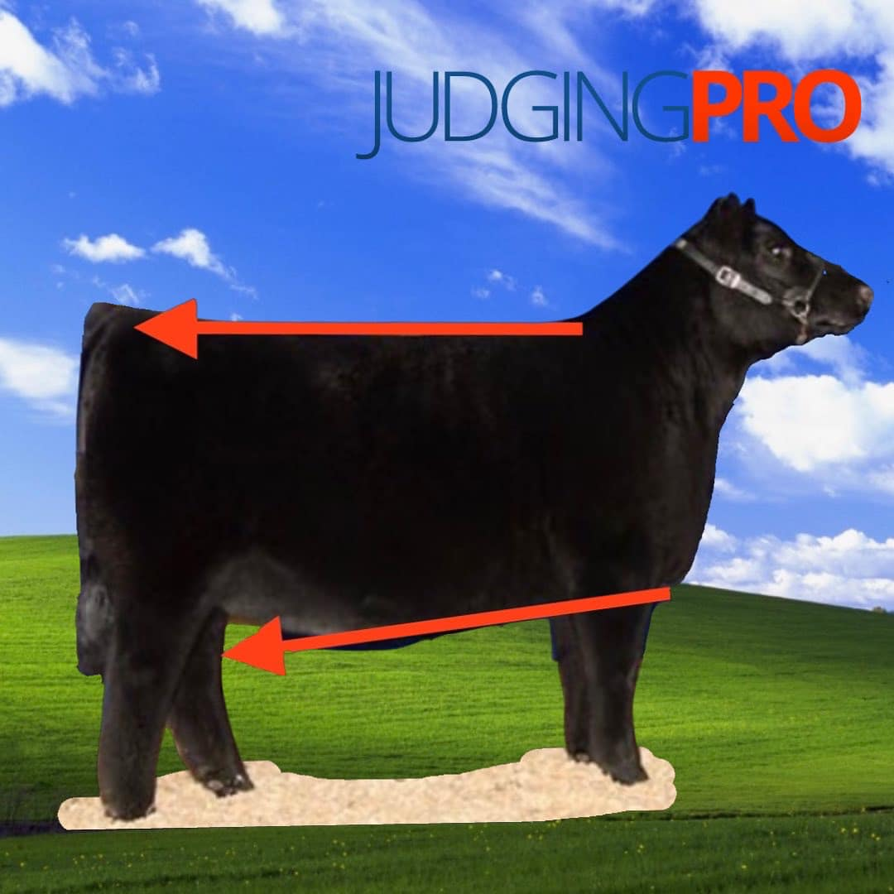
Maternal Wedge
“Maternal Wedge” sometimes called “feminine wedge”. When viewed from the side we want that female to be elevated or “shallow” in their chest floor, and then get progressively deeper and more maternal in their underline as we move to their navel and on to their flank. All while still having a strong, level top line. This creates the “wedge” or maternal triangle view.

Slide 25
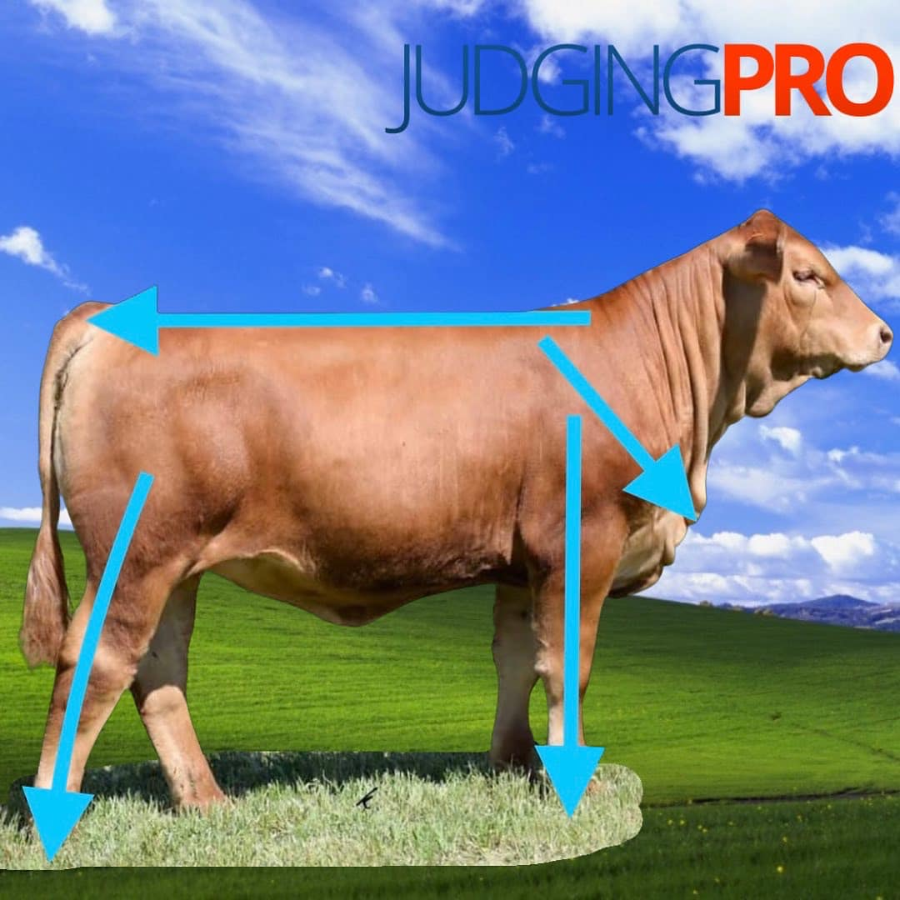
Build
Really this goes hand in hand with skeletal correctness. It has a lot to do with feet and legs, and how an animal moves, but we think there is more to the story. It’s also how that animal puts their skeleton together up high. Blade angle, hip angle, how their spine migrates between those two points all relate to build. It is hard for an animal to have “look” or “quality” without the correct skeletal “build”

Slide 26
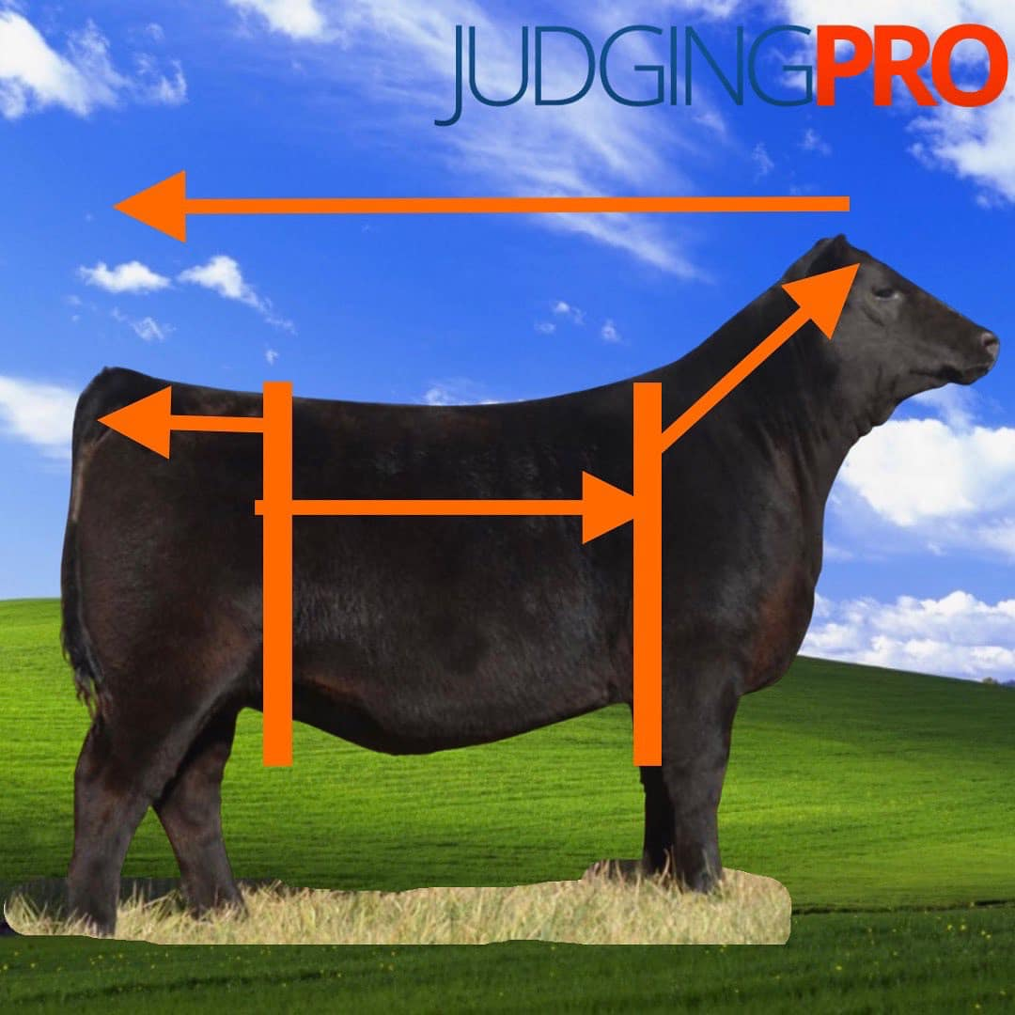
Extended
We see this one as a measure of length from nose to tail. Not only is that animal long bodied, but they have length of hip and are extended from their blade forward to complete the picture. It can also be used to describe just length of spine or body. Certainly, there are advantages to skeletal extension, but just make sure that added extension doesn’t have a negative effect on balance, or strength down their top.

Slide 27
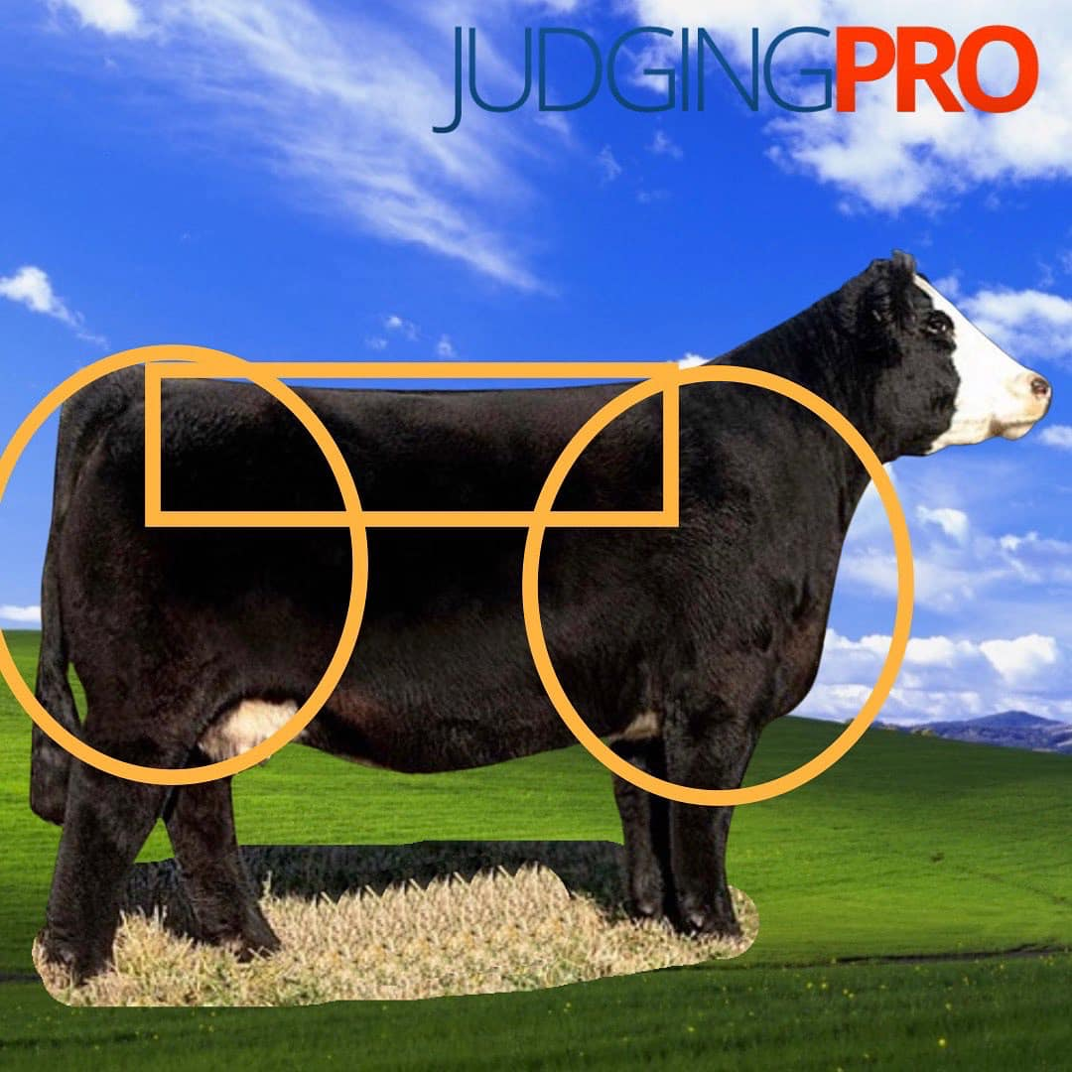
power
Power is used to describe so many things in today’s livestock. We tend to think it goes with mass, width and muscle or product. Livestock with “Power” tend to be wider hipped, open at the top side of their skeleton, and bolder at their blade. Coincidently, this usually goes along with a bigger, bolder rib cage. In terms of muscle, we tend to think of animals that are stout. They can have dense, wide, bulk of muscle- or they can have shape, expression, and be three dimensional in their muscle pattern. Sometimes they combine both types of muscle. Lastly animals that we think of as having “power” also tend to be uniform and close to ideal in the body condition and fat cover. That helps paint the picture that they are wide, stout, and “powerful” from end to end.

Slide 28
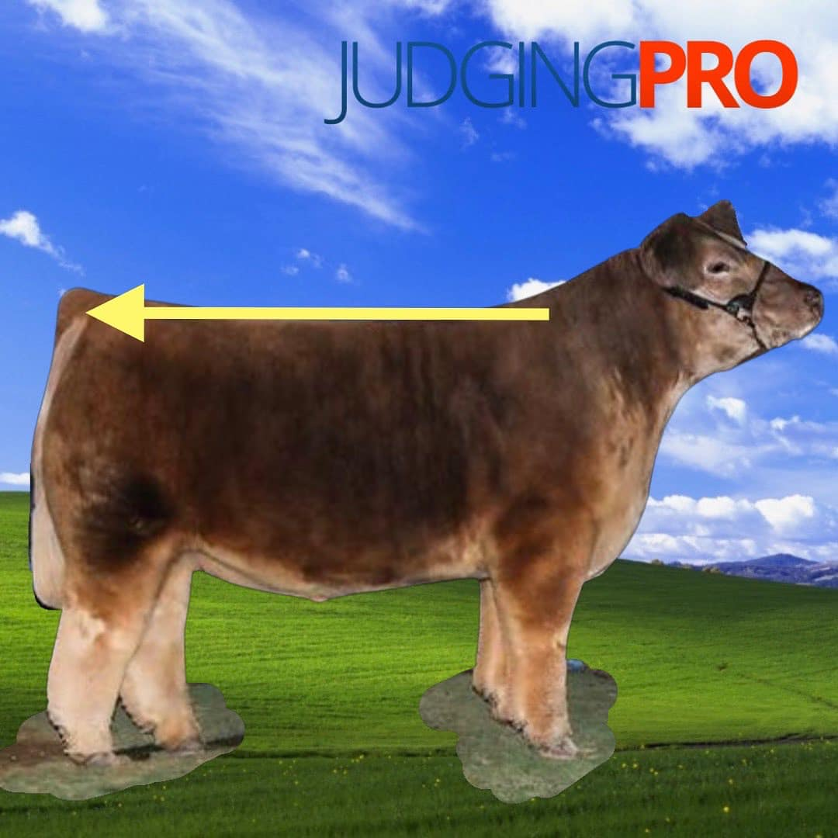
Level designed
We think of level designed as another way to describe animals that are good in their spine or top line. From the top of their shoulder (at the base of their neck) to pin set (back side of the hip structure). These animals are usually level in their top and level in their hip, not only at the profile, but they stay strong and uniform in how they handle their spine when set in motion. We think level animals tend to have a better look from the profile and seem to balance up better.

Slide 29
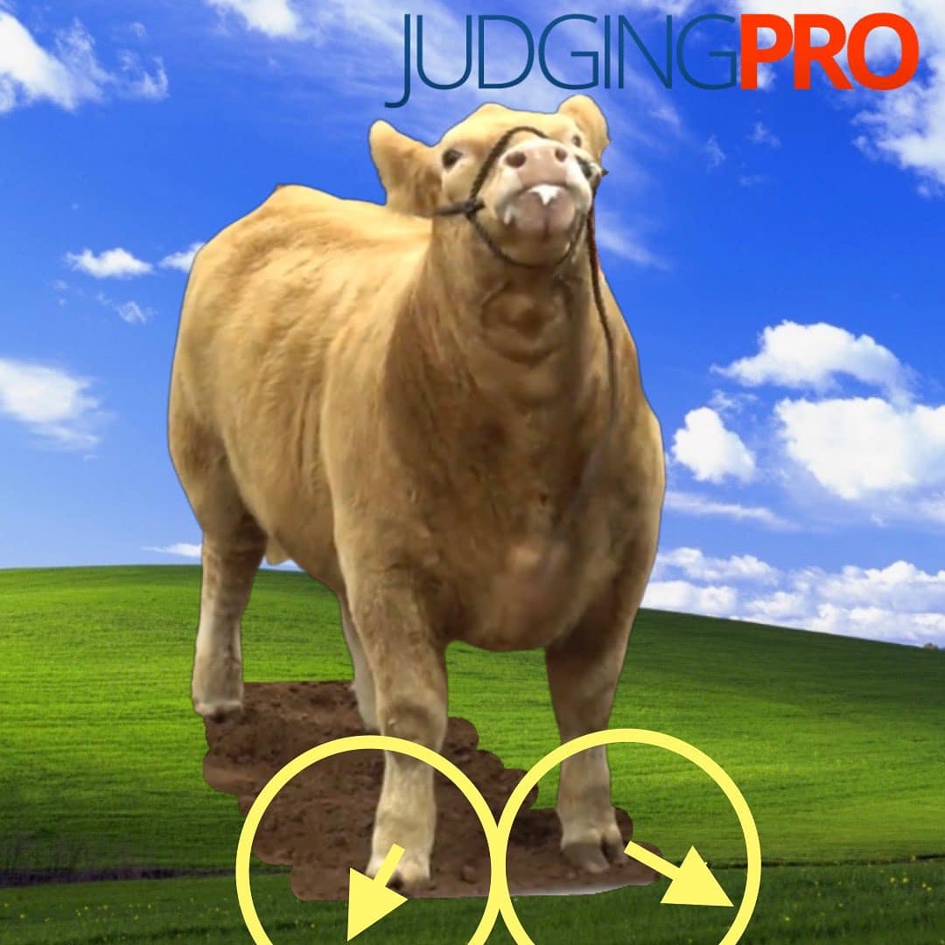
Toed out
We will start with a little truth- every livestock animal “toes out” to a certain degree. We would use this one to describe animals that have an excessive degree of turn from the knee to the direction their toes point. A little is ok- and certainly better than an animal who “toes in”. We hear this used a lot-and sometimes described as “splay footed”, we think “toes out” is a better way to describe the front feet of those animals you may find.

Slide 30
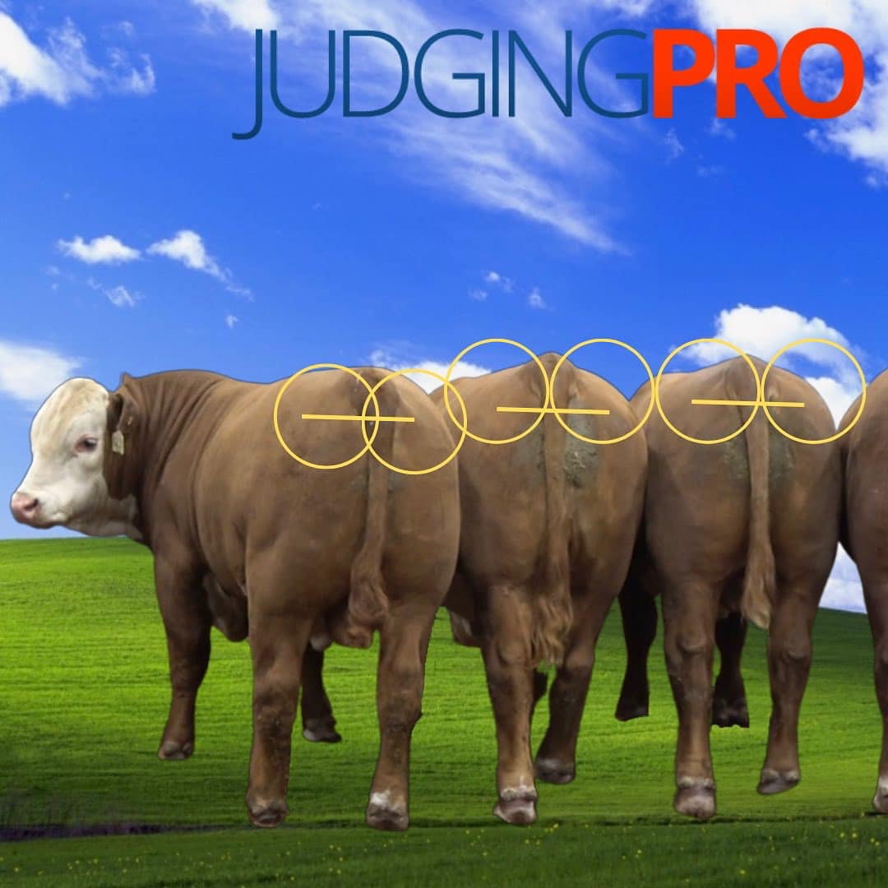
Pins
The pins are the most posterior part of the pelvic structure, and you find them on either side of the tail or dock. We talk about animals being “wider pinned” or “level from hooks to pins”. We think that animals who are “wide” pinned indicate that they have a little extra skeletal width.

Slide 31
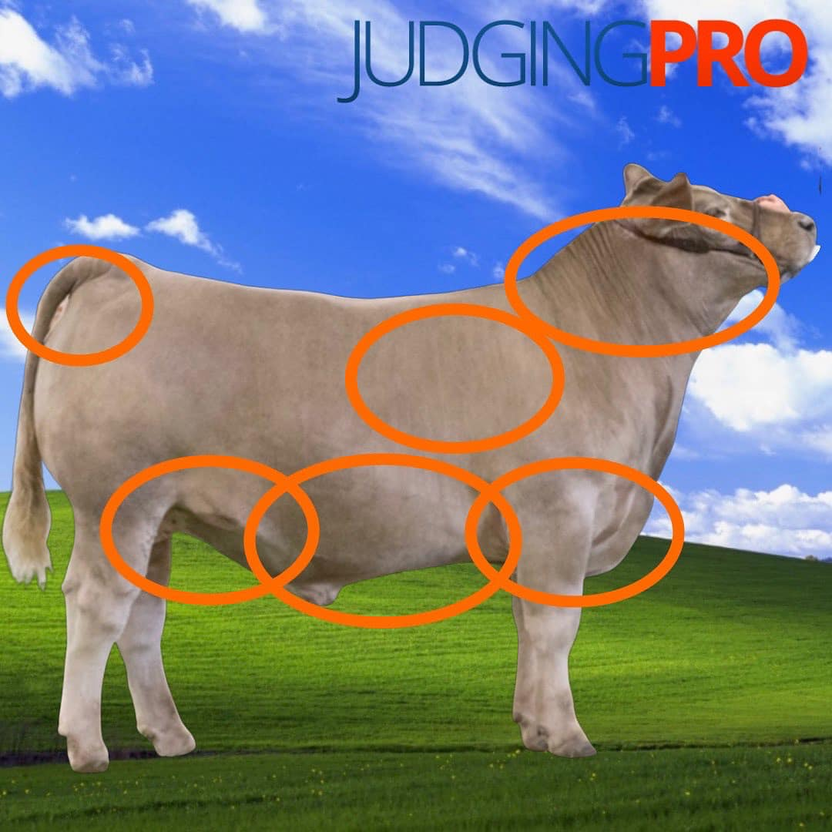
Cover
Cover is just another term for “finish” or the amount of fat “cover” an animal has deposited over their skeletal framework. Animals tend to deposit fat from front to back- and top to bottom. While each species has an optimum degree of cover, we certainly can have situations where they don’t have enough- or, have too much. If you know where to look, you can make a determination about that animal's degree of cover. The neck, upper rib, chest, middle (belly, flank), loin edge, and pins are usually where fat is easiest to find- and easiest to read on the body.

Slide 32
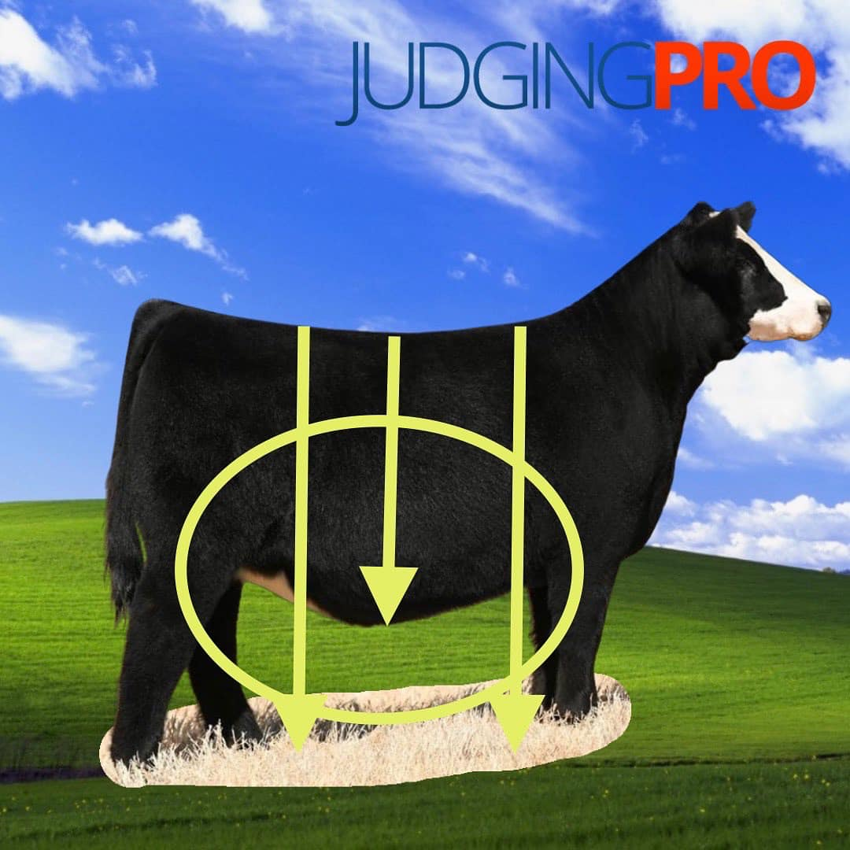
Deep
We like them deep bodied- but do we really know why? Depth of body is and indicator of rib, internal capacity, and fill. An animal’s ability to be “deep” can also indicate finish or cover or give them an “easy feeding” look. We think that the appropriate amount of depth or “fill” also helps complete the picture and helps an animal’s balance. “Deep” is like everything else- it needs to fit and be proportionate to the build, frame and design of the animal

Slide 33
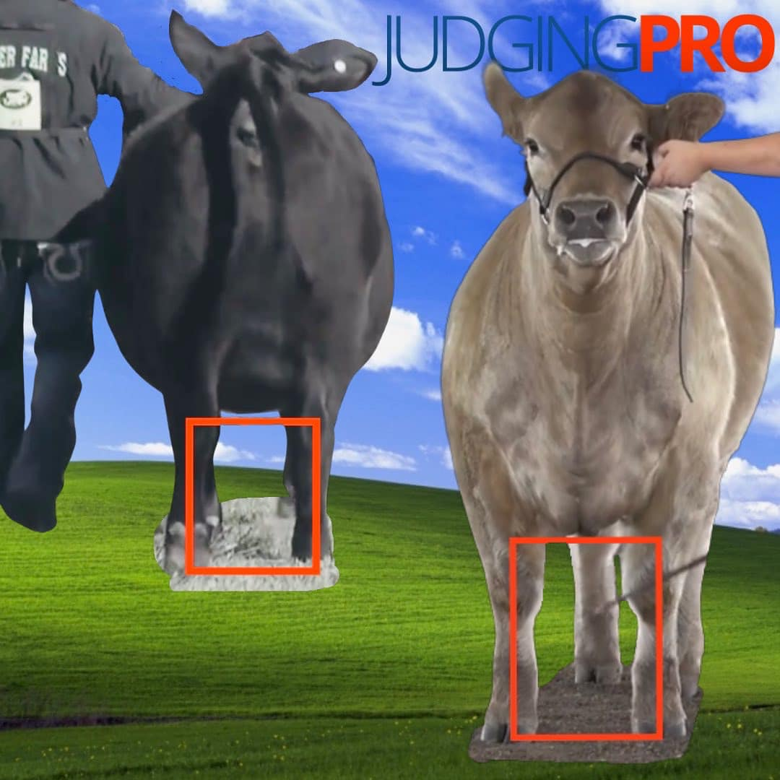
Square
What we really mean is an animal is in line within their skeleton. You can see it when they are set in motion or parked. The chest, knee, and toe all line up and point the same direction. The same way their hip, hock and heel do. That means that animal is usually also truer tracking and comfortably inside their skeletal plain

Slide 34
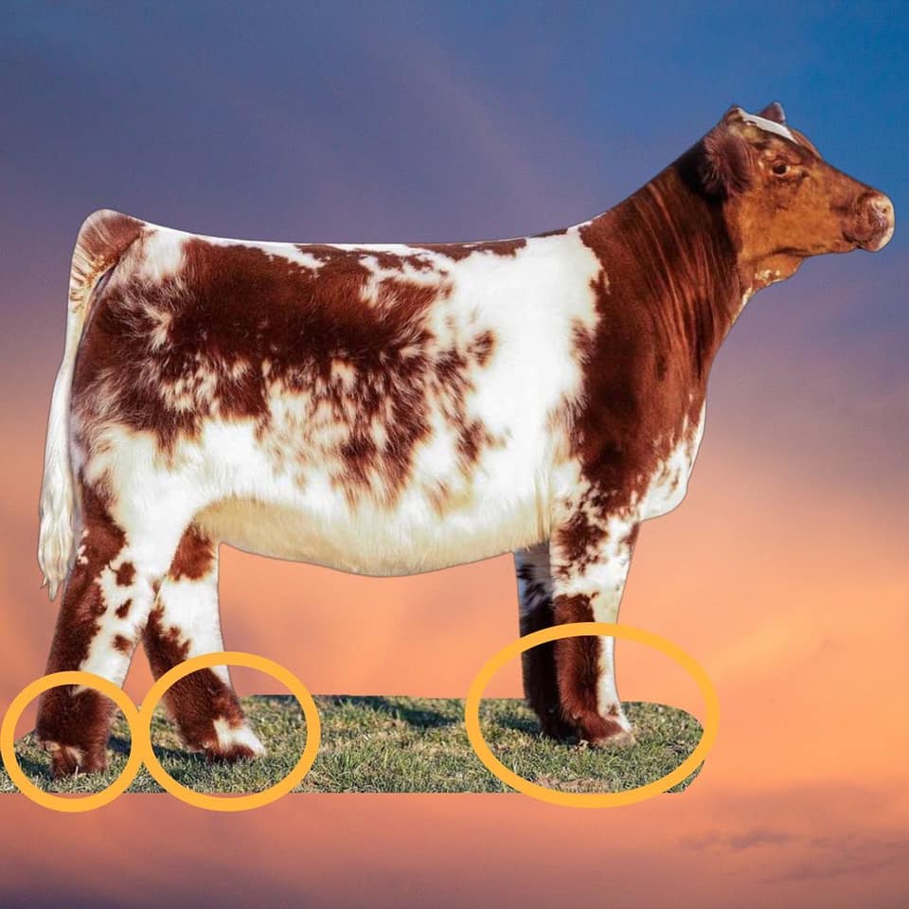
Pasterns
The pastern is the lowest joint on the leg, and has a BIG impact on that animals skeletal build. Pasterns should be strong, but should still have enough flex so that they provide cushion when that animal is on the move. When the pastern is too “soft” (weak), those animals (especially hogs) can actually start to touch their dewclaws to the ground, and over time this can cause soundness problems- this typically happens on the front legs. On the other side of the coin, animals can get to stiff and begin to actually “pop” or “knuckle over” their pasterns (especially cattle) on the move- which can also be problematic- this typically happens on the rear leg. The pastern joint should be strong but pliable to allow for a smooth stride no matter what the surface they are moving over.

Slide 35
Strong topped
“Strong Topped” can also be used as level topped, or “jet level”. What we mean is that an animal is level from their blade (at the base of their neck), down their spine, to their hip, and eventually out to their tail. In this case it isn’t just an aesthetic- you don’t want animals that get “high topped” or “up in their top” or that “roach up”. You also don’t want livestock to get “low” or “weak” in their top line- as that is usually a symptom of problems with skeletal build, and sometimes could effect an animals functionality. A good, strong, level top is a great way to build a solid foundation for all that mass and outward rib shape we like

Slide 36
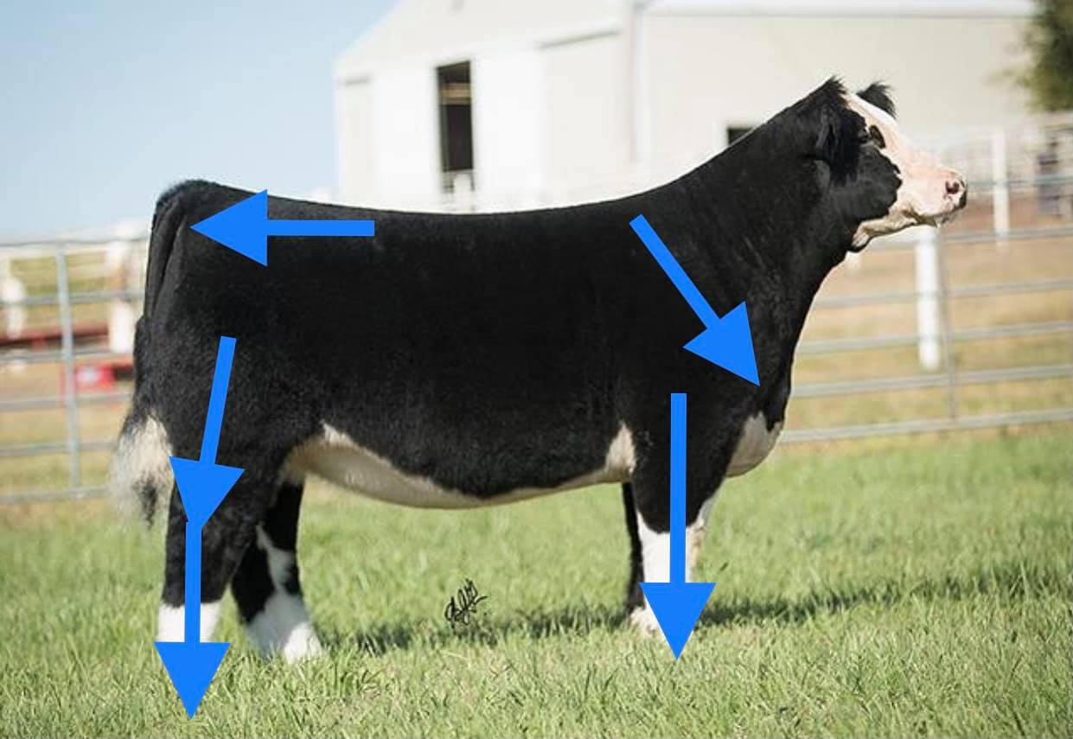
Fundamentally sound
We talk a lot about building animals with a sound foundational base. Here’s what we mean. Animals should have flex and reach out of their joint and the natural athletic pivot points in their skeletal framework. They should be able to push their hock back and flex it to gather that stride back up. They should have enough flex and comfort off of the front end to reach forward and start a big stride. These are things to look for from the profile when an animal is in motion. You can’t necessarily see how square an animal is in their hock or how true from their knee to the ground from the side, those are better viewed coming at and going away from you. Just make sure they plant and push of a sound base with plenty of flex and comfort. It’s always a good place to start.

Slide 37
Two Creek Steers
Notes:
3,5,6,1,4,2

Slide 38
1

Slide 39
2

Slide 40
3

Slide 41
4

Slide 42
5

Slide 43
6

