Slide 1
Managing your time as graduate student
ABBIE Richards
Associate Professor in Chemical And Biological Engineering

Slide 2
What takes up your time in grad school
Setting goals
Managing your time

Slide 3
Flexibility

Slide 4
Differences in the Graduate School Experience
Flexibility in your schedule
  Fewer classes
  Longer deadlines
  In-depth assignments
New responsibilities – teaching/TA

Slide 5
How will you spend your time?
6-9 hrs
Time spent in class
Studying or group work
Research
TA Responsibilities
Sleeping
Eating
15 hrs
20+ hrs
20 hrs
56 hrs
15 hrs

Slide 6
What else takes up time??
Commuting to school
Exercising
Friends/Family
Personal growth
Another 2-3 hours per day?

Slide 7
How many hours are in one week??
168

Slide 8
What are you left with?
Not a whole lot ☹

Slide 9
How to effectively use your time
Determine what is important to you
Set goals that align with your values
Fill your time with activities that bring you closer to your goals

Slide 10
Goals
Long-term goals
  What do you want to have accomplished by the end of your life?
  What do you want to have accomplished 20-30 yrs from now?
Mid-term goals
  What do I hope to do achieve over the next 2-5 years?
  What do I want to accomplish this year?
Short-term goals
  What to I want to accomplish this semester/month
  What do I hope to achieve today?

Slide 11
What are your goals?
Think about one long-term, one mid-range and one short-term goal

Slide 12
SMART Goals
Specific: Be blunt! Spell out exactly what you want to achieve.
Measurable: Have a means of measuring whether your goal has been meet.
Action Oriented: Describe your goals using action verbs and, at the very least, mentally outline the actual steps that you will take to accomplish your goal.
Realistic: Make sure that your day to day goals are something that you actually can succeed at (particularly if it involves studying).
Time Bound: Give yourself a time limit.

Slide 13
Get Started!
Starting a project is often biggest barrier
Break up big projects into smaller tasks

Slide 14
Finally…
Be flexible but also honest with yourself…
If you didn’t achieve your goal because you lost your focus, admit as much, take a short break, and begin again.

Slide 15
The “Big” Picture
Creating your PhD/Masters committee
Develop a program of study
Holding regular committee meetings
Settling on a graduate mentor/research topic
Conducting Research
Reading publications
Lab work
Tracking results
Start writing!
Receiving a Graduate Degree
The Thesis/Dissertation defense
writing, writing, writing
Communication of research
  Conferences/seminars
  Abstract submission deadlines
  Publications
Semester Coursework/TA responsibilities
  Assignments
  Grading, office hours, labs
Qualifying exams/ Comprehensive Exams
Even more research
More research..

Slide 16
Steven Covey’s Seven Habits of Highly Effective People
First 3 habits…
Habit 1: Be Proactive
  Take initiative and responsibility for actions
Habit 2: Begin with the End in Mind
  Use your goals drive daily activities
Habit 3: Put First Things First
  Manage daily activities to align with goals

Slide 17
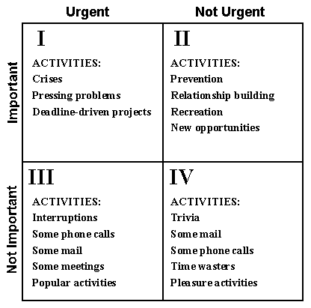
Time Management Matrix
Taken from Steven Covey’s text 7 Habits of Highly Effective People

Slide 18
Important vs. Urgent Activities
Important activities will directly impact your goals
Urgent activities demand immediate attention
Some Urgent Activities are Not Important

Slide 19
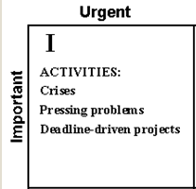
Time Management Matrix
Two types
  Urgent/Important matters you cannot control
  Urgent/Important matters that you can control
Come up with personal strategies to keep important matters from becoming urgent
Taken from Steven Covey’s text 7 Habits of Highly Effective People

Slide 20
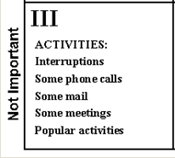
Urgent and Not Important
Time sensitive distractions
  Can come from friends and family
  Don’t be afraid to say no!
  Hide!
Taken from Steven Covey’s text 7 Habits of Highly Effective People

Slide 21
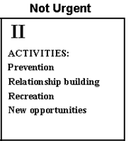
Not Urgent but Important
Activities that further your goals
  Things you can plan for
  Not time sensitive… Yet
Spend your time here!

Slide 22
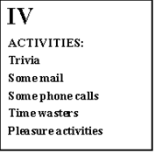
Not Urgent and Not Important
Distractions to avoid completely
  Web browsing
  Randomly watching TV
  Facebook, Twitter, Google Chat
Avoid spending time here

Slide 23
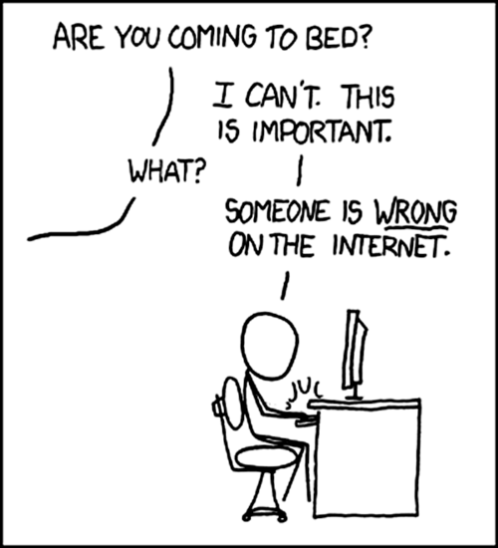

Slide 24
Time Management Matrix
Taken from Steven Covey’s text 7 Habits of Highly Effective People

Slide 25
Staying Organized
Keep a to-do list
Schedule time for things that do not have immediate deadlines
  Reading papers
  Writing
Try to have blocks of time for research/teaching
Set aside time for personal/physical/emotional health
Evaluate your ability to stick to the schedule

Slide 26
Work expands so as to fill the time available for its completion
-Parkinson’s Law, Cyril Parkinson

Slide 27
Prevent Parkinson’s Law from Coming True
Set clear, concise goals regarding work to be done
Define a reasonable and fixed amount of time to complete these tasks
Attack the task with intensity and stick to your time limit

Slide 28
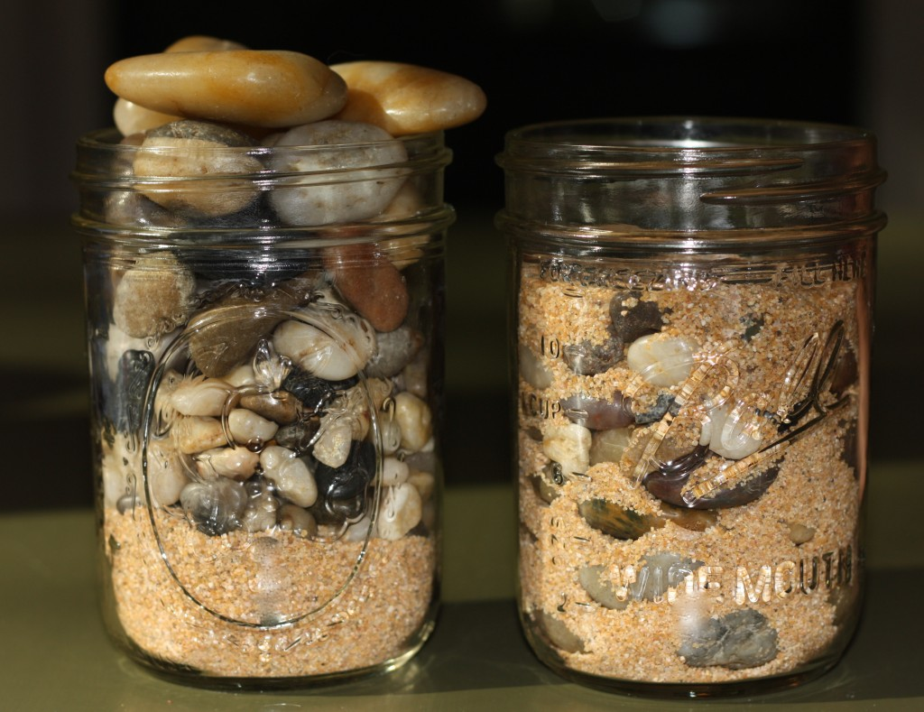
Put First things First – Big Rocks

Slide 29

Big Rocks
Dr. Stephen R. Covey, First Things First One day this expert was speaking to a group of business students and, to drive home a point, used an illustration I’m sure those students will never forget. After I share it with you, you’ll never forget it either. As this man stood in front of the group of high-powered over-achievers he said, "Okay, time for a quiz." Then he pulled out a one-gallon, wide-mouthed mason jar and set it on a table in front of him. Then he produced about a dozen fist-sized rocks and carefully placed them, one at a time, into the jar. When the jar was filled to the top and no more rocks would fit inside, he asked, "Is this jar full?" Everyone in the class said, "Yes." Then he said, "Really?" He reached under the table and pulled out a bucket of gravel. Then he dumped some gravel in and shook the jar causing pieces of gravel to work themselves down into the spaces between the big rocks. Then he smiled and asked the group once more, "Is the jar full?" By this time the class was onto him. "Probably not," one of them answered. "Good!" he replied. And he reached under the table and brought out a bucket of sand. He started dumping the sand in and it went into all the spaces left between the rocks and the gravel. Once more he asked the question, "Is this jar full?" "No!" the class shouted. Once again he said, "Good!" Then he grabbed a pitcher of water and began to pour it in until the jar was filled to the brim. Then he looked up at the class and asked, "What is the point of this illustration?" One eager beaver raised his hand and said, "The point is, no matter how full your schedule is, if you try really hard, you can always fit some more things into it!" "No," the speaker replied, "that’s not the point. The truth this illustration teaches us is: If you don’t put the big rocks in first, you’ll never get them in at all." What are the big rocks in your life? A project that you want to accomplish? Time with your loved ones? Your faith, your education, your finances? A cause? Teaching or mentoring others? Remember to put these Big Rocks in first or you’ll never get them in at all.

